Slide 1
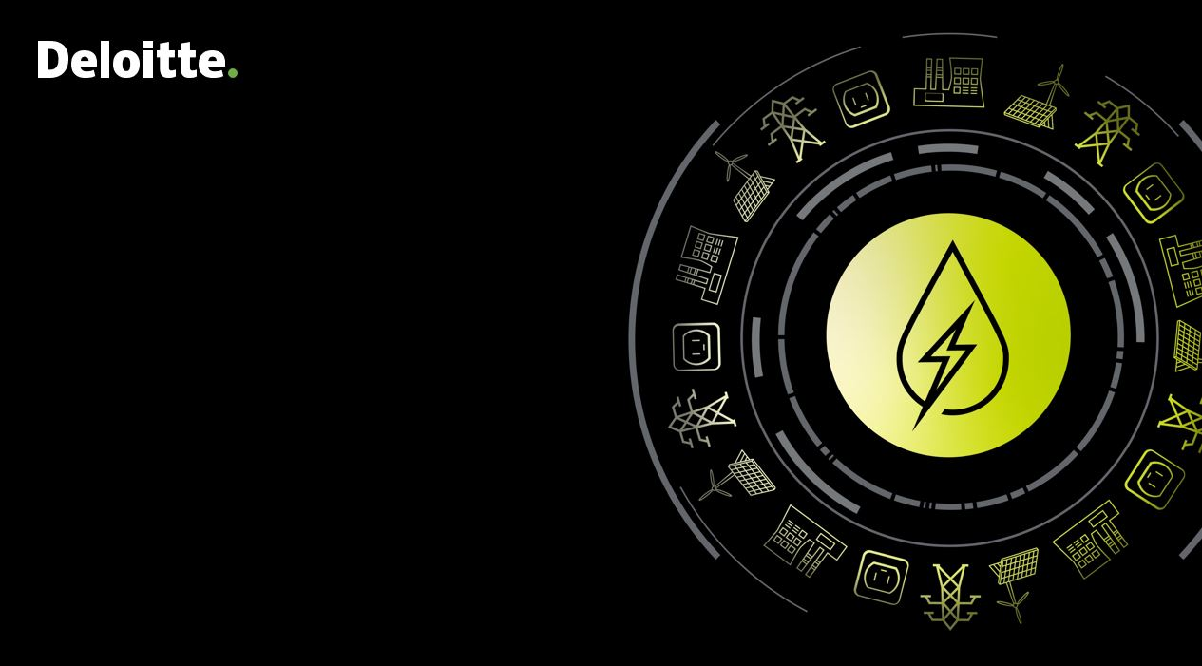
As-Is Analysis Report -Review of impact of past completed (2015–2019) on-going and proposed State and Central schemes running in West Bengal
Strategic planning and transformation of the West Bengal Power Sector
Department of Power, Government of West Bengal
Deloitte Touche Tohmatsu India LLP, June 2022
Notes:
To be picked from https://consulting.deloitteresources.com/brand/Pages/Imagery.aspx
https://brandspace.deloitte.com/content/index/guid/image_library?search_term=&list_size=25&assettag%5B16%5D%5B%5D=43&assettag%5B19%5D%5B%5D=50

Slide 2
Contents
1
Introduction
2
Review of Programs /Schemes Completed, Ongoing and Proposed under Central and State level Schemes
3
Distribution Sector Performance Improvement Projects
4
Power Generation Projects implemented by WBPDCL including Upcoming Projects
5
Long Term PPA from CGS and IPPs within and outside West Bengal- Option to Surrender Excess PPA
6
Conversion of Agriculture Water Pumps to Solar Energy based Pumps- Existing Schemes & Way Forward
7
Identification of Policy and Regulatory Interventions to accelerate Grid Connected and off grid RE Projects
8
Proposed Scheme
9
Way Forward

Slide 3
Introduction
1

Slide 4
Summary: Ongoing Schemes/ Funded Projects for WBSEDCL- Capex Flow As on 2021-22
Sl. No | Name of the Project | Central Share | Released | State Share | Released | Total Sanctioned | Total Released | Remarks
1 | DDUGJY | 2565.74 | 2007.07 | 1067 | 1045 | 3632.74 | 3052.07 | 671.61-Utility share
2 | IPDS | 1755.01 | 1543 | 731 | 643.5 | 2486.01 | 2186.5 | 438.75-utility share
3 | SAUBHAGYA | 155.43 | 136.5 | 64.77 | 64.77 | 220.2 | 201.27
4 | TURGA PSP | 0 | 0 | 1921 | 165.41 | 1921 | 165.41
5 | HVDS II | 0 | 0 | 2200.91 | 1141.45 | 2200.91 | 1141.45
6 | HVDS I | 0 | 0 | 308 | 205.11 | 308 | 205.11
7 | UG Cabling | 0 | 0 | 290 | 160 | 290 | 160
8 | RIDF | 0 | 0 | 1081 | 912 | 1081 | 912
9 | SEEDN I | 0 | 0 | 319 | 319 | 319 | 319
10 | SSEDN II | 0 | 0 | 400 | 400 | 400 | 400
11 | SEEDN III | 0 | 0 | 300 | 132.5 | 300 | 132.5
12 | RE X PLAN | 431.62 | 399.16 | 43.57 | 43.57 | 475.19 | 442.73
13 | RE XI PLAN | 2037.52 | 1788.83 | 199.96 | 199.96 | 2237.48 | 1988.79
14 | RE XI-Ph-II | 179.09 | 123.94 | 0 | 0 | 179.09 | 123.94
15 | RE XII PLAN | 546.85 | 511.96 | 132.03 | 132.03 | 678.88 | 643.99
16 | BRGF | 2511 | 2511 | 0 | 0 | 2511 | 2511
17 | WBEGMP | 0 | 0 | 44.5 |  | 44.5 | 0
18 | 125 MW Solar Park | 0 | 0 | 14.16 |  | 14.16 | 0
 | TOTAL | 10182.26 | 9021.46 | 9058.24 | 5564.3 | 19299.16 | 14585.76
WBSEDCL has been receiving financial support continuous basis for capital projects for Distribution infrastructure strengthening named as SEEDN, UG cabling, HVDS project etc. and electrification of agriculture pump-sets, up to FY 2021-22 which helps to WBSEDCL to avoid a loan burden and reducing its impact on tariff on the consumers.
Centre: Rs 9021.46 Cr out of Rs. 10182.26 Cr (~88.5%) released
State: Rs. 5564.3 Cr. 9058.24 Cr. released (~61.4%)
Considerable amount of funds pending to be released from state in comparison to Centre’s share
Source : WBSEDCL RDSS Proposal, June 2022

Slide 5
Review of Programs /Schemes Completed, Ongoing and Proposed under Central and State level Schemes
2
Topics Covered
Power Distribution related Schemes
RGGVY & DDUGJY
RAPDRP & IPDS
NEF (Interest Subsidy) Scheme
REAPS
RDSS
Power Generation & Transmission related Scheme
F. - PSDF

Slide 6

Progress Status of Rajiv Gandhi Gramin Vidyutikaran Yogona ( RGGVY) & Deen Dayal Upadhyaya Gram Jyoti Yojana (DDUGJY) & 'SAUBHAGYA' Scheme
2-A
Topics Covered
Salient Feature of Project
Financial Progress of Project
Physical Progress of Project

Slide 7
Salient Feature of Rural Electrification (RE) Scheme under RGGVY
Background
Rajiv Gandhi Gramin Vidyutikaran Yogona (RGGVY) is central scheme for rural electrification and providing service connection to BPL consumers.
RGGVY (X Plan) covered following areas : North & South 24 Parganas, Birbhum, Burdwan, Uttar & Dakshin Dinajpur, Malda, Murshidabad, Darjeeling (Siliguri Mahakuma Parishad), Purba & Paschim Medinipur, Bankura and Purulia districts.
RGGVY (XI Plan) covered following areas : South 24 Parganas, Birbhum, Burdwan, Uttar & Dakshin Dinajpur, Malda, Murshidabad, Darjeeling, Howrah, Hooghly, Coochbehar, Nadia, Paschim Medinipur and Purulia districts.
RGGVY (XI Plan) (Ph-II) covered 188 villages for electrification and providing new service connection exclusively in Darjeeling Hilly Area.
RGGVY (XII Plan) covered 7 (seven) non-backward districts viz. (i) Coochbehar, (ii) Darjeeling (SMP), (iii) Nadia, (iv) Bardhaman, (v) Howrah, (vi) Hooghly & (vii) North 24 Parganas.
Physical Progress as on 31.10.2021
Particulars | Units | Sanction Quantity | Awarded Quantity | Surveyed Quantity | Achievement | Bal w.r.t Surveyed
Substation 33/11 KV (New) | Nos | 23 | 23 | 22 | 22 | 0
Aug. of Substation 33/11 KV | Nos | 14 | 14 | 17 | 17 | 0
Distribution Transformer | CKm | 42444 | 40548 | 37593 | 37593 | 0
LT Line | CKm | 59891 | 57298 | 59879 | 59879 | 0
11 KV Line | CKm | 23339 | 20016 | 18376 | 18376 | 0
33 & 66 KV Line | CKm | 372 | 286 | 346 | 346 | 0
Source : Internal (Department of Power)

Slide 8
Financial Progress of the Rural Electrification(RE) Scheme under RGGVY
RE Scheme’s wise Sanctioned and Released of GOI Grant (Rs. Crore)
Likely Implementation Challenges
High cost of grid extension and low recovery due to highly subsidized tariff, low level of tariff collection resulting in negative return
Tender awards, Vendor delays, ROW issue
Status of Grant Release as on 31.10.2021
Plan | No. of Projects Sanctioned (Nos) | No. of Projects closed (Nos) | Sanctioned Project Cost (Rs. Cr) | Sanctioned Gol Grant (Rs. Cr) | Gol Grant released (Rs. Cr) | % GOI Grant Released
X | 13 | 13 | 479.8 | 431.82 | 399.16 | 92%
XI | 15 | 15 | 2263.9 | 2037.52 | 1788.53 | 88%
XI-Ph-II | 1 | 1 | 198.99 | 179.09 | 123.94 | 69%
XII | 7 | 7 | 607.62 | 546.85 | 511.96 | 94%
Total | 36 | 36 | 3550.31 | 3195.28 | 2823.59 | 88%
Source : Internal (Department of Power)

Slide 9
Salient Feature of DDUGJY
Background
Govt. of India, vide Office Memorandum F.No.44/44/2014-RE dated 3rd December 2014 issued by the
Ministry of Power, launched Deendayal Upadhyaya Gram Jyoti Yojana (DDUGJY) with the following
components :-
Separation of agriculture and non-agriculture feeders for supply to agricultural & non-agricultural consumers in the rural areas for effective demand side management.
Strengthening and augmentation of sub-transmission & distribution (ST&D) infrastructure in rural areas, including metering at distribution transformers, feeders and consumer end.
Rural electrification, as per CCEA approval dated 01.08.2013 for completion of the targets laid down under RGGVY for 12th and 13th five-year plans.
Funding Pattern of Scheme
1
Nodal Agency : Rural Electrification Corporation Limited is the Nodal Agency for implementation of the scheme under the guidance of MoP.
GOWB (Grant)
2
Project Management Agency (PMA) : REC Power Distribution Company Ltd and PFC Consulting Ltd have been appointed as Project Management Agency for monitoring he implementation of the project.
GOI (Grant)
WBSEDCL
(Loan/Equity)
3
Mode of Implementation : Project is implemented on the turn-key basis.
Source : WBSEDCL Website

Slide 10
Financial Progress Status of DDUGJY : New Project
Status of progress of expenditure against funds released
Sanction vs Release- As on 30.04.2022
 | Sanctioned value (Rs. in crore) | Fund Received up to 30.04.2022 (Rs. in crore) | Fund utilised up to 30.04.2022 (Rs. in crore)
GOI | 2,565.74 | 2,393.44 | 2,240.29
GoWB | 1,067.15 | 1,054.63 | 1054.63
Loan from REC (15%) | 671.61 | 618.64 | 615.40
Total | 4,304.50 | 4,066.71 | 3910.32
93.2% amount released
Source : Internal (Department of Power)
The work considered for Darjeeling district had been undertaken under Departmental mode as the tenders invited for turnkey execution was not matured for the district
The turnkey contract for the execution of work under Bankura, Purulia and Howrah districts were terminated due to non-performance of the turnkey agency; fresh tenders were invited, and the work has been re-awarded
GOWB ( Grant)
GOA ( Grant)
Source : WBSEDCL RDSS Proposal, June 2022

Slide 11
Physical Progress Status of DDUGJY : New Project
Physical Progress Summary as on 08.12.2021
Physical Progress as on 31.12.2021
Sl. No. | Milestone Name | Unit | Final executed quantity
1 | 33/11 KV New Substations | Nos. | 80
2 | Augmentation of 33/11 KV Substations | Nos. | 146
3 | New Distribution Transformers (DTR s) | Nos. | 19,311
4 | Feeder Segregation (Excluding 11 KV Line) | Nos. | 485
 |  | Ckm | 9424.19
5 | LT Line | Ckm | 4291.77
6 | 11 KV Line (Excluding Feeder Segregation Lines) | Ckm | 3052.79
7 | 33 KV Line | Ckm | 1534.63
8 | Energy Meter - Consumer | Nos. | 25,88,801
9 | Energy Meter - DTR | Nos. | 28,866
10 | Energy Meter - 11 KV Feeder | Nos. | 512
11 | Renovation of LT OH bare conductor line by LT AB Cable | Ckm | 36,119
12 | SAGY Villages | Nos. | 1
13 | Connection to BPL Households | Nos. | 7,363
Total sanctioned projects under DDUGJY Scheme is 56 Nos (Out of Total 56 Projects – 36 Nos projects are under rural electrification, 19 Nos of projects under new projects and 1 projects for Saubhagya.
Out of total 56 Nos of projects, 37 projects has been completed and 19 projects under new projects category is work under progress.
GOWB ( Grant)
GOA ( Grant)
Source : 1) Internal (Department of Power) 2) WBSEDCL RDSS Proposal, June 2022

Slide 12
Last Mile Connectivity under 'SAUBHAGYA' Scheme
Details
Mantri Sahaj Bijli Har Ghar Yojona: GoI has launched Saubhagya focusing on last mile connectivity and electricity connections to all un-electrified households.
The Saubhagya project has been implemented through listed contractors of WBSEDCL
Households electrified from 11.10.2017 upto 31.03.019 is 7.32 Lakhs
The State reported 100% electrification of all households as on 31.03.2019
Financial Status as on 31.10.2021 (Rs. Crore)
Year wise GOI released Grants since 2017-18 (Rs. Crore)
88% Grant released
GOWB ( Grant)
GOA ( Grant)
Source : Internal (Department of Power)

Slide 13
Progress Status of Integrated Power Development Scheme (IPDS)
2B
Topics Covered
Salient Feature of IPDS
Financial Progress of IPDS
Physical Progress of IPDS

Slide 14
R-APDRP Component of IPDS
Financial Status as on 31.10.2021 (Rs. Crore)
Physical Progress as on 31.10.2021
PART –A (IT) |  |  | PART –A (SCADA)
No. of Towns | Town declared Go-live | Project Cost (in Rs. Cr) | No. of sanctioned Towns | SCADA system completed | Project Cost (in Rs. Cr)
61 | 61 | 162.03 | 3 | 3 | 18.78
100 % Completed
No of Circle : 19
**Note: Due to cancellation of projects under R-APDRP, the additional GOI loan released (Rs 13.55 Cr) is being recovered from the utility.
Source : 1) Internal (Department of Power) 2) WBSEDCL Annual reports

Slide 15
Salient Feature of IPDS
Background
MoP had launched Integrated Power Development Scheme (IPDS) for strengthening of Distribution Infrastructure for the Urban areas having population of more than 5,0000 as per census 2011 with the following components:
Strengthening of sub-transmission & distribution networks including provisioning of Solar Panels and Net-metering.
Metering of distribution transformers / feeders / consumers.
IT enablement of distribution sector and strengthening of distribution network
Funding Pattern of Scheme
1
Nodal Agency : Power Finance Corporation is the Nodal Agency for implementation of the scheme under the overall guidance of MoP.
2
Project Management Agency (PMA) : RECPDCL and PFCCL have been appointed for monitoring the IPDS Project.
GOWB ( Grant)
WBSEDCL
( Loan/Equity)
3
Mode of Implementation : The project may be executed on the basis of turn-key/ partial turn-key/ departmental basis, through e-tendering.
GOI ( Grant)
Source : WBSEDCL Website

Slide 16
Progress Status of IPDS
Physical Progress :
Milestone Name |  | Unit | Awarded Quantity | Completion | % Physical progress achieved
Substations | New Substation | No. | 50 | 50 | 100%
 | Capacity enhancement & Additional Transformers | No. | 167 | 167 | 100%
Over-headlines | HT New (33 & 11KV) | Km | 1153 | 1153 | 100%
 | HT Aug ( 33& 11 KV) | Km | 1730 | 1730 | 100%
 | LT Line (New & Aug) | Km | 128 | 128 | 100%
Cables | Aerial Bunch / Under Ground | Km | 16566 | 16566 | 100%
Distribution Transformers |  | No. | 4354 | 4354 | 100%
Consumer-System |  | No. | 733420 | 733420 | 100%
Solar Panels |  | KWp | 4160 | 4160 | 100%
Achievements:
24x7 power supplies for consumers has been ensured in all the municipal towns.
Reliability of Power supply in all the municipal towns have improved significantly over the years after IPDS.
SAIDI-SAIFI in all the municipal towns have been Improved to a great extent after implementation of IPDS project.
DTR Failure in all the municipal towns have been reduced significantly.
AT & C loss and T&D loss of WBSEDCL has reduced significantly after implementation of IPDS Project.
Sanctioned Amount (Rs. Crore)
Awarded Amount (Rs. Crore)
Financial Status as on 31.10.2021 (Rs. Crore)
Source : 1) WBSEDCL RDSS proposal 2) Internal (Department of Power)

Slide 17
Progress Status of National Electricity Fund Scheme (NEF)
2C
Topics Covered
Salient Feature of NEF
Financial Progress of NEF
Physical Progress of NEF

Slide 18
Salient Feature of NEF Scheme
Background
GoI had approved the NEF (Interest Subsidy) scheme to promote capital investment in the distribution sector by providing interest subsidy, linked with reform measures, on the loans taken by public and private power utilities for various capital works under Distribution projects.
This Scheme is applicable for the projects which are not considered under RGGVY and R-APDRP Scheme
Projects which are considered under NEF (Interest Subsidy) Scheme are :
Loss reduction measures – Metering, Strengthening of Energy Accounting and Audit, HVDS etc
System augmentation and strengthening of Network, Reconducting & Upgradation of Old Network
Enhancing Operational Efficiency – SCADA, IT Infrastructure and Distribution System Management
Customer relationship management/grievance redressal
1
Nodal Agency : Nodal agency shall be required to appraise the eligibility of the borrower based on its details sent by the lender
Source of Funding for Scheme
2
Lenders : Financial Institutions like REC, PFC and Banks shall send details of the borrowers to the nodal agency for ascertaining the eligibility under the scheme
3
Borrower : They are generally State Power Utilities, State Power Departments and Distribution Companies (DISCOMs) – both the Public and Private DISCOMs and franchises
GOWB ( Grant)
GOI ( Grant)
Source : NEF Website and WBSEDCL Annual Accounts

Slide 19
Flow Chart : : NEF (INTEREST SUBSIDY) SCHEME
SPUs, SPDs, DISCOMs and other private players including franchisees, hereafter called “Borrowers” in non-R-APDRP and non-RGGVY areas for distribution sector
Participants in States Other than Special category & focused States.
The participants in States Special category and focused States
Power Departments
Other than Power Dept.
All the above Borrowers will submit the proposals to Financial Institutions including PFC and REC and other Commercial Banks, hereafter called “Lenders”
Lenders will submit the respective proposals to REC hereafter called “Nodal Agency” for evaluation of eligibility under the scheme.
The respective lenders would do due diligence and appraisal of proposals
Nodal Agency will intimate the respective lenders about the eligibility of respective borrower under the scheme.
Sanction of Steering Committee after determination of baseline parameters i.e. AT&C losses, ARR, ACS.
Lenders would sanction the proposals.
Lenders would disburse the funds to Borrowers and are to ensure – Utilization of fund, Project monitoring & Evaluation
Respective lenders are required to submit the relevant documents (submitted by borrowers) to Nodal Agency after disbursement along with details showing the achievement of planned/predetermined targets (or from the date of rejection of the earlier claim of subsidy)
Whether
approved ?
Nodal agency will categories the borrower proposal to ascertain quantum of subsidy
If NOT
Nodal agency will Release the interest subsidy to the respective lender for releasing the same to the respective borrower or adjusting the same in the account
If YES
Source : http://nefgov.in/NEF_Guidelines

Slide 20
Progress Status of NEF Scheme
Physical Progress as on 31.03.2020 (In %)
Project Name | Project Cost | FY 2019-20 |  | FY 2018-19 |  | FY 2017-18 |  | FY 2016-17 |  | FY 2015-16
 | In Crore | Progress | Plan | Progress | Plan | Progress | Plan | Progress | Plan | Progress | Plan
Cabling and Upgradation of sub-transmission and distribution system in Bolpur and Nabadwip towns | 90.76 | 100% | - | 100% | - | 100% | - | 98% | 2% | 15% | 65%
Replacement of 33 & 11 KV OCB by VCB & Capacity augmentation of 33/11 KV sub-station under Midnapur, Kolkata and Burdwan Zones | 114.55 | 100% | - | 100% | - | 100% | - | 99% | 1% | 10% | 60%
Financial Progress as on 31.03.2020 (In Crore)
Project Name | Project Cost | FY 2019-20 |  | FY 2018-19 |  | FY 2017-18 |  | FY 2016-17 |  | FY 2015-16
 | In Crore | Progress | Plan | Progress | Plan | Progress | Plan | Progress | Plan | Progress | Plan
Cabling and Upgradation of sub-transmission and distribution system in Bolpur and Nabadwip towns | 90.76 | 75.12 |  | 68.71 | 4.74 | 68.56 | 6.5 | 61 | 20 | 9.13 | 42.87
Replacement of 33 & 11 KV OCB by VCB & Capacity augmentation of 33/11 KV sub-station under Midnapur, Kolkata and Burdwan Zones | 114.55 | 105.76 | 5 | 105.26 | 5.26 | 103.8 | 10.75 | 95 | 15 | 6.57 | 49.03
Total (In Crore) | 205.22 | 180.88 | 5 | 173.97 | 10 | 172.36 | 17.25 | 156 | 35 | 15.7 | 91.9
GOWB ( Grant)
GOA ( Grant)
Source : Respective Annual Accounts of WBSEDCL

Slide 21
Progress Status of Rapid Electrification of Agricultural Pump Sets (REAPS) Scheme
2D
Topics Covered
REAPS Phase I
REAPS Phase II
REAPS Phase III

Slide 22
REAPS Scheme – Phase I
Total estimated financial involvement of Rapid Electrification of Agricultural Pump Sets (REAPS) in West Bengal including consumers under OTA scheme of GoWB was Rs. 1141.51 Crore with the following funding arrangement
SL No. | Description | Total Cost (In Rs. Crores)
1 | Consumers' contribution | 21.72
2 | Assistance from GoWB | 407.33
3 | From Own fund/ Loan from Financial Institution | 712.46
4 | Total Estimated Project Cost for effecting STW connection | 1141.51
The project cost was revised to Rs. 1205.37 Crore in place of Rs. 1141.51 Crore as detailed below :-
Scheme Objectives:
S.No | Description of Work | Quantity | Total Cost in Rs Crore
1 | 11 kV solid T-off arrangement | 16923 Nos | 30.38
2 | Installation of Distribution Substations of Capacity 16/25/63 KVA | 16923 Nos | 292.41
3 | Drawal of LT Service line with 4 Core 10 sq. mm 1.1 kV grade PVC cable | 54311 Nos | 448.99
4 | Drawal of 11 kV O/H line on 8 mtr PCC pole with 50 sq. mm ACSR conductor | 12692.25 KM | 389.41
5 | Installation of 3 phase static whole current meter with LPR communication facilitate DTR end | 54311 Nos | 44.18
6 | Total Project Cost Sum 1:5 |  | 1205.37
7 | Consumers Contribution |  | 21.72
8 | Net Project Cost 8 = 6-7 |  | 1183.65
Installation of Distribution transformers of appropriate capacity close to irrigation pump sets considering HVDS to minimize distribution losses
Installation of energy meters at DTR end and drawal of LT service line with insulated cable to prevent accident as well as theft of electricity.
GPS survey of proposed infrastructure for electrification of agricultural pump sets of all intending farmers who have applied to WBSEDCL within 30.04.2015 including those under OTA scheme of Government of West Bengal
Source : https://wberc.gov.in/sites/default/files/OA249.pdf

Slide 23
REAPS Scheme – Phase II & III
REAPS Scheme Phase II
In order to effect electric connection of 30000 agricultural pump sets, WBSEDCL has formulated a scheme termed as 'Rapid Electrification of Agricultural Pump Sets (REAPS Phase 2) with the following salient features:
Drawal of 11 kV line from the nearby 11 kV rural feeder, especially from existing agricultural feeder to the cluster points.
Installation of 25 kVA, 11/0.4 kV Distribution Transformers (DTR) close but at optimum location to form a cluster of three numbers of Agricultural Pump sets.
Installation of energy meters at DTR end and drawal of LT service line with 4 core insulated cable to prevent accident as well as theft of electricity.
Benefits of the project are rapid disposal of Shallow Tube Well (STW) electric connection along with strengthening rural infrastructure and economy The scheme will also help in better utilization of network assets and 33/11 kV substations created or to be created under government sponsored schemes.
No | Description of Work | Quantity | Total Cost in Rs Crore
1 | Drawal of 1 1 kV line with T-Off arrangement | 10000 CKms | 468.44
2 | Installation of Distribution Substations-25 KVA Capacities | 10000 Nos | 232.56
3 | Drawal of LT service line with 4 core 10 sq. mm. 1.1 kV rade PVC cable | 9900 CKms | 274.71
4 | Total Project Cost Sum 1:3 |  | 975.71
5 | Projected Interest |  | 319.73
6 | Total Project Cost including Interest |  | 1295.45
Funded By |  |  | Total Cost in Rs Crore
1 | Contribution by Consumers |  | 12
2 | Alread received rant in aid from Government of West Bengal |  | 450
3 | Loan assistance from RECL |  | 513.71
Total |  |  | 975.71
REAPS Scheme Phase III
WBSEDCL has submitted for 6138 numbers of new electric connection rapidly to the intending farmers who have applied for supply of power of their pump sets,
WBSEDCL has formulated a scheme termed as Rapid Electrification of Agricultural Pump Sets (REAPS Phase 3) with an estimated project cost of Rs. 210 Crores.
Note: Phase I & II: Scheme has been completed with help of own fund over and above the Govt grant and consumer contribution as the loan fund was not available till then; For Phase III, as per WBSEDCL Annual report, Phase III was under implementation stage which was expected to be completed March 2022
Source : https://wberc.gov.in/sites/default/files/OA-322_19-20.pdf

Slide 24
Details of Revamped Distribution Sector Scheme (RDSS)
2E

Slide 25
Background of RDSS - Reforms-based and Results-linked Scheme
Background
RDSS Scheme has been approved by Central Government with objective to improve the quality, reliability and affordability of power supply to consumers through a financially sustainable and operationally efficient distribution sector.
Main aim of the Scheme :
Reduce the AT&C losses to pan-India levels of 12-15% by 2024-25
Reduce ACS-ARR gap to zero by 2024-25
Total Estimated outlay of Rs. 303758 crore over a period of five years from FY 2021-22 to FY 2024-25
Part A of Scheme
Part B of Scheme
Item Description | Quantity | GBS, % (Max)
Prepaid Smart metering solution including consumer, DT and Feeder level including integration of existing infrastructure | 25 Crore | 15% / 22.5% (Limited upto 900 or 1350 respectively per meter per consumer)
Other cost including encumbrance free standardized billing modules for all States, data management, data analytics, Support Implementation, AI etc | Lumpsum | 100 %
Segregation of Agriculture Feeders | 10,000 Nos
Replacement of existing LT overhead bare conductor with AB Cable/HVDA | 4,00,000 Kms
Distribution Automation in Urban Area
SCADA/DMS including OPEX for 2 years | 100 Nos (Big City) 3875 Nos (for Other)
Infrastructure including HVDS, IT, Transformer, Cables, Substations, feeders etc | As required
Item Description | Outlay (Rs. Crore) | GBS (%) (Max) | GBS (Rs. Crore)
Augmentation of Smart Grid Knowledge Center including Al | 30 | 100% | 20
Training /Capacity Buildings/ Awards and Incentives | 200 | 100% | 200
Reforms Support in form of Consultancy | 200 | 100% | -200
Nodal Agency Fee, MOP enabling activities and PMA Charges | 1000 | 100% | 1000
Sub Total | 1430 |  | 1030
Amount for reform support in form of consultancy may be taken State Government and utilized for Scheme
Source: https://powermin.gov.in/sites/default/files/uploads/Final_Revamped_Scheme_Guidelines.pdf

Slide 26
Revamped Distribution Sector Scheme – Objectives and Features
DISTINGUISHING FEATURES
Focus on Reforms
Funding linked to Results/Performance
Thrust on Smart Metering
Funds for works leading to loss reduction and improvement in quality and reliability
Measures and works customized to the specific needs of the state
OBJECTIVES and BENEFITS
The objectives of the scheme are to:
Improve the quality, reliability and affordability of power supply
Reduce the AT&C losses to pan-India levels of 12-15% by 2024-25.
Reduce ACS-ARR gap to zero by 2024-25.
State-wise targets will depend on their current levels of AT&C losses and ACS-ARR gap.
RDSS
BACKGROUND
The Scheme is earmarked to have a total outlay of INR 3,03,758 crore, with the government pledging a budgetary support of INR 97,631 crore
Existing power sector reforms schemes such as Integrated Power Development Scheme, Deen Dayal Upadhyaya Gram Jyoti Yojana, and Pradhan Mantri Sahaj Bijli Har Ghar Yojana will be merged into this umbrella program.
Nodal agencies for implementation are Rural Electrification Corporation (REC) and Power Finance Corporation (PFC).

Slide 27
Scope of RDSS - Action Plan Guidelines
Scope of the Scheme
The scheme is divided into two parts –
Part A: Metering and Distribution Infrastructure Works
Part B: Training, Capacity Building and Other Enabling & Support Areas
All State owned DISCOMs and State/UT Power Departments (excluding private sector power utilities) eligible for financial assistance under the revamped scheme
Ongoing projects under IPDS, DDUGJY and PMDP-2015 (for the erstwhile State of J&K) to be subsumed under the new scheme, no new projects to be sanctioned under IPDS and DDUGJY
Already sanctioned projects under IPDS & DDUGY will be eligible to receive funds up to 31st March 2022 in this scheme
Guideline on Action Areas
Application by DISCOMs to receive funds are to be approved based on submission of Action Plan and DPR
Action plans are structured under three areas –
Part I: Metering and Distribution Infrastructure Works
Part II: Reform Measures for Financial Viability
Part III: Results, Outcome and Evaluation
DPR to be prepared for Part-I of scheme and is to be structured in three areas of a. Metering b. Infra works for loss reduction (50% share) and c. Infra works for network strengthening (50% share)
Action plan formulation in consultation with nodal agency, plan approval by DRC and State Cabinet before submission to MoP

Slide 28
Action Plan Brief under Parts I, II and III
Action Plan Part I
Loss reduction and network strengthening through metering and other works
Action Plan Part II
Reforms for reduction of losses and ACS-ARR gap and improving Discom viability
Action Plan Part III
Results, outcomes and evaluation
Metering Plan to be spelled out, to target 100% metering as per targets below:
- Feeder and DT metering (by June’ 2023)
- Agriculture DT metering (by Mar’ 2025)
- Prepaid consumer metering (by Mar’ 2025)
Plans for other infrastructure works including:
- works targeted at loss reduction
- works targeted at system strengthening
Priority will be given to works focused on loss reduction
Action plan to broadly include challenges, targeted infrastructure works and annual capital outlay
Root cause analysis of reasons for losses, ACS-ARR gap and other challenges, targeted reform measures, expected results and timelines
Road map for bringing down AT&C losses and reducing ACS-ARR gap to zero by 2024-25
Plan to also include the financial support needed from state govt. (subsidy, govt. dues etc.)
Clear mapping of problems and solutions
Activities and reform based on operational and financial data (accounts)
Action plan to include baseline data and annual targets (based on Part I and II plan) across following outcomes :
- Financial Stability (AT&C, ACS-ARR, regulatory assets etc.)
- Supply Reliability (hours of supply, SAIFI, DT failure etc.)
- Infra. works progress (%metering, feeder segregation, AB cabling etc.)
- Structural reforms progress( training, DBT, energy audit, tariffs etc.)
- Base year –FY2019-20
- Targets/ parameters to be proposed for FY2021-22 to FY2025-26
- Plan to form basis for Result Evaluation Framework

Slide 29
Scope of Work – Components under Part I
Component 1
Component 2
Component 3
100% Consumer metering (including agricultural) through prepaid or smart prepaid mode
Prepaid smart meter tenders initiated after 1st January 2020 in TOTEX mode eligible for funding
100% communicable DT & Feeder Metering with AMI to enable energy accounting
Metering of unmetered feeders and making all feeder meters (new and old) online
Replacing current non-communicable DT meters with communicable AMI integrated meters
Replacement or fresh DT meter installation in TOTEX mode
Loss Reduction (DPR Part I )
Armored / Aerial bunched Cables in high loss areas
New feeders, capacitors, etc. for loss reduction
Segregation / Bifurcation of feeders and allied works
HVDS in high loss areas
Replacement of conductors, which are old/frayed
Network Strengthening (DPR Part II)
Augmentation of Substations
IT/OT enablement works, SCADA in all urban areas
DMS in 100 urban centres with population over 2.75 lakhs
Additional HT lines to improve quality of supply
Other distribution works for system strengthening
Project Management Agency (PMA) shall be appointed by each DISCOM
Scope of work under PMA -
DPR preparation
Tender documents
Project awarding
Monitoring
Quality assurance
Material inspection
Results evaluation
Other aspect as decided by DISCOMs
PMA costs to be restricted to 1% of project cost
PMA charges above the permitted amount to be borne by respective DISCOM / State government
The share of project cost for Part I and Part II shall be 50% each. In case the distribution losses are low (less than 12% in the base year), then the DISCOM may allocate more funds to System Strengthening works, with suitable justification

Slide 30
Disbursement Mechanism under Metering & Infrastructure Works
Metering
Distribution Infrastructure works
Consumer Meter- 15% of the cost per meter (subject to max. Rs.900/ meter)
DT/ Feeder Meter- 15% cost per meter
Condition for fund release-
Consumer meter- Demonstration of one successful bill recharge
DT/ Feeder meter- Successful communication with server
DISCOM can claim the grant funds in phased manner for every 5% of meters commissioned against total number of meters awarded
Phase I: 10% advance (10% of 50% of the Distribution Infrastructure) upon DPR Part I approval (5% advance on sanction and 5% on award of works)
Phase II: Based on evaluation in FY2022-23, DISCOM to be eligible for:
30% funding against DPR Part I
30% funding against DPR Part II (10% advance on sanction and 20% on award)
Phase III: Based on evaluation in FY2023-24, DISCOM to be eligible for:
60% of project cost against DPR Part I and II
Phase IV: Based on DISCOM evaluation in FY2024-25, DISCOM to be eligible for
100% of project cost against DPR Part I and II
For Distribution infra works, disbursement is subject to DISCOM qualification based on Action Plan submitted and the Result Evaluation Matrix
If a DISCOM is unable to get any fund released by FY26, the initial advance of 10% will have to be refunded
If a DISCOM achieves the targets as per Action Plan of any previous FY in a subsequent year, then it shall be eligible for release pertaining to that FY
PMA grant shall be based on sanction or award cost (whichever is lower) in March every year – 10% as advance in sanction year, 30% annually for each subsequent year subject to utilization certificates for previous year

Slide 31
Key Business Targets to be met under RDSS Scheme
As per the target set in RDSS proposal, the ACS- ARR gap projected to be “Zero” by FY 2024-25, whereas AT&C Loss level estimated to be reduced by ~ 7% in five years period

Slide 32
Distribution’s Modernization & Loss Reduction Investments under RDSS
Sr. No. | WORK DESCRIPTION | Total Outlay (in INR Cr.)
1 | Distribution Infrastructure works for Loss Reduction | 7384.97
2 | Distribution Infrastructure works for Modernisation | 1914.34
Sub-Total For Distribution Infrastructure Work(Excluding PMA Charges) |  | 9299.31
Sub-Total For Distribution Infrastructure Work(Including PMA Charges) |  | 9438.80
3 | Metering Works(Excluding PMA Charges) | 2933.25
Metering Works(Including PMA Charges) |  | 2944.25
Grand Total (Excluding PMA Charges) |  | 12232.56
Grand Total (Including PMA Charges) |  | 12383.04
Additionally, 400-500 Crores of Investment will be required for transitioning the OH network in Siliguri to a complete Under Ground network

Slide 33
Financing Arrangement Proposed
Targeted Interventions Under RDSS_WB (In Rs. Crore) | GBS [For Metering Work (15% of the approved cost, not more than Rs. 900/meter for consumer metering only) And 60% For Distribution Infrastructure works ] | Counterpart Fund (Will be provided by State Govt.) | Counterpart Fund (Loan From ADB.) | Counterpart Fund (Will be provided by WBSEDCL) | Total Cost Incl. PMA Grant
Metering works Incl. PMA grant | 450.99 | 450.99 | - | 2042.27 | 2944.25
Distribution Infrastructure works for Loss Reduction Incl. PMA grant | 3420.00 | 1036.65 | 3039.10 | 0.00 | 7495.75
Distribution Infrastructure works for Modernization Incl. PMA grant | 868.80 | 263.35 | 810.90 | 0.00 | 1943.05
TOTAL | 4739.79 | 1750.99 | 3850.00 | 2042.27 | 12383.04

Slide 34
Estimated Project Cost And Funding Arrangement For RDSS
Project Funding
The anticipated year wise fund requirement for the project including interest during construction are given below:
Sr. No. | Year | Amount (In Rs Crores)
1 | Phase I_FY2022 (10% of Project Cost) | 1238.30
2 | Phase II_FY2023 (20% of Project Cost) | 2476.61
3 | Phase II_FY2024 (30% of Project Cost) | 3714.91
4 | Phase II_FY2025 (40% of Project Cost) | 4953.22
Total |  | 12383.04
Sr. No. | Targeted Interventions Under RDSS | Total outlay (Rs. in Lakh) | GBS (in %) | GBS (Rs. in Lakh) | Remarks
1 | Metering works Incl. PMA grant | 294424.48 | Rs 900 for consumer metering and 15% for system metering | 45098.64 | The remaining share is self-financing, WBSEDCL can also raise fund from State Govt/banks/FIs
2 | Distribution Infrastructure works Incl. PMA grant | 943879.94 | 60% of Sanction Cost by Nodal Agency | 428880.00 | For the remaining part, counterpart funding will be provided by WBSEDCL/State Govt/Bilateral/ Multilateral Agency/REC/ PFC etc.

Slide 35
Loss Reduction Work – Priority wise break up
Priority 1 : AB cabling work in loss prone divisions with estimated project outlay of Rs 6668.75 Cr
Priority 2 : IT/OT & Data centre Upgrade for unified Billing, DCU/SIM work with estimated project outlay of Rs. 218.26 Cr
Priority 3 : Feeder segregation and bifurcation work with estimated project outlay of Rs 364.39 cr
Priority 4 : Installation of 11KV Capacitor Bank in 33/11 KV Sub-Station with estimated project outlay of Rs 12.24 Cr
Priority 5 : Installation of Public Charging Infrastructure for Electric Vehicles (EVs) with estimated project outlay of Rs 73.33 Cr
Distribution Modernization – Priority wise break up
Priority 1 : Construction of new 33kV/11kV substation and augmentation of 33kV/11kV substation with estimated project outlay of Rs 1305.87 cr.
Priority 2 : Augmentation of Existing 33/11Kv Sub-stations with estimated project outlay of Rs 139.40 cr.
Priority 2 : Renovation and modernization of 33kV/11kV substations with estimated project outlay of Rs 146.03 cr.
Priority 3 : Installation of New DTR and Modernisation of System by replacing 1-Phase DTR with estimated project outlay of Rs 49.56 Cr.
Priority 4 : Implementation SCADA, DMS, OMS and RT-DAS with estimated project outlay of Rs 42.98 Cr
Priority 5 : Disaster Resilient Infrastructure Works with estimated project outlay of Rs 60.15 Cr
Priority 6 : ERP Infra, HANA, Oracle Licenses, SOC Implementation and other Miscellaneous Work with estimated project outlay of Rs 83.00 Cr

Slide 36
Year on Year Phasing of Project Cost (1/3)
a) Metering Works
Sl. No. | Targeted interventions for Metering Work | Year on year phasing of project Cost (INR Cr.) based on Physical targets |  |  | Estimated Outlay as per DPR (Rs. Cr)
 |  | FY23 | FY24 | FY25
1 | 1 Ph Whole Current Smart Meter - Consumer Meter | 40.84 | 386.89 | 1476.00 | 1903.73
2 | 3 Ph Whole Current Smart Meter - Consumer Meter | 109.16 | 217.89 | 0.00 | 327.05
3 | 3 Ph LT-CT Operated Smart Meter - DT Meter | 69.00 | 633.46 | 0.00 | 702.46
 | Total (excluding PMA Charges) (INR Cr.) | 219.00 | 1238.25 | 1476.00 | 2933.25
Total GBS |  |  |  |  | 439.99
PMA Charges @ 2.5% of the GBS |  |  |  |  | 11.00
Total GBS including PMA Fee |  |  |  |  | 450.99
Total Project Cost including PMA Fee |  |  |  |  | 2944.25

Slide 37
Year on Year Phasing of Project Cost (2/3)
b) Loss Reduction Works
Sr. No. | Targeted interventions for loss reduction | Year on year phasing of project Cost (INR Cr.) based on Physical targets |  |  |  | Estimated Outlay as per DPR (Rs. Cr)
 |  | FY22 | FY23 | FY24 | FY25
1 | Infrastructure work
 | Segregation of feeders | 0 | 109.02 | 109.02 | 146.35 | 364.39
2 | Provision of ABC cables | 0 | 2192.40 | 2192.05 | 2284.30 | 6668.75
3 | Installation of 11KV Capacitor Bank in 33/11 KV Sub-Station | 0 | 4.80 | 4.80 | 2.64 | 12.24
4 | Public Charging Infrastructure for Electric Vehicals (EVs) | 0 | 21.47 | 26.11 | 25.76 | 73.33
 | Smart MCCB 6000 Nos. | 0 | 16.00 | 16.00 | 16.00 | 48.00
5 | IT/OT enablement works
5a | Procurement for infrastructure of IT/OT integration | 0 | 47.06 | 9.50 | 6.70 | 63.26
5b | Unified data management system with analytics and dashboard. | 0 | 15.00 | 25.00 | 25.00 | 65.00
6 | Data centre Upgrade for unified Billing
6a | Data center infrastructure upgradation(for introduction of monthly billing system)server storage network devices | 0 | 40.25 | 25.25 | 20.00 | 85.50
7 | DCU/SIM
7a | DCU for Feeder metering/ System metering. | 0 | 0.50 | 2.00 | 2.00 | 4.50
Total (excluding PMA Charges) (INR Cr.) |  | 0 | 2446.50 | 2409.72 | 2528.75 | 7384.97
PMA Charges @ 1.5% of the project cost (Loss reduction works) |  |  |  |  |  | 110.78
Total Project Cost Inc. PMA |  |  |  |  |  | 7495.75

Slide 38
Year on Year Phasing of Project Cost (3/3)
c) Modernization Works
Sl. No. | Targeted interventions for system strengthening | Year on year phasing of project Cost (INR Cr.) based on Physical targets |  |  |  | Estimated Outlay as per DPR (Rs. Cr)
 |  | FY23 | FY24 | FY25 | FY26
1 | Construction of New 33/11KV Sub-Station and drawl of associated I/C and O/G lines with 33KV 2nd Source. | 135.09 | 300.20 | 390.26 | 480.32 | 1305.87
2 | Augmentation of Existing 33/11Kv Sub-stations | 11.90 | 17.00 | 34.00 | 76.50 | 139.40
3 | Renovation and Modernisation of existing 33/11KV Sub-Station. | 12.17 | 24.34 | 48.68 | 60.85 | 146.03
4 | Augmentation of Conductor Size 11KV | 21.23 | 21.23 | 21.23 | 23.67 | 87.35
5 | Modernisation of System by replacing 1-Ph DTR alongwith drawal of required 3-Ph HT lines and conversion of 1-Ph LT by 3-Phase ABC | 7.23 | 9.78 | 13.43 | 19.13 | 49.56
6 | Implementation SCADA/DMS/OMS /RT-DAS | 0.00 | 15.00 | 10.00 | 17.98 | 42.98
7 | Disaster Resilient Infrastructure Works | 15.04 | 15.04 | 15.04 | 15.04 | 60.15
8 | Project Monitoring Application Tools | 0.000 | 0.50 | 0.00 | 0.00 | 0.50
9 | a.ERP Infra (Storage and Server upgradation) | 0.000 | 12.00 | 6.00 | 2.00 | 20.00
10 | b. Upgradation of ERP & ISU to S/4 HANA Application | 0.000 | 15.00 | 10.00 | 7.00 | 32.00
11 | Oracle Licenses for set up of DR for CRM application and implementation | 0.000 | 7.00 | 0.00 | 0.00 | 7.00
12 | Upgradation of Video Conferencing | 9.50 | 0.00 | 0.00 | 0.00 | 9.50
13 | Implementation of Security Operation Centre(SOC) & Security Incident and Event Management Sytem | 0.00 | 5.00 | 3.00 | 0.00 | 8.00
14 | Upgradation of Training Centres with Training facilities | 0.00 | 0.00 | 3.00 | 3.00 | 6.00
 | Total Excluding PMA Charges (INR Cr.) | 212.15 | 442.08 | 554.63 | 705.49 | 1914.34
PMA Charges @ 1.5% of the project cost (Modernization works) |  |  |  |  |  | 28.72
Total Project Cost Inc. PMA |  |  |  |  |  | 1943.05

Slide 39
Progress Status of Power System Development Fund (PSDF) Scheme
2-F
Topics Covered
Salient Feature of Project
Financial Progress of Project
Physical Progress of Project

Slide 40
Background of PSDF Scheme
Background
The Government has approved the scheme for operationisation of Power System Development Fund (PSDF) in January 2014. As on 31.12.2013, about Rs.6300 crore was available with this Fund.
The criteria and purpose for which the PSDF will be utilized are as follows :-
Creating necessary transmission systems of strategic importance based on operational feedback by Load Dispatch Centers for relieving congestion in Inter-State Transmission Systems (ISTS) and Intra-State System which are incidental to the ISTS.
Installation of shunt capacitors, series compensators and other reactive energy generators for improvement of voltage profile in the grid.
Installation of standard and special protection schemes, pilot and demonstrative projects, and for setting right the discrepancies identified in protection audits on regional basis.
Renovation and Modernization (R&M) of transmission and distribution systems for relieving congestion.
Any other scheme / project in furtherance of the above objectives, such as, conducting technical studies and capacity building etc.
Utility Wise | Estimated cost by entity | Project Cost accepted by Appraisal Committee. | Grant Approved by Monitoring Committee
WBPDCL | 140.64 | 77.81 | 70.03
WBSETCL | 443.61 | 415.67 | 335.11
Total (In Rs. Crore) | 584.25 | 493.48 | 405.14
Proposal not eligible for funding from PSDF/Deemed Return | 1292.68
Source : https://pib.gov.in/newsite/PrintRelease.aspx?relid=103924

Slide 41
Summary Status of the PSDF as on 26.05.2022 for WBSETCL (1/2)
Name of Scheme and Unique ID No | Date of Submission of Scheme by Entity | Estimated cost by entity | Date of Techno- Economic clearance | Date of Recommend action by Appraisal Committee | Project Cost accepted by Appraisal Committee. | Date of Concurrence by CERC. | Grant Approved by Monitoring Committee | Date of Approval by Monitoring Committee | Date of Issuance of sanction order by MoP | Date of Signing of Agreement | Completion schedule w.r.t date of 1st Instalment | Grant availed so far | Total awards amount of placed of till date | Latest status
Renovation and Upgradation of protection system of substations (007) | 30-Jul-14 | 136.45 | 25-Aug-14 | 29-Aug-14 | 120.67 | 7-Oct-14 | 108.6 | 8-Oct-14 | 31-Dec-14 | 10-Feb-15
Installation of switchable reactor & shunt capacitor for voltage improvement. (88) | 3-Feb-16 | 48.45 | 8-Jan-16 | 17-Apr-17 | 48.19 | 15-May-17 | 43.37 | 1-May-17 | 22-May-17 | 10-Aug-17 | 22-Jan-20 | 33.07 | 40.83 | 90% grant availed on award cost. Will get completed by Oct'21
Renovation & Modernization of Transmission System(087) | 3-Feb-16 | 72.65 | 31-Mar-17 | 17-Apr-17 | 93.51 | 15-May-17 | 70.13 | 1-May-17 | 22-May-17 | 10-Aug-17 | 25-Jul-20 | 63.12 | 96.44 | 90% grant availed on award cost. Will get completed by Mar'22
Source : PSDF Website and http://erpc.gov.in/wp-content/uploads/2022/05/191st-OCC-Minutes.pdf

Slide 42
Summary Status of the PSDF as on 26.05.2022 for WBSETCL (2/2)
Name of Scheme and Unique ID No | Date of Submission of Scheme by Entity | Estimated cost by entity | Date of Techno- Economic clearance | Date of Recommend action by Appraisal Committee | Project Cost accepted by Appraisal Committee. | Date of Concurrence by CERC. | Grant Approved by Monitoring Committee | Date of Approval by Monitoring Committee | Date of Issuance of sanction order by MoP | Date of Signing of Agreement | Completion Schedule w.r.t date of 1st Instalment | Grant availed so far | Total awards amount of placed of till date | Latest status
Installation of Bus Reactors at different 400kV Substation within the state of West Bengal for reactive power management of the Grid. (210) | 12-Mar-18 | 79.71 | 30-Oct-18 | 15-Nov-18 | 79.71 | 13-Mar-19 | 71.74 | 7-Jan-19 | 24-May-19 | 24-Jun-19 | 23-May-21 | 39.3 | 45.62 | 30% grant availed on award cost. 04 Nos. of Reactors will be commissioned by December 2021. LoA of the 5th Reactor is yet to be placed.
Project for establishment of reliable communication and data acquisition at different substation. (222) | 10-May-18 | 80.39 | 30-Oct-18 | 15-Nov-18 | 62.39 | 13-Mar-19 | 31.19 | 7-Jan-19 | 24-May-19 | 24-Jun-19 | 23-Nov-21 | 3.12 | - | The tender has been cancelled for OPGW. Re-tendering has to be done.
Implementation of Integrated system for Scheduling, Accounting, Metering and Settlement of Transactions (SAMAST) system(197) | 22-Dec-17 | 25.96 | 25-Mar-19 | 26-Jul-19 | 11.2 | NA | 10.08 | 31-Jan-20 | 20-Mar-20 | 22-Jun-20 |  |  |  | 10% grant not yet requested
Source : PSDF Website and http://erpc.gov.in/wp-content/uploads/2022/05/191st-OCC-Minutes.pdf

Slide 43
Summary Status of the PSDF as on 26.05.2022 for WBPDCL
Name of Scheme and Unique ID No | Date of Submission of Scheme by Entity | Estimated cost by entity | Date of Techno- Economic clearance | Date of Recommend action by Appraisal Committee | Project Cost accepted by Appraisal Committee. | Date of Concurrence by CERC. | Grant Approved by Monitoring Committee | Date of Approval by Monitoring Committee | Date of Issuance of sanction order by MoP | Date of Signing of Agreement | Completion schedule w.r.t date of 1st instalment | Grant availed so far | Total awards amount of placed of till date | Latest status
Renovation and Modernization of 220/ 132 kV STPS switch yard and implementation of Substaion Automation System.(072) | 23-Dec-15 | 28.5 | 6-May-16 | 31-May-16 | 26.09 | 5-Aug-16 | 23.48 | 19-Aug-16 | 5-Sep-16 | 29-Dec-16 | 18-Nov-18 | 21.13 | 32.09 | Target date for completion of project is Sept.'21 subject to availability of S/D & Covid scenario. Request for release for final 10% grant has been placed.
Implementation of Islanding scheme at Bandel Thermal Power Station. (097) | 27-Jun-16 | 1.64 | 28-Sep-16 | 28-Oct-16 | 1.54 | 5-May-17 | 1.39 | 10-Apr-17 | 16-May-17 | 10-Aug-17
Renovation and Modernization of switchyard and related protection system of different power stations (BTPS, BKTPS and KTPS) of WBPDCL (155) | 26-Apr-17 | 110.5 | 29-Sep-17 | 5-Feb-18 | 50.18 | 14-Jun-18 | 45.16 | 2-May-18 | 27-Jul-18 | 20-Dec-18 | 27-Mar-20 | 34.52 | 41.68 | Target date for completion of project is Oct'21, subject to availability of S/D & Covid scenario. 90% grant availed on award cost.
Source : PSDF Website and http://erpc.gov.in/wp-content/uploads/2022/05/191st-OCC-Minutes.pdf

Slide 44
Distribution Sector Performance Improvement Projects
3
Topics Covered
DSIS (Distribution System Improvement Scheme) (REC Loan)
Distribution Network Strengthening and Grid Modernization in its distribution system (WORLD BANK)
HVDS WORK UNDER SPECIAL INFRASTRUCTURE PROJECT (SIP) under P&NES, GoWB
UG CABLING WORK UNDER GREEN CITY MISSION under UD&MA, GoWB
SEEDN (Strengthening & Extending Electricity Distribution Network)

Slide 45
DSIS (Distribution System Improvement Scheme) (REC Loan)
3A

Slide 46
Background of DSIS Scheme
Salient Feature of DSIS Scheme
Installation of 33/11KV Sub-Stations which were not considered under any other ongoing projects to accommodate future load growth, for enhancing system reliability as well as reduction of Technical loss.
Drawal of 33 KV 2nd feeder from the separate GSS for existing 33/11 KV Substation to increase the reliability of power supply.
Augmentation / system improvement of 33 kV distribution system
Augmentation of PTR in existing substation
Key Benefits
Improvement of power quality and reliability
Capacity enhancement of Distribution network to accommodate prospective load growth
Improvement voltage profile for furthest end consumers
To provide renewed thrust for improvement of industrial and agricultural growth of the state
Reduction of financial burden of WBSEDCL by minimizing the T&D loss and AT&C loss
Reduction of public commotion due to power outage
Key Consideration in formulating the Scheme
GOWB ( Grant)
Entire licensee area of WBSEDCL hos been selected for implementation of the project
Works not covered under only ongoing project viz IPDS, DDUGJY, BRGF, NEF, SEEDN, Deposit scheme etc are only been considered
The works under the scheme will be executed in FY 2020-21, FY 2021-22 and FY 2022-23
GOA ( Grant)
Source : https://www.wbsedcl.in/irj/go/km/docs/internet/new_website/pdf/DSIS_08_11.pdf

Slide 47
Background of DSIS Scheme
Sl. No | Description of Work | Proposed allocated quantity | Proposed allocated amount (Crore)
1 | Installation of new 33/11 KV Substation and drawal of associated incoming and outgoing lines | 2 Nos | 18.45
2 | Drawal of new 33 KV line & Evacuation of power at 33 KV & 11 KV from GSS to enhance system reliability | 288.308 Km | 66.68
3 | Augmentation of PTR in 33/11 KV Substation | 11 Nos | 19.03
4 | Augmentation / System improvement of 33 KV and 11 KV distribution system | LS | 16.80
5 | Miscellaneous 33 KV & 11 KV system improvement work throughout West Bengal | LS | 5
Total |  |  | 125.96
Source : https://www.wbsedcl.in/irj/go/km/docs/internet/new_website/pdf/DSIS_08_11.pdf

Slide 48
Distribution Network Strengthening and Grid Modernization in its distribution system (WORLD BANK)
3B

Slide 49
Background Of Distribution Network Strengthening and Grid Modernization
Details of Scheme
High Voltage Distribution System with conversion of LTOH bare conductor line by LT AB Cable in 13 Districts viz. Howrah, Purba Medinipur, Bankura, Purulia, Nadia, Murshidabad, Malda, Uttar Dinajpur, Dakshin Dinajpur, Darjeeling, Jalpaiguri, Coochbehar and Alipurduar
Construction of 15 number of 33/11 KV GIS in districts mentioned above.
Conversion of overhead network to underground cable system at 5 towns viz. Asansol, Baruipur, Kharagpur, Baguihati, Kestopur and Rajarhat.
Creating IT backbone for rolling out AMI and SCADA system at 20 towns viz Balurghat, Alipurduar, Bankura, Berhampur, Bishnupur, Burdwan, Coochbehar, English Bazar, Jalpaiguri, Jhargram, Krishnanagar, Midnapur, Nabadwip, Purulia, Raiganj, Suri, Tamluk, New Town and Kharagpur.
3 Phase 4 CT operated AMR compatible Static metering and Distribution Transformer (DTR) for AMR
Innovative Schemes for Distribution System Strengthening
Capacity Building
Project Benefits
Use of HVDS results in reduction in losses and improvement of quality. Availability and reliability of the power supply. As 11 kV line is taken near to the load point improvement in voltage regulation will be there. Thus, technical benefits will be achieved by way of improved system parameters achieved through improvement of infrastructure quality.
To ensure increased customer satisfaction
To improve safety for consumers particularly in congested areas
Reduction in failure of Distribution Transformer.
Infrastructure will be used for release of connections against pending applications.
Financial benefits by way of reduction in Losses & damages of energy & infrastructure in the project area.
Socio-Economic benefits through improved quality and reliability of supply
Source : https://wberc.gov.in/sites/default/files/OA346.pdf

Slide 50
Project Phasing including Implementation Details
Implementation Agency : WBSEDCL
Project Duration : 3 Years from Commencement
Funding Pattern : 70% as World Bank and 30% from State share of West Bengal
West Bengal Cabinet approval obtained on 21.01.2020
Sl. No | Particular | Revised Cost (Rs. Cr) | Executing Department
1 | HVDS with conversion of LTOH bare conductor line by LT AB cable in 13 districts (Howrah, Purba Medinipur, Bankura, Purulia, Nadia, Murshidabad, Malda, Uttar Dinajpur, Dakshin Dinajpur, Darjeeling, Jalpaiguri, Coochbehar and Alipurduar) | 1080.54 | DPD
2 | Construction of 15 number of 33/11 KV GIS in 13 districts. | 180 | Project – III
3 | Conversion of Overhead network into Underground cable system at Asansol – 340 Cr ; Baruipur – 170 Cr ; Kharagpur – 210 Cr ; Baguihati & Kestopur – 172 Cr ; Rajarhat – 138 Cr | 1030 | Project - III
4 | Creating IT backbone for rolling out AMI and SCADA system under WBSEDCL | 400
a | Installation of New SCADA Center at 20 Towns (Balurghat, Alipurduar, Bankura, Berhampur, Bishnupur, Burdwan, Coochbehar, English Bazar, Jalpaiguri, Jhargram, Krishnanagar, Midnapur, Nabadwip, Purulia, Raiganj, Suri, Tamluk, New Town and Kharagpur) |  | Communication Dept.
b | Installation of AMI (5 Lacs Approx.) – 250 Cr |  | IT&C
5 | 3 Phase 4 CT operated AMR compatible Static metering and Distribution Transformer (DTR) for AMR metering of existing DTRs | 50 | IT&C
6 | Innovation Scheme for Distribution system strengthening | 50 | Distribution (O&M)
7 | Capacity building of WBSEDCL Officials | 10 | WBSEDCL
 | Total Project Cost | 2800.54

Slide 51
Phase Wise Project Details
Phase 1 Implementation
Phase 2 Implementation
Sl. No | Particular | Project Cost (In Rs. Cr)
1 | HVDS with conversion of LTOH bare conductor line by LT AB cable in 10 districts out of 13 districts (Howrah, Purba Medinipur, Bankura, Purulia, Malda, Uttar Dinajpur, Dakshin Dinajpur, Jalpaiguri, Coochbehar and Alipurduar) | 971.20
2 | Conversion of Overhead network into Underground cable system at Baruipur | 170.27
3 | Creating IT backbone for rolling out AMI and SCADA system at 2 towns | 176.24
4 | Capacity building of WBSEDCL Officials | 10
 | Total Project Cost | 1327.71
Sl. No | Particular | Revised Cost (In Rs. Cr)
1 | HVDS with conversion of LTOH bare conductor line by LT AB cable in 3 districts (Nadia, Murshidabad and Darjeeling ) | 290.74
2 | Construction of 15 number of 33/11 KV GIS in 13 districts. | 310
3 | Conversion of Overhead network into Underground cable system at Baguihati & and Rajarhat | 295.22
 | Total Project Cost | 895.96
Source : 1) https://www.wbsedcl.in/irj/go/km/docs/internet/new_website/pdf/Tariff_Volumn/HVDS_World_Bank_Phase_1.pdf
2) https://www.wbsedcl.in/irj/go/km/docs/internet/new_website/pdf/Tariff_Volumn/HVDS_World_Bank_Phase_2.pdf

Slide 52
HVDS WORK UNDER SPECIAL INFRASTRUCTURE PROJECT (SIP) under P&NES, GoWB
3C

Slide 53
Progress of Special Infrastructure Project Scheme as on 31.11.2020
Background
Special Infrastructure Project Scheme was approved by Government of West Bengal for HVDS Work.
HV HVDS works to reconfigure the existing HT/LT network using distribution transformer (DTR) and HT/LT aerial bundled (AB) cable in various districts of West Bengal have been taken up.
The project was undertaken for
Burdwan and Birbhum districts : Project Cost of Rs. 308 Crore
Hooghly, Paschim Midnapur, 24 Parganas (North and South) districts : Project Cost of Rs. 2200 Crore
Burdwan and Birbhum districts
Burdwan and Birbhum districts
39 % of Project Cost
31 % of Project Cost
GOWB ( Grant)
Physical Progress >
3 nos LOA placed on 14.03.2018.
Execution works are in progress.
Physical Progress >
BOQ has been finalized for 15 nos packages.
Drawing & GTP approval and Procurement of materials are under progress.
Execution of works are in progress.
GOA ( Grant)
Source : WBSEDCL Website

Slide 54
UG CABLING WORK UNDER GREEN CITY MISSION
3D

Slide 55
Progress of Green City Mission Scheme as on 31.11.2020
Background
Green City Mission Scheme was approved by Government of West Bengal for Underground Cabling Work.
Replacement of existing overhead distribution lines with underground cables in Coochbehar and Nabadwip Towns will be done under Green City Mission project.
Coochbehar Town
Nabadwip Town
82 % of Project Cost
63 % of Project Cost
Physical Progress >
LOA placed on 14.03.18.
Survey is completed.
Drawing & GTP approval are done.
Procurement of materials and Execution of work is under progress.
About 98.5% work is completed.
Physical Progress >
LOA placed on 06.07.18.
Survey is completed.
Drawing & GTP approval are done.
Procurement of materials and Execution of work is under progress.
About 98.5% work is completed.
GOWB ( Grant)
GOA ( Grant)
Source : WBSEDCL Website

Slide 56
SEEDN (Strengthening & Extending Electricity Distribution Network)
3E

Slide 57
Background of Strengthening & Extending Electricity Distribution Network Scheme
Details of Scheme
Installation of 33/11 KV substations at various load centers to accommodate future load growth'
Reduction of length of 11 KV line for enhancing system reliability as well as reduction of Technical Loss
Conversion of single-phase LT line into three phase with LT AB cable to improve voltage regulation, reliability of power supply at LT level, to avoid accident arising out of bare conductor snapping and to check pilferage of Power for AT&C loss reduction.
GIS mapping of HT & LT assets and automated outage management system to reduce downtime and monitoring of O&M activity for asset management towards cost reduction
Total Investment of Rs. 1137.10 Crore divided into four phase for target consumer of 1.2 Lakh at 19 different districts.
Project Benefits
Rapid electrification to intending consumers within stipulated time frame
Increase in rural electrification rate and household electrification
Improvement of power quality and reliability
Reduction of Technical as well as Commercial Loss
Better utilization of network assets & 33 KV/11 KV sub-stations already created/to be created under other Govt. sponsored scheme viz. BRGF, DDUGJY, IPDS etc.
Increased capability of accommodating prospective load due to enhancement of
distribution network
Implementation of Automated outage management and monitoring of O&M activity
Reduction of financial burden of WBSEDCL
Source : https://www.wbsedcl.in/irj/go/km/docs/internet/new_website/pdf/Tariff_Volumn/Investment_Approval.pdf

Slide 58
Background of Strengthening & Extending Electricity Distribution Network Scheme
Sl. | Description of Work | Quantity | Total Cost (Cr)
1 | Already effected new connection in BRGF districts | 860000 Nos | 215
2 | Drawal of new 33 KV line to cater power to the proposed new 33 KV Sub-Station | 1510 Km | 90.50
3 | Installation of new 33/11 KV Sub-Station with capacity 2x3.15 MVA | 79 Nos | 237
4 | Spill over service connections with or without pole using 2 core 4 Sq. mm, 1.1 KV grade PVC cable effected in rural areas all over the state beyond scope of BRGF & RGGVY | 120000 Nos | 61.10
5 | Drawal of LT AB cable for conversion of 1 Ph line into 3 Ph line | 10000 | 448
6 | GIS survey of existing HT & LT line and its mapping with integration in WBSEDCL system | 477726 Km | 84.50
Total Project Cost |  |  | 1137.10
Note: Although project cost is Rs 1137 Cr, total sanction accorded by GoWB is Rs 1019 Cr. Thus, WBSEDCL had decided to accordingly revise project cost to Rs. 1019 Cr (additional amount of Rs. 118.10 Cr to be subsumed in next DPR; and accordingly, Rs 1019 Cr was approved by Commission as the project cost for SEEDN (Ph-I,II,III)
Phasing of Work with Investment Proposal for SEEDN Scheme (In Crore)
Phase 4
LT line Phase Conversion work ; New 33/11 KV Substation etc
Rs. 215 crore has already been utilized, remaining Rs. 104 crore are partly completed or ongoing as mentioned below :
Service Connection with or without Pole – Rs. 60.10 Cr
Unmanned 33/11 KV Substation – Rs. 12 Cr
GIS mapping for LT line from 1 Ph to 3 Ph – Rs. 10 Cr
Conversion of LT lines from 1 Ph to 3 Ph using AB cabling – Rs. 20 Cr
Phase 3
Upgradation of LT network using AB Cabling ; New 33/11 KV Substation with Incoming line construction ; GIS mapping of LT & HT assets
Phase 2
Phase 1
Source : https://www.wbsedcl.in/irj/go/km/docs/internet/new_website/pdf/Tariff_Volumn/Investment_Approval.pdf

Slide 59
Power Generation Upcoming Projects
4
Topics Covered
Status of Existing RE Projects
Status of Planned/ Upcoming Projects

Slide 60
Status of Rooftop Solar (RTS) Grid Connected Solar PV Power Plant-WBSEDCL in FY 21
Sl No. | Name of the Project and Capacity | Financial Achievement | Physical Achievement
1 | 2.4 MW Grid Connected Solar School RTS Program (10 kWp each) | Awarded Cost: Rs. 18.86 Cr Fund Received: Rs. 18.86 Cr | Project Completed Generation: 0.47684 MU CUF achieved for FY 21: 2.27%
2 | 4.715 MW (Revised) RTS PV plant (5 kWp each) Project under IPDS Programme | Fund was then in process of being released from Project-II Dept of WBSEDCL under IPDS scheme | Project Completed Generation: 4.064448 MU CUF achieved for FY 21: 9.84%
3 | 5.425 MW (Revised) RTS PV plant (Min 10 kWp each) Project under Alo Shree Programme | Fund was then in process of being released from WBREDA | Project Completed Generation: 3.146043 MU CUF achieved for FY 21: 6.62%
Note: As can be seen from above, with respect to RTS projects mentioned above under IPDS and Alo Shree Schemes, there has been a gap in project implementation and fund disbursement timelines, leading to likely IDC expense

Slide 61
Status of Ground Mounted Grid Connected Solar PV Power Plant-WBSEDCL in FY 21 (1/3)
Sl No. | Name of the Project and Capacity | Financial Achievement | Physical Achievement
1 | 10 MW Teesta Canal Bank Solar PV Power Project | Awarded Cost: Rs. 65.88 Cr Fund Received: Rs. 65.88 Cr | Project Completed Generation: 10.126844 MU CUF achieved for FY 21: 11.56%
2 | 10 MW Solar PV Project at Charrah, Purulia | Awarded Cost: Rs. 56.06 Cr Fund Received: Rs. 56.44 Cr (including evacuation cost) | Project Completed Generation: 8.8371075 MU CUF achieved for FY 21: 10.09%
3 | 10 MW Solar PV Project at Mejia, Bankura | Awarded Cost: Rs. 56.06 Cr Fund Received: Rs. 56.44 Cr (including evacuation cost) | Projects Completed Generation: 0 MU Plants kept in idle Condition Under Tendering stage for revamp
4 | 10 MW Solar PV Project at Santaldih, Purulia | Awarded Cost: Rs. 56.61 Cr Fund Received: Rs. 59.21 Cr (including evacuation cost)
5 | 10 MW Solar PV Project at Salboni, Paschim Medinipur | Awarded Cost: Rs. 44.63 Cr Fund Received: Rs. 45.30 Cr (including evacuation cost) | Project Completed Generation: 13.53485 MU CUF achieved for FY 21: 15.45%
6 | 10 MW Solar PV Project at Khemasuli (Patni), Paschim Medinipur | Awarded Cost: Rs. 44.73 Cr Fund Received: Rs. 45.94 Cr (including evacuation cost) | Project Completed Generation: 14.1574 MU CUF achieved for FY 21: 16.16%

Slide 62
Status of Ground Mounted Grid Connected Solar PV Power Plant-WBSEDCL in FY 21 (2/3)
Sl No. | Name of the Project and Capacity | Financial Achievement | Physical Achievement
7 | 10 MW Solar PV power plants on canal top of TCFHP Tail Race Canal, Stage II Power Station at Haptiagachh in Uttar Dinajpur District | Awarded Cost: Rs. 84.49 Cr Fund Received: Rs. 71.45 Cr | Project Completed Generation: 11.59489 MU CUF achieved for FY 21: 13.24%
8 | 10 MW SPV Project at Dhaka - I at Birbhum, West Bengal | Awarded Cost: Rs. 39.6341 Cr Fund Received: Rs. 39.6341 Cr | Project Commissioned on 07.10.2020 Generation: 5.89787 MU CUF achieved for FY 21: 14.04%
9 | 10 MW SPV Project at Dhaka - II at Birbhum, West Bengal | Awarded Cost: Rs. 39.51 Cr Fund Received: Rs. 39.51 Cr | Project Commissioned on 06.08.2020 Generation: 4.27081 MU CUF achieved for FY 21: 7.51%
10 | 10 MW ground mounted solar at Raniganj (Chalbalpur, Raniganj, Burdwan) | Awarded Cost: Rs. 41.94 Cr Fund Received: Rs. 41.94 Cr | Project Commissioned on 29.09.2020 Generation: 2.46068 MU CUF achieved for FY 21: 5.60%
11 | 10 MW Solar PV Project at Koltaldih (Phase - I), Asansol, Burdwan district | Awarded Cost: Rs. 41.72 Cr Fund Received: Rs. 25.03 Cr | 75% Completed. Exp to be commissioned by Jun 2021 as per WBSEDCL Annual Report for FY 21

Slide 63
Status of Ground Mounted Grid Connected Solar PV Power Plant-WBSEDCL in FY 21 (3/3)
Sl No. | Name of the Project and Capacity | Financial Achievement | Physical Achievement
12 | 10 MW Solar PV power Project at Sankrail, Jhargram | LOA Placed on 07.10.2020. 30% Work completed. Exp to be commissioned by Sep 2021 as per WBSEDCL Annual Report for FY 21
13 | 10 MW Solar PV Project at Kalpani-Baldiahati, Coochbehar district | DPR has been submitted to the Power & NES Dept. GoWB for sanction under RIDF scheme of NABARD.
14 | 10 MW Solar PV Power Plants at Mahananda Main Canal, Uttar Dinajpur
15 | 04 MW Solar PV Project at Koltaldih (Phase - IA), Asansol, Burdwan district
16 | 02 MW Solar PV Project at Chiranjibpur, Haldia
17 | Phase - I (125 MW) & phase - II (75 MW) of 200 MW Solar Park, at Dadanpatra, Purba Medinipur | Exp to be completed by January 2022 as per WBSEDCL Annual Report for FY 21
18 | Cumulative 7 MW solar PV (solarization of pumps) under KUSUM scheme (Component C) | Tenders were floated and Bid opening completed. Out of 7 packages, LOIs for 4 packages placed. Evaluation under process for 2 packages and 1 package got cancelled due to non-availability of bidders
All the above projects are under development/ recently commissioned (to be checked with WBSEDCL)

Slide 64
Details of Upcoming Projects for WBSEDCL
REW | Project Details | Financing By
Solar Ground Mounted | 2 X 10 MW Ground Mounted Project at Gangapur, Block-Rajnagar, Birbhum | RIDF, NABARD
 | 125 MW Goaltore Solar Park Project Phase-II | KfW
Roof Top Solar | 10 MW Rooftop Solar Power Project across West Bengal (Domestic) | MNRE
Agri Solar | Solarisation of 700 No Agricultural Pump Under Kusum – C Burdwan & Hooghly (5 MWp) Solarisation of 23000 No Agricultural Pump Under Kusum – C | MNRE
Floating Solar | PPSP 10 MW Floating Solar Project, (Upper Dam)Barria Mouja, Ajodhya Hills, Dist –Purulia | RIDF, NABARD
PPSP | 1000 MW Kulbera 1000 MW Katlajaal | TA for preparation of DPRs for PPP mode projects

Slide 65
Details of Upcoming Project for WBPDCL
Environmental Impact Reduction Projects
Type of Project | Project Name | Financing By
Extension Project | Sagardighi Phase – III Extension Project of Unit- 5, (1x660 MW) | State Govt. and PFC
DSI Project | Installation of DSI for Bakreshwar Thermal Plant (5x210 MW) Installation of DSI for Bandel Thermal Plant (1x215 MW) Installation of DSI for Kolaghat Thermal Plant (4x210 MW) | State Govt.
FGD Project | Installation of Wet Flue Gas Desulphurization System for Sagardighi Thermal Plant ( 2x300 MW & 2X500 MW) Installation of Wet Flue Gas Desulphurization System for Santaldih Thermal Plant (2X500 MW) | State Govt.
Renewable Projects
Type of Project | Project Name | Financing By
Solar Project | Floating Solar, BkTPP (1x500 MW) | State Govt. & WBPDCL & MDB
 | Floating solar stg-2 & 3 SgTPP ( 1x10 MW & 1x5 MW) Floating Solar, STPS (1x 7.5 MW & 1x5 MW) Ground Solar , STPS ( 1x20 MW) | RIDF
Island Solar Project | Nayachar Solar Project (1200 MWp) | Technical Assistance for PPP mode projects
Dam Project | 1200 MW Kangsabati Project 270 MW Teesta Project 155 MW Tilpara Project | Technical Assistance for PPP mode projects

Slide 66
Overview of Nayachar Solar Power Park Project- As per Nayachar PFR Report
Particular | Description
Project Size | 1200 MW
District Name | Purba Medinipur
Name of the State | West Bengal
Geographical coordinates | 21.98 ºN and 88.09 ºE
Meteorological data source | Meteonorm 7.0
Type of system | Fixed axis (inclined at latitude) facing south
Tilt angle of solar PV Modules | 17-degree due south
Data format | Hourly in Typical Meteorological Year (TMY) format
Daily average Global Solar Irradiance | 4.20 kWh/m2
Annual Global Solar Irradiance | 1743.7 kWh/m2
Daily average diffuse irradiance | 2.26 kWh/m2
Annual diffuse irradiance | 930 kWh/m2
Annual average ambient temperature | 26.34 deg C
Annual average relative humidity | 62.20%
Annual average wind speed | 2.5 m/s
Land availability (acres) | More than 6800 acres
Land quality | Barren and non-agricultural land
Life of the Project | 25 Years
Connectivity and accessibility | Haldia Port
Minimum plant size capacity | 1200 MW
Nearest airport | Kolkata
Nearest railway station | Haldia
Solar PV Technology | Mono crystalline solar PV
Key Highlights
Permissible area of 6800 acres available for Renewable Energy project development.
The Project size is determined to be 1200 MW under the Ultra Mega Solar Park project having a project life of 25 years.
Monocrystalline solar PV modules are to be used in this project.
24 Pooling substations (33/132 kV each) are proposed to be developed which will be connected from Nayachar to Haldia NIZ 132 kV substations.
The 1200 MW Nayachar Solar Park will be implemented in a time frame of about 36 months.
Nayachar is an island located in the Hooghly River, off Haldia in Purba Medinipur district, connected via Ferry Services. The river Hooghly has a width around 1.1 KM.
Source: Nayachar PFR Report

Slide 67
Objectives and End goals of the Project - As per Nayachar PFR Report
Increase penetration of affordable clean energy sources
Clean Energy Production and : solar power plant will help to produce around 1700 MU electricity per year
Promote economic activities and alternate livelihood
Community Involvement: other income opportunity will be created simultaneously boosting overall economic development of the region (Further scope for indirect employment of upto ~20000)
Create employment and sustainable development
Employment Opportunity : The project will provide direct employment opportunities around 5000
Transition towards a Carbon Neutral future
Reduction of Carbon Footprint: Reduction of 7800000 tons CO2 production per year
Source: Nayachar PFR Report

Slide 68
Project Cost details (infrastructure and material) - As per Nayachar PFR Report
Particulars | Cost (INR crore)
Land cost | 0
Site Development | 300
Roads and drainage system | 102
Cost of street-light | 5
Water supply system | 5
24 No. of 132 kV pooling substations | 350
132 kV transmission line | 45
Marian cable for power Evacuation | 50
Extension of 132 kV bay | 2.37
Administration building and other | 12
Cost of developing green belt | 8
Survey and soil testing and Geotechnical investigations | 2
One time Expenditure towards consultancy for ESIA and CSR | 15
Total hard cost for Infrastructure | 1076.37
EPC cost of 1200 MW PV with 5 Years O&M | 6576
Total Cost | 8648.74
Particulars | Capital Cost w/o BCD(INR Lakh/MW) | Capital Cost (INR Lakh/MW) Including BCD @25% | Percentage of Capital Cost
PV Modules | 220 | 275 | 53.01%
Land Cost | 25 | 25.00 | 4.13%
Civil and General Works | 50 | 50.00 | 8.25%
Mounting Structures | 50 | 50.00 | 8.25%
Power Conditioning Unit | 45 | 45 | 7.43%
Evacuation Cost up to Inter‐ connection Point (Cables and Transformers) | 55 | 55 | 9.08%
Preliminary and Pre‐ Operative Expenses including IDC and Contingency | 48 | 48 | 8.01%
Total Capital Cost | 463 | 548 | 100%
EPC Cost for 1200 MW Project with 5 years O&M | 6576 Cr
Source: Nayachar PFR Report

Slide 69
Financing Plan to develop Ultra Mega Solar Power projects
Option 1*
MNRE grant under the ‘Scheme for Development of Solar Parks and Ultra Mega Solar Power Projects’
Option 2
As per the policy, these solar parks will be developed in collaboration with the State Governments.
Option 3
The proposed 1200 MW Solar Power would be developed in 24 no of blocks of 50 MW capacities.
Developers will be involved in an PPP basis by Renewable Energy Service Company (RESCO) Model for Solar Power Generation.
Option 4
The grant sought would be up to Rs.20 lakhs per MW for Solar Power Park Developer (SPPD) or 30% of the project cost.
The remaining Capex shall be funded through a combination of contribution from solar project developers, multilateral funding, PFC and IREDA,
25 Lakh support will be provided by MNRE for DPR Preparation.
The implementation agency would be Solar Energy Corporation of India (SECI) on behalf of Government of India (GOI). SECI will handle funds to be made available under the scheme on behalf of GOI
SECI will act as Nodal Agency on behalf of MNRE, GoI to administer the scheme and funds will be routed through SECI and designated agency of the State government will act as Solar Power Park Developer .
The SPPD may arrange fund for developing the proposed solar park from own sources by way of loan and equity.
Each 50 MW Solar Power capacity block, one pooling substation of 33/ 132 kV is proposed and may be developed through developer mode by competitive bidding process. The bidding will be done by state nodal agency.
The plant supporting Infrastructure will be developed through CAPEX investment by Govt. of West Bengal.
Capex shall be funded through a combination of contribution from multilateral funding, PFC, IREDA etc
State Govt. will provide land and power evacuation infrastructure through a lease agreement for 25 Years
Nodal agency selected by the State Govt. will engage private developer through Tender on RESCO model
Energy generated may be transferred to the grid and / or may be allowed for consumption by local residential and commercial units. The developer will take up all infrastructure cost from the revenue received from state government.
*Further sub-options for Option 1 are provided in subsequent section
Source: Nayachar PFR Report

Slide 70
Steps Forward - As per Nayachar PFR Report
Taking back the Land at Nayachar Island leased out to the Universal Success (USE) Group by GoWB and subsequent action for transfer of the said land to the DoP, GoWB.
Survey and Investigation of the proposed area including soil stability assessment
CRZ Mapping of the Area
Preparation of DPR covering all related studies, preparation of Transmission Network plan, Project Master Plan, Cost Estimates and financial analysis to facilitate in decision making
Acquiring Statutory Clearances as mentioned in the above note.
Issue relating connectivity with mainland.
Funding Mechanism to be worked out.
Proposal to be placed before MNRE, GoI for sanction
Source: Nayachar PFR Report

Slide 71
Long Term PPAs with CGS and IPPs within and outside West Bengal
5
Topics Covered
Load Curve of WBSEDCL
Status of Existing PPA from CGS, State Genco, IPPs
Opportunities for Surrender of PPA
Steps for WBSEDCL’s PPA Optimization Decision

Slide 72
Season-wise average hourly load-generation balance (in MW) for WBSEDCL for FY 2018-19
Source: WBSEDCL Perspective Plan submitted before WBERC under MYT Petition

Slide 73
Season-wise average hourly load-generation balance (in MW) for WBSEDCL for FY 2019-20
Source: WBSEDCL Perspective Plan submitted before WBERC under MYT Petition

Slide 74
Season-wise average hourly load-generation balance (in MW) for WBSEDCL for FY 2020-21
Source: WBSEDCL Perspective Plan submitted before WBERC under MYT Petition

Slide 75
Season-wise average hourly load-generation balance (in MW) for WBSEDCL for FY 2021-22
Source: WBSEDCL Perspective Plan submitted before WBERC under MYT Petition

Slide 76
As per Clause No. 5.10.6 (Pg No. 40) of WBSEDCL 7th MYT Tariff Order issued by WBERC – “Considerable surplus power throughout the day even during the peak hours. The major reason is the already entered long-term PPA by WBSEDCL in recent years, when generation from WBPDCL was low due to poor availability of coal”
FY | Minimum Demand (In MW) | Maximum Demand (In MW) | Average Demand (In MW)
FY 21 | 4100 | 5600 | 4552
FY 22 | 4000 | 6700 | 4726
FY 23 | 4150 | 6800 | 4905
FY | Minimum Demand (In MW) | Maximum Demand (In MW) | Average Demand (In MW)
FY 21 | 4100 | 6000 | 4609
FY 22 | 4350 | 6250 | 5093
FY 23 | 4700 | 6800 | 5219
FY | Minimum Demand (In MW) | Maximum Demand (In MW) | Average Demand (In MW)
FY 21 | 4000 | 4750 | 4254
FY 22 | 4250 | 5000 | 4635
FY 23 | 4400 | 5350 | 4866

Slide 77
Details of PPA and Share of generating station for WBSEDCL (1/3)
With State owned Generating Stations
Constituent | Station | Share of State Generating Station till December 2019
 |  | Total installed capacity in MW | % share | Share in MW
WBSEDCL HYDEL | RHP (Rammam) | 51 | 100 | 51
 | JHP (Jaldhaka) | 44 | 100 | 44
 | TCF (Teesta Canal) | 67.5 | 100 | 68
 | Massanjore Hydel Project | 4 | 100 | 4
 | Rinchington Hydel Project | 2 | 100 | 2
 | Little Rangit Hydel Project | 2 | 100 | 2
 | Mungpoo Kalikhola hydel project | 3 | 100 | 3
 | Sidrapong Hydel Project | 0.33 | 100 | 0.33
 | Fazi Hydel project | 1.1 | 100 | 1.1
 | PPSP | 900 | 100 | 900
 | Total | 1075 |  | 1075
WBSEDCL SOLAR | TCF Solar | 20 | 100 | 20
 | Salboni solar | 10 | 100 | 10
 | Patni solar | 10 | 100 | 10
 | Mejia Solar | 10 | 100 | 10
 | Chharrah solar | 10 | 100 | 10
 | Total | 60 |  | 60
WBPDCL including DPL | BTPS (bandel) | 275 | 100 | 275
 | STPS (Santaldih) | 500 | 100 | 500
 | KTPP (Kolaghat) | 840 | 100 | 840
 | BkTPP (Bakreshwar) | 1050 | 100 | 1050
 | SgTPP (Sagardighi) | 1600 | 100 | 1600
 | DPL | 550 | 100 | 550
 | Total | 4815 |  | 4815
100 % share for State Generating Station considered for WBSEDCL.

Slide 78
Details of PPA and Share of generating station for WBSEDCL (2/3)
With Central Generating Station
Constituent | Station | Share of Central Generating Station till December 2019
 |  | Total installed capacity in MW | % share | Share in MW
ISGS Share | Farakka-I&II | 1600 | 31.93 | 511
 | Farakka-III | 500 | 37.64 | 188
 | Talcher Stage-I | 1000 | 9.21 | 92
 | MTPS-II (Kanti Muzzafarpur) | 390 | 9.635 | 38
 | KHSTPP-I (Kahalgaon) | 840 | 6.07 | 51
 | Tala | 1020 | 38.25 | 390
 | Chukha | 270 | 31.85 | 86
 | Mandechu | 720 | 32.14 | 231
 | Teesta | 510 | 23.98 | 122
 | Rangeet | 60 | 28.34 | 17
 | Kuruchu | 60 | 50 | 30
 | TLDP 3 | 132 | 100 | 132
 | TLDP 4 | 160 | 100 | 160
 | DVC Mejia Unit V | 250 | 100 | 50
 | Total | 7512 |  | 2098
Bundle Power | Solar |  |  | 50
 | Farakka Stage I&II | 1600 | 0.92 | 15
 | Farakka stage III | 500 | 0.92 | 5
 | Kahalgaon stage I | 840 | 0.92 | 8
 | Kahalgaon stage II | 1500 | 0.92 | 14
 | Talcher stage I | 1000 | 0.92 | 9
 | Thermal total |  |  | 51
 | Total |  |  | 101

Slide 79
Details of PPA and Share of generating station for WBSEDCL (3/3)
With Private and Other Generating Station
Constituent | Station | Share of Private & Other Generating Station till December 2019
 |  | Total installed capacity in MW | % share | Share in MW
Intra state IPP | Rashmi cement Ltd. (RCL) |  |  | 18
 | Rashmi Ispat Limited |  |  | 12
 | Bengal energy Ltd. |  |  | 40
 | Shree Renuka Sugar Ltd. |  |  | 15
 | Nippon Power Limited |  |  | 3
 | Concast |  |  | 5
 | WBREDA |  |  | 2
 | M/S Neora Hydro Ltd. |  |  | 3
 | M/s Amrit Bio-Energy & Industry Ltd. |  |  | 10
 | Electro Steel |  |  | 12
 | Himadri Chemicals and Industries Ltd. |  |  | 20
 | IPC(H)L | 450 | 66.7 | 300
 | Total |  |  | 440
From outside merchant capacity | Baghlier | 450 | 22.3 | 100
 | Adhunik Power | 540 |  | 100
 | MPL | 1050 | 26.71 | 283
 | DVC Raghunathpur | 1200 | 17 | 204
 | Dagachhu |  |  | 126
 | GoHP |  |  | 235
 | Stressed Asset |  |  | 200
 | SIPL Solar | 5 | 100 | 5
 | Total |  |  | 1253
Share of Intra State IPP and From Outside Merchant Capacity for WBSEDCL

Slide 80
Window of Opportunity for exiting High Cost PPA for WBSEDCL ( Rates are as per Issued Tariff Order of WBERC Pertaining to FY 2020-21)
The above analysis is in line with the MOP notification (F.No. 09/11/2021-RCM ) dated 26th May 2022 as highlighted below:
Around 58 BUs of thermal power generated by the public, state, and private sector generating stations can be substituted by 30 GW of renewable energy by the FY 26
MoP has identified 81 TPS(s) in the central, state, and private sectors to replace coal with renewable power by 2026
Generating stations that have installed or procured a higher capacity of power for the purpose of replacement but not scheduled are free to sell such power in the exchanges

Slide 81
Power Purchase Portfolio Management needs a Focused Optimization and Real Time Management based on Tariff Order for FY 2020-21 of 7th Control Period for WBSEDCL
Retirement/revision of PPAs with higher cost incidence.
Renewable Portfolio addition will progressively reduce power purchase cost burden (500 MW Solar Plant @ 25% CUF will enable avoiding energy charges payment by ~ Rs. 50 Crores annually
Simulated Estimation of savings by optimizing the Purchase Portfolio – DVC, Farakka U#1&2 & Kolaghat procurement entirely replaced with low-cost power purchases cost ( Avoidance calculated on total Cost basis )
Source | Allocation (in MW) | Approved (MU) | Utilization Factor (%) | Average Cost | Average Rate
 |  |  |  | (Crore) | ( Rs/KWh)
Kolaghat | 1139 | 1710 | 17% | 594 | 3.48
DVC | 250 | 1771 | 81% | 796 | 4.49
Farakka U#1&2 | 476 | 3546 | 85% | 1255 | 3.54
WBPDCL excl. Kolaghat | 3170 | 21943 | 79% | 6882 | 3.14
DPL | 502 | 3518 | 80% | 1352 | 3.84
NTPC excl. Farakka U#1&2 | 618 | 3680 | 68% | 1343 | 3.65
PTC -Thermal | 300 | 1242 | 47% | 578 | 4.65
HMEL | 270 | 2010 | 85% | 1040 | 5.17
PTC-Hydro | 985 | 3297 | 38% | 990 | 3.00
NHPC | 426 | 1865 | 50% | 795 | 4.26
Other |  | 5331 |  | 1909 | 3.58
Total |  | 49913 |  | 17535 | 3.51
Source | Allocation (in MW) | Approved (MU) | Utilization Factor (%) | Average Cost | Average Rate
 |  |  |  | (Crore) | ( Rs/KWh)
Kolaghat | Scenario for retirement/Surrender of PPA
DVC
Farakka U#1&2
WBPDCL excl. Kolaghat | 3170 | 23601 | 85% | 3.14 | 7402
DPL | 502 | 3738 | 85% | 3.84 | 1437
NTPC excl. Farakka U#1&2 | 618 | 4601 | 85% | 3.65 | 1680
PTC -Thermal | 300 | 2234 | 85% | 4.65 | 1039
HMEL | 270 | 2010 | 85% | 5.17 | 1040
PTC-Hydro | 985 | 4312 | 50% | 3.00 | 1295
NHPC | 426 | 1865 | 50% | 4.26 | 795
Other |  | 7552 |  | 3.58 | 2704
Total | 6270 | 49913 |  | 3.48 | 17392
As it seems from the above, if we consider the cheaper power source at its normative utilization factor, the net savings in power purchase cost is ~150 Crore (i.e., Rs. 0.03 / kwh)

Slide 82
MOP Guideline dated 22.03.2021 for Exit of PPA for DISCOMS after completion of term of PPA i.e beyond 25 years or a period specified in PPA (1/2)
Willing State/Discoms may relinquish their share from eligible CGSs after expiry of the term of the PPA i.e. on completion of 25 years from the date of commissioning of the plant or a period specified in the PPA.
The request for relinquishment of such power from CGSs may be submitted only after the approval of the State Commission who would ensure the adequacy of power tied up with the Discoms to meet the demand of electricity for all the consumers.
The States/ Discoms having Long-term PPAs with the Central Generating stations, which are due to expire in the near future can opt to relinquish the entire allocated power (firm and unallocated share) from such eligible CGSs post completion of the PPA tenure i.e. on completion of 25 years from the date of commissioning of the plant or a period specified in the PPA by giving six months advance notice for their intention to relinquish such power.
For the Stations, which have already completed 25 years, States may exit from the PPA of such eligible CGS after giving six months of notice of relinquishment of such power.
The relinquishment of such power will be considered only after the State/ Discoms have cleared all the past dues. The State/Discoms shall continue to be liable to make all the eligible payments/ dues as per the prevailing rules/regulations to the Generators whose share of power has been relinquished till final settlement
The relinquishment of such power will be considered only after the State/ Discoms have cleared all the past dues. The State/Discoms shall continue to be liable to make all the eligible payments/ dues as per the prevailing rules/regulations to the Generators whose share of power has been relinquished till final settlement
In all such cases of relinquishment of share from power stations, the power allocation, if any, made by the Central government to the State from that power station would be treated as withdrawn. Intimation to this effect will be required to be given by either the generating company or the State to the Ministry of power
States may also relinquish the entire unallocated power from the CGSs (except some specific allocations e.g. power which has been bundled with solar etc). Part relinquishment of share from unallocated pool of power shall not be feasible and accordingly shall not be allowed.

Slide 83
MOP Guideline dated 22.03.2021 for Exit of PPA for DISCOMS after completion of term of PPA i.e beyond 25 years or a period specified in PPA (2/2)
Any share for Central Generating stations, once relinquished by the State, will not be allowed to be taken back by the State under the same PPA conditions.
In case of Bulk Power Supply Agreement (BPSA) also, the state / Discoms may relinquish entire allocated power from such projects which have completed 25 years since commissioning of the project. Power supply from other projects shall continue as per the terms of the PPA.
For Nuclear Power Generating Stations, the mechanism of relinquishment of power after completion of term of PPA shall be as decided by the Department of Atomic Energy as the tariff of Nuclear Power Generating Stations is determined by the Department of Atomic Energy on recommendation of CEA
The central generating stations, whose power gets relinquished by States, would be free to sell such relinquished power under the various avenues such as:-
Tie up with any other buyers desiring to go for long term PPAs or Medium term PPAs (upto 5 years) or short term PPAs through competitive bidding route.
Sell power in the power exchanges including Day-ahead, Real-time market and Term-ahead markets, etc.
Get the power reallocated to the willing buyers, if any, as per the extant provisions of reallocation of power from CGSs
Source : https://powermin.gov.in/sites/default/files/Enabling_the_Discoms_to_either_continue_or_exit_from_the_PPA_after_completion.pdf

Slide 84
MOP Guideline for Replacement of Thermal Plants with Renewable Energy
Revised minimum Thermal Capacity from 55% to 40% within 2 to 3 years.
Energy from thermal plants which is having high tariff need to be replaced with cheaper renewable energy
58,000 MU from thermal station can be substitute with RE generation ( 30,000 MW @ 22% CUF)
All generating stations and States are directed to implement inorder to reduce their tariffs, meet their RPO commitments, increase utilization of transmission lines and reduce emission.
Replacement of thermal power will save coal and leading to reduction of emission.
Implementation of scheme is estimated to conserve 34.7 MMT of coal and reduces carbon emission by 60.2 MMT.
Year-wise trajectory for replacement of Thermal Power with Renewable Power
Sector | Thermal Energy in MU to be replaced | Equivalent Solar MW needed | 2023-24 |  |  | 2024-25 |  |  | 2025-26
 |  |  | % | MU | MW | % | MU | MW | % | MU | MW
Central | 33,260 | 17,258 | 20 | 6,652 | 3,452 | 35 | 11,641 | 6,040 | 45 | 14,967 | 7,766
State | 12,386 | 6,427 | 20 | 2,477 | 1,285 | 35 | 4,335 | 2,249 | 45 | 5,574 | 2,892
Private | 12,224 | 6,343 | 20 | 2,445 | 1,269 | 35 | 4,278 | 2,220 | 45 | 5,501 | 2,854
Total | 57,869 | 30,028 |  | 9,129 | 4,737 |  | 15,976 | 8,290 |  | 20,541 | 10,658
** An illustration of Savings in Power purchase cost by replacing surplus power with RE Power has been shown in Slide No. 103

Slide 85
Steps to Consider for PPA Optimization Decision for WBSEDCL
Demand Assessment
Peak and Off-Peak Power Demand Assessment
Power Supply Assessment
RPO Obligation
Gap Assessment
Selection of PPAs which need to be considered for evaluation based on :
Assessment of Terms and Conditions of PPA
Regulation and Policy Assessment
Stakeholders Discussion
Consumer consumption assessment
Current and Future Peak and Off- Peak Demand Analysis
Peak Demand Period Analysis
Target Vs Actual Achievement
Future Projection to meet Target
Termination Clause
Revision of Cost of Generation and Escalation Factor)
Availability Factor
Reliability Factor
Cost of Generation
Quantum of Energy
Dependency on Network
Gap Assessment based on Power Demand and Supply
MOP guideline for exit of PPA
CERC Orders on PPA Exit
Bilateral Negotiation with revised terms and condition with GENCOs
PPA Termination Petition to WBERC
Seasonal consumer demand assessment for different categories
Additional Power demand growth drivers – Industrial Park, SEZ, Real Estate, Commercial etc
Seasonal Peak Demand Analysis
EV demand Impact Assessment
Decision Points
Utility Wise Power Availability Assessment – Central, State & Private GENCOs
Source Wise Power Availability assessment – Thermal, RE, Hydro etc
Short Term availability through Power Exchange and other Bilateral Platforms
Notice to GENCO for Termination
PPA Tenure > 25 Years
Future REW Integration requirements (Ramp up, System Margin)
Evaluation of PPA for direct Exit
Evaluation of PPA for RPO Obligation ( Replacement of Thermal with RE Source)

Slide 86
Conversion of Agriculture Water Pumps to Solar Energy based Pumps
6
Topics Covered
PM-KUSUM (Pradhan Mantri Kisan Urja Suraksha evam Utthaan Mahabhiyan)
RIDF Scheme for Agriculture Solar Pump

Slide 87
PM-KUSUM (Pradhan Mantri Kisan Urja Suraksha evam Utthaan Mahabhiyan)
6A

Slide 88
Components of KUSUM Scheme – Details- At National Level
Component A
Component B
Component C
Among the three Components, WBSEDCL is carrying out Only Component C of Kusum Scheme
Small Solar Power Plants
Standalone solar pumps
Solarization of Existing Grid-connected pumps
Target Capacity – 10000 MW
Target – 20 lakh pumps
Sanctioned Capacity – 4906 MW
Sanctioned – 3.59 lakh pumps
Individual Pump Solarization
Feeder level solarisation
Installed Capacity – 42.75 MW
Installed – 98350 pumps
PBI of 40 paisa/ kWh provided for 5 years from commissioning
57 Plants for 42.75 MW in Rajasthan and Himachal Pradesh
30% support by Central Government and at least 30% by the State Government
Sanctioned 0.76 lakh pumps under individual pump solarization
Sanctioned 9.27 lakh pumps under feeder solarization
LOA issued for approx. 1070MW
Installation under Ph-II started
30% support by Central Government & at least 30% by the State Government
30% CFA up to Rs. 1.05 Cr/ MW provided under RESCO/ CAPEX modes
PPA signed for approx. 350MW
Remote monitoring portal operational
Source: RPM Meeting Presentation

Slide 89
Kusum Scheme – Financial Outlay of Component C
30%
Central Financial Assistance
30%
Contribution from State Government
100%
40%
Farmer’s contribution
40% contribution attributed to farmers is a significant amount which in turn is a challenge in the widespread implementation of this scheme
To solve this issue, State Financial Corporations can play a significant role towards farmer contribution; with proper recovery mechanism
We have proposed a Convergence Scheme for Agri-Solarization of Pumps as Proposed Scheme (Slide No-118-122) to bring multiple stakeholders under one umbrella to ensure seamless operation, monitoring and aim to improve de-carbonization
Additionally, a proper Project Monitoring and Governance Unit can be put in place to ensure smooth monitoring of KUSUM as well proposed Convergence Scheme and proper recovery mechanism needs to be put in place inter alia
Source: RPM Meeting Presentation

Slide 90
Salient Points on Status of implementation - West Bengal
Component C (Feeders to be solarized)
~100
Component C (Standalone AG Pumps)
23,000
Estimated Loan Requirement
~750 Cr.
PM-KUSUM
Component C (standalone AG pumps): Work for 700 AG pumps has started with concessional loan from NABARD. WBSEDCL planning to install another 23,000 AG pumps under Component C and are awaiting allocation from MNRE ~Rs 450 Cr. for 23,000 AG pumps (considering 7.5 HP pumps)
Component C (Feeder Level Solarization): WBSEDCL plans to solarize ~100 number of 11 kV feeders and are interested to avail loan for the 70% of the capital cost required to set up Solar power plant in order to solarize ~100 number of feeders Rs.300 Cr. for Solarization of 100 feeders, considering 1 MW SPP required to solarize one 11 KV AG feeder
Key Statistics at a Glance
No of Agriculture Consumers in West Bengal : 339526 Nos
Consumption of Agriculture consumers in last one year: 1378.84 MU
Component C Progress - West Bengal
5478 Pumps sanctioned
Tender for selection of Bidders was floated in 7 packages of 100 each.
Capacity of 5.25 MW with quantity 700 nos x 7.5Kwp
10 NTPs has been issued
Requested additional 23000 nos. of pumps; 4478 nos. of pumps allocated

Slide 91
RIDF Scheme for Agriculture Solar Pump
3B

Slide 92
Review of status of schemes sanctioned under different RIDF Tranche (1/6)
[yellow-completed, grey-deleted, rest are ongoing]
Sl No | Name of Project | District | Name of the implementing Agency | TFO | RIDF Loan | Awarded Cost | Fund released in FY 2021-22 | Tranch-wise cumulative amount disbursed | Present Physical Progress/Financial Progress (% wise) | Reasons for non utilisation
i | iii | iv | v | vi | vii | viii | ix | x | xi | xv
1 | Setting up of 10 MW Teesta Canal Bank Grid Connected Solar Photo Voltaic Power Plant at block: Chopra, district: Uttar Dinajpur. | Uttar Dinajpur | WBSEDCL | 5136.99 | 4880.14 | 6636 | 0 | 5136.99 | 100/PCR submitted | MNRE contribution of Rs. 1500 lakh received out side NABARD contribution/ PCR submittted
2 | Setting up of 10 MW Grid-connected Solar Photo Voltaic Power Plant at village: Mejia, Block: Mejia, District: Bankura. | Bankura | WBSEDCL | 6134 | 5827.30 | 5606.23 + 169.42 [power evacuation cost] = 5775.65 | 0 | 5775.65 | 100/PCR submitted | PCR submitted
3 | Setting up of 10 MW Grid-connected Solar Photo Voltaic Power Plant at village: Santaldih, block: Raghunathpur- II, district: Purulia. | Purulia | WBSEDCL | 6194 | 5884.30 | 5660.9 + 260.26 [power evacuation cost] = 5921.16 | 0 | 5921.16 | 100/PCR submitted | PCR submitted
4 | Setting up of 10 MW Grid-connected Solar Photo Voltaic Power Plant at village: Chharra, block: Purulia- II, district: Purulia. | Purulia | WBSEDCL | 6124 | 5817.80 | 5606.23 + 37.47 [power evacuation cost] = 5643.7 | 0 | 5643.70 | 100 | PCR submitted
Source: Dept. of Power, WB, RDSS Proposal

Slide 93
Review of status of schemes sanctioned under different RIDF Tranche (2/6)
[yellow-completed, grey-deleted, rest are ongoing]
Sl No | Name of Project | District | Name of the implementing Agency | TFO | RIDF Loan | Awarded Cost | Fund released in FY 2021-22 | Tranch-wise cumulative amount disbursed | Present Physical Progress/Financial Progress (% wise) | Reasons for non utilisation
i | iii | iv | v | vi | vii | viii | ix | x | xi | xv
Sub-Total [Tranche XXI] |  |  |  | 23588.99 | 22409.54 | 23976.51 |  | 22477.50
5 | Setting up of 10 MW Grid Connected Solar Photo Voltaic Power Plant at Khemasuli, Kharagpur-I, Paschim Medinipur | Paschim Medinipur | WBSEDCL | 6017.86 | 5716.97 | 4472.80 + 121.045 [power evacuation]= 4593.845 | 0 | 4593.87 | 100/PCR submitted | PCR submitted
6 | Setting up of 10 MW Grid Connected Solar Photo Voltaic Power Plant at Salbani, Paschim Medinipur | Paschim Medinipur | WBSEDCL | 6000.66 | 5700.63 | 4462.80 + 67.437 [power evacuation cost] = 4530.237 | 0 | 4530.24 | 100/PCR submitted | PCR submittted
7 | Setting up of canal top 10 MW Grid Connected Solar Photo Voltaic Power Plant at Haftiagacch, Uttar Dinajpur | Uttar Dinajpur | WBSEDCL | 8835.11 | 6184.57 | 8449.08 + Evacuation | 270.21 | 6184.57 | 100/PCR submitted | PCR submitted.
Source: Dept. of Power, WB, RDSS Proposal

Slide 94
Review of status of schemes sanctioned under different RIDF Tranche (3/6)
[yellow-completed, grey-deleted, rest are ongoing]
Sl no | Name of Project | District | Name of the implementing Agency | TFO | RIDF Loan | Awarded Cost | Fund released in FY 2021-22 | Tranch-wise cumulative amount disbursed | Present Physical Progress/Financial Progress (% wise) | Reasons for non utilisation
i | iii | iv | v | vi | vii | viii | ix | x | xi | xv
8 | Setting up of 10 MW Solar Photo Voltaic Power Plant (Grid-connected) at villages: Atna & Icchamara block: Bagmundi, | Purulia | WBSEDCL/ WBREDA | 6033.03 | 5731.38 | 2664.44 + Evacuation | NA | 532.89 | ____ | Proposal for deletion of the projects was sent by FD to NABARD vide O.M. no. 951-FB dt. 21/10/19. Out of released amount of Rs.30 crores only Rs.3 crores was utilized. The balance amount was adjusted against project at sl no. 14
9 | Setting up of 4 MW Solar Photo Voltaic Power Plant (Grid-connected) at village: Koshangi, block: Jaipur. | Purulia | WBSEDCL | 2436.95 | 2315.10 | 4181.00 + Evacuation | NA | 2508.60 | ____
10 | Setting up of 6 MW Solar Photo Voltaic Power Plant (Grid-connected) at village: Baghkhuar, block: Manbazar- I. | Purulia | WBSEDCL | 3573.37 | 3394.70 |  | NA |  | ____
Sub-Total [Tranche XXII] |  |  |  | 32896.98 | 29043.35 | 24418.602 | 270.21 | 18350.17
11 | 10 MW Solar PV Power (grid connected) plant at Bhajanghat | Nadia | WBREDA | 5255.89 | 4993.10 | 4646.00 [excluding Evacuation] | 934.75 | 4646.00 | 100% | Net release :- 4646 lakh. Project commissioned on 8th March,2021. PCR to be submitted.
Source: Dept. of Power, WB, RDSS Proposal

Slide 95
Review of status of schemes sanctioned under different RIDF Tranche (4/6)
[yellow-completed, grey-deleted, rest are ongoing]
Sl no | Name of Project | District | Name of the implementing Agency | TFO | RIDF Loan | Awarded Cost | Fund released in FY 2021-22 | Tranch-wise cumulative amount disbursed | Present Physical Progress/Financial Progress (% wise) | Reasons for non utilisation
i | iii | iv | v | vi | vii | viii | ix | x | xi | xv
12 | 10 MW Solar PV Power (grid connected) plant at Andherijhari, Chopra | Uttar Dinajpur | WBSEDCL | 5104.25 | 4849.04 | Non grounded | 0 | Nil | ____ | Proposal for deletion of the projects was sent by FD to NABARD vide O.M. no. 951-FB dt. 21/10/19.
13 | 4 MW Solar PV Power (grid connected) plant at Leusipukuri, Chopra | Darjeeling | WBSEDCL | 2047.14 | 1944.78 | Non grounded | 0 | Nil | ____
Sub-Total [Tranche XXIII] |  |  |  | 12407.28 | 11786.92 | 4646.00 | 934.75 | 4646.00
14 | 10 MW Ground mounted Solar PV power plant (grid connected) at Sankrail [ earlier it was proposed in Srirampur of the same district] | Jhargram | WBSEDCL | 5119.17 | 4863.21 | 5925.69 | 2402.58 | 5119.17 | 100 | Revised project cost :- Rs.59 crores Revised order issued. Fund sanctioned :- Rs.51.19 crores including Rs. 27 cr. adjusted against deleted projects. Balance amount will be borne from state exchequer.
15 | 10 MW Ground mounted Solar PV power plant (grid connected) at Chalbalpur, Block : Ranigunj, | Paschim Barddhaman | WBSEDCL | 5249.84 | 4987.35 | 4194 [excluding power evacuation] | 0.00 | 4194.00 | 100% | Commissioned. PCR submitted
Source: Dept. of Power, WB, RDSS Proposal

Slide 96
Review of status of schemes sanctioned under different RIDF Tranche (5/6)
[yellow-completed, grey-deleted, rest are ongoing]
Sl no | Name of Project | District | Name of the implementing Agency | TFO | RIDF Loan | Awarded Cost | Fund released in FY 2021-22 | Tranch-wise cumulative amount disbursed | Present Physical Progress/Financial Progress (% wise) | Reasons for non utilisation
i | iii | iv | v | vi | vii | viii | ix | x | xi | xv
16 | 10 MW Ground mounted Solar PV power plant (grid connected) at Kotaldih-I, Asansol | Paschim Barddhaman | WBSEDCL | 5202.82 | 4942.68 | 4172(excluding power evacuation) | 1668.80 | 4172.00 | 100% | 100% physical progress
17 | 10 MW Ground mounted Solar PV power plant (grid connected) at Kotaldih-II, Asansol | Paschim Barddhaman | WBSEDCL | 5186.18 | 4926.87 | Non grounded | 0 | 0 | ____ | Proposal for deletion of the projects was sent by FD to NABARD vide O.M. no. 951-FB dt. 21/10/19.
18 | 10 MW Ground mounted Solar PV power plant (grid connected) at Dhaka-I, Rajnagar | Birbhum | WBSEDCL | 5104.77 | 4849.53 | 3963.41(excluding power evacuation) | 0.00 | 3963.41 | 100% | Commissioned. PCR submitted
19 | 10 MW Ground mounted Solar PV power plant (grid connected) at Dhaka-II, Rajnagar |  | WBSEDCL | 5104.77 | 4849.53 | 3951.1(excluding power evacuation) | 0.00 | 3951.1 | 100% | Commissioned. PCR submitted
Source: Dept. of Power, WB, RDSS Proposal

Slide 97
Review of status of schemes sanctioned under different RIDF Tranche (6/6)
[yellow-completed, grey-deleted, rest are ongoing]
Sl no | Name of Project | District | Name of the implementing Agency | TFO | RIDF Loan | Awarded Cost | Fund released in FY 2021-22 | Tranch-wise cumulative amount disbursed | Present Physical Progress/Financial Progress (% wise) | Reasons for non utilisation
i | iii | iv | v | vi | vii | viii | ix | x | xi | xv
20 | 7 MW Ground mounted Solar PV power plant (grid connected) at DPL | Paschim Barddhaman | WBREDA | 4017.98 | 3817.08 | 0 | 0 | 523.60 | 20% | Termination notice served to the contractor. DPL was entrusted with the job. New contractor will be selected through e-Tender. Tendering process started.
21 | 10 MW Floating Solar PV power plant (grid connected) at Sagardighi TPS | Murshidabad | WBPDCL | 6002.52 | 5702.40 | 5654.79 | 3068.74 | 3068.74 | 56% | 56% physical progress
Sub-Total [Tranche XXIV] |  |  |  | 40988.05 | 38938.65 | 27860.99 | 7140.12 | 24992.02
22 | REAPS [energization of 6138 no. of Agricultural Pump sets] under TR XXV | W.B. | WBSEDCL | 20747.92 | 19710.52 | 20747.92 | 3053.43 | 20747.92 | 100% | 6138 service connections effected. PCR to be submitted.
GrossTotal |  |  |  | 130629.22 | 121889 | 101650.02 | 11398.51 | 91213.61 |  | BE 2021-22 :- Rs.30000 lakh
TFO [excluding deleted projects] :- 106248.30 lakh. * Cumulative Awarded cost [excluding deleted projects] :- 101650 lakh | (1) Total No of proposal deleted :- 6. (2) Cumulative Amount disbursed :- Rs 91213.61 lakh. (3) Total value of Projects surrendered :- Rs. 24380.92 lakh. (5) % utilization during FY 21-22:- 99 on ceiling amount
% disbursement against Awarded cost is 82
Source: Dept. of Power, WB, RDSS Proposal

Slide 98
Identification of Policy and Regulatory Interventions to accelerate Grid Connected and off grid RE Projects
7

Slide 99
RE Integration Low in West Bengal- Significant scope for improvement
With respect to Renewable Purchase Obligation (RPO), total RPO figures have drastically reduced in comparison to previous years, although target has increased
Decrease in actual RPO can be because Total RE purchase has decreased from 890.55 MUs in FY 2019-20 to 384.37 MUs in FY 2020-21 (reduction by ~57%)
Largest share of RE potential in West Bengal comes from Solar (6.26 GW) out of which only 0.17 GW solar capacity has been installed as on January 2022 (Less than 3%)
*Note: Estimated actual RPO figures calculated from WBSEDCL Annual Report 2020-21
Source: RE potential data from MNRE’s Akshay Urja Portal
Source: 1) Actual RPO details from respective APR Application 2) Target RPO figures from WBERC 3) Actual installed capacity as on January 2022 from MNRE

Slide 100
West Bengal State Owned Power Utility wise RE Installation Status as on 31.03.2021
Figures in MW
Total RE portfolio including commissioned projects as well as pipeline for WBSEDCL, WBPDCL and DPL is ~2.9 GW (out of total scope of ~7.2 GW RE potential)
Hence, significant opportunity for further RE capacity addition plans (~4.3 GW; 3.3 GW alone from solar) can be looked into for optimum utilization of RE resources in state
Source: 1) Solar portfolio of WBSEDCL taken from Annual report 2020-21 2) Solar portfolio data of WBPDCL and DPL from respective utilities and their website 3) Small HEP portfolio data taken from WBSEDCL Annual report 2020-21

Slide 101
Target RPOs – Comparison among Rajasthan, Gujarat and West Bengal
Source: RPO regulations from respective State ERC website

Slide 102
Reduction in Bulk Power Purchase Cost through fulfilling RPO - Illustration
Inputs:
Particulars | Value | Unit
Total Power purchase cost | 18627 | Rs Crore
Total Power Purchase in MUs | 42,353 | MUs
Requisite MUs to fulfil Total RPO | 3174 | MUs
Resultant savings on influx and swapping with RE to the extent of quantum for which RPO is unfulfilled for FY 21
Particulars | Value | Unit
Actual Average Power Purchase Cost for FY 21 | 439.80 | Paisa/Unit
Average power purchase cost with full RPO Obligation met: RE Purchases @ Rs. 3/unit (*Keeping total Power Purchase Volume Constant) | 429.33 | Paisa/unit
Total Savings | 10.48 | Paisa/unit
Total Savings | ~460 | Rs. Crore
Source: Deloitte Analysis

Slide 103
West Bengal Draft Solar Policy Highlights (1/3)
Targets for grid connected renewable sources:
Provisions for Distributed Land Based Solar Projects:
Small Hydro (MW) | Wind (MW) | Biomass (MW) | Waste to Energy (MW) | Solar Power (MW) | Total Capacity (MW)
200 | 100 | 200 | 150 | 6000 | 6650
Target of 1600 MW through land based solar projects (less than 10 MW) till 2027
DISCOMs could use any spare land available in their substations to develop solar projects with a minimum capacity of 1 MW
Obligated Entities are to either set up their own solar projects or purchase power from solar projects to meet their RPOs
No stamp duty shall be levied for land conversion as per Industrial Policy 2013
The Project Developer shall contribute ₹15 lakhs/MW towards West Bengal Green Energy Fund
Solar technology wise capacity addition targets:
Technology | Distributed Land Based Solar Projects | Solar or Hybrid Park | Projects utilising water bodies | Projects on consumer side of meter
Target by 2027 (MW) | 1600 | 2000 | 1100 | 1300
Decentralized RE targets:
Year | 2022-23 | 2023-24 | 2024-25 | 2025-26 | 2026-27
Target (MW) | 10 | 12 | 15 | 17 | 20

Slide 104
West Bengal Draft Solar Policy Highlights (2/3)
Solar/Hybrid parks
The ratio of solar generation, in energy terms, should be at least 50% of total electricity generated in Hybrid Project.
Solar/Hybrid parks would have a minimum capacity of 50 MW
Minimum capacity allotted to any individual solar power developer is 1 MW and maximum capacity allocated to a single developer shall be 20% of the Solar Park capacity
There will be two modes of implementation of the Solar/hybrid Parks, viz, Government Owned Parks and Private Developer Parks
Performance guarantee of Rs.10 Lakh/MW or Rs 2.5 Laky/acre of land allotted, whichever is higher shall be levied.
Project developer shall confirm acceptance of the project within 4 weeks of issuance of LOA
On selection of developer, a LOA shall be issued to the developer.
Performance guarantee by project developer
Performance guarantee shall be returned to the developers within 3 months of project commissioning after deducting the penalty, if any.

Slide 105
West Bengal Draft Solar Policy Highlights (3/3)
Private Park Development
Developer shall identify suitable site and procure at least 25% of land before approaching nodal agency. In case of Govt. land, WBREDA would have to be approached
The land allotted for solar power generation cannot be diverted for any other purpose and developer should initiate within 6 months of allotment
PPD may either develop project on his own or further sub-let plots after creating basic infrastructure necessary
The project developer shall be responsible for execution of the project and the same shall be monitored by the Steering Committee
The private park developer shall pay 3 times the lease rent for every year for every 1 MW shortfall if 80% of project capacity is not developed within a period of 5 years
Projects Utilizing Water Bodies
WBREDA shall be the Nodal Agency for development of solar projects utilizing water bodies & co-ordinate with the concerned Departments.
The entity controlling water body shall provide full cooperation to the agency developing solar project selected by the state Government
The project developers need not pay any lease charges for water surface area/ canal top area.
WBREDA shall co-ordinate with DISCOM for floating tenders for power procurement from floating solar plant through competitive bidding
DISCOMs shall procure power by competitive bidding process
Alternatively, WBERC may determine tariff under Sec 62 of EA 2003

Slide 106


Key Provisions -Rooftop Solar Projects in Draft West Bengal RE Policy 2022
Projects on consumer side of meter:
These projects would use the solar power within the premises of the consumer during the day in tandem with grid power and export excess power.
A target of 1300 MW by 2027 is set for Small scale solar PV project on consumer side of the meter. It can be either RESCO or CAPEX model
The consumer may set up the project using net metering, net billing or behind the meter framework
The consumer shall be allowed to set up solar project up to its Contract Demand, Connected Load as the case may be.
The Consumer who wants to develop rooftop PV projects can set up their facility by connecting to the grid as per the relevant regulation of WBERC
DISCOMs would act as the implementing agency for all projects installed in consumer side of the meter.
The consumer/ Project developer shall follow the net metering/gross metering regulations as issued by the WBERC
DISCOMs shall coordinate with MNRE for implementation of its scheme announced from time to time, including incentives/subsidies

Slide 107
Promotion of Innovative Solar Technologies Proposed in Draft WB RE Policy 2022
 | Agro PV | Solar City | Vertical PV
Target | To promote Agro PV in all farming activities | To solarize minimum of 2 solar cities | To implement 2 pilot projects with vertical PV
Description/ Rationale | Agra-PV is promoted as it leads to sustainable agriculture and clean energy transitions. | RE city aims at least 10% reduction in projected demand of conventional energy at the end of five years. | With increasing concerns across land availability Agra/vertical PV could be the required solution
Implementing Agency | WBREDA and DISCOMs | Respective Urban local body and NRES/WBREDA | WBSEDCL/WBREDA
Duration | 5 Years | 2 years | 2 years
Activities for IA | Identify present Agro consumptions Implementation of central schemes such as KUSUM with MNRE WBREDA to prepare detailed plans for solarisation of all Ag-feeders DISCOMs to solarise agro-feeders. | Act as a nodal point for Co-ordination with MNRE for implementation of Solar city schemes Identify priority city and prepare detailed DPR Coordinate with DISCOMS and WBSETCL | Choose suitable sites vertical PV Prepare DPR for each project. Engage with prospective funding agencies to implement the project

Slide 108
Solar Manufacturing Policy Highlights (1/2)
Operational Eligible units shall be given subsidy for 5 years
100% net SGST reimbursement (FCI) for Large Units having FCI of over Rs.500 Cr
50% of net SGST reimbursement (FCI) for Large Units having FCI of over Rs.50 Cr- Rs.500Cr
100% net SGST reimbursement (FCI) for MSME Units and up to a maximum of Rs.10Cr
100% exemption from Land Mutation & Conversion Fees for privately purchased lands to set up the Units within the Policy Period
Land cess exemption
Stamp Duty exemption
100% exemption from Stamp Duty: For all transactions of deeds within the Policy Period
Subsidy on FCI
Eligible units will get 50% of employer's contribution of EPF and ESI for five years from CCP . 100% of employer’s contribution of EPF and ESI for five years particularly for Women, Specially Abled and Transgenders who are domiciled in the state of West Bengal
Industrial Promotion Assistance
100% exemption from any additional Charge levy by any State Agency for supplying water to the Unit.
Employment Generation Subsidy
Water cess exemption
Skill Development Subsidy
Electricity Duty exemption
Eligible units (operational) shall be given subsidy for 5 years 100% costs of skill development would be borne through State budgetary grant for minorities domiciled in West Bengal. development are undertaken or endorsed by the State Technical Education and Training Department GoWB.
New units being established and registered within the Policy Period which become operational within two years before the Policy End Date are eligible for electricity duty exemption for a period of five years from date of the commercial operations

Slide 109
Solar Manufacturing Policy highlights (2/2)
Solar Manufacturing excluding upstream products like Wafer and Polysilicon, the key components for Cell and Modules are:
Major Solar Components
Silver Paste (for printing of finders and bus bars for Solar PV cells)
Aluminum Paste
(used for the back-surface field of PV cells)
Chemicals
(e.g. POCl₃, Hydrogen Peroxide, HF, KOH, HCl, H₂SO_{4,} HNO₃₎
Gases
(e.g. Nitrogen, Oxygen, Mono Silane, Ammonia, TMA, N2O)
Junction box
(helps prevent system damage)
Aluminium frame
(Protects the laminate and play a certain role in sealing and supporting)
Glass
(Ultra-white tempered, high transmittance)
EVA
(common encapsulation)
Anodized aluminum frame
(offers resistance to corrosion)
Ribbon
(copper core material with Sn/Pb-60/40 coating and thickness of 0.21 mm)
If the Policy is intended to target any specific industry /component; then the policy will need to be aligned to those specific component(s)
Solar Manufacturing players usually prefer a hinterland or a radius of influence to keep the supply chain flow into the production process
Not available domestically
Scarce availability – majorly dependent on imports
Partly available
Domestic Suppliers Available

Slide 110
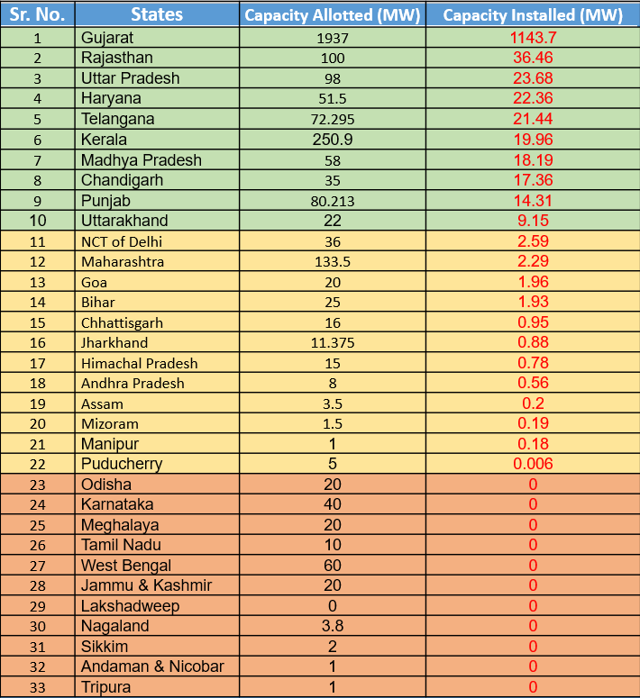





























Status of Rooftop Solar Progress -West Bengal vs other states as on May 2022
RTS Progress Status
Significant Progress
Slow Progress
No Progress
All figures in MW

Slide 111
RTS implementation status of select states (1/2)
*As on Dec 2021 **As on May 2022
Sl No | Particulars | Gujarat* | Rajasthan* | Uttar Pradesh* | Madhya Pradesh* | West Bengal**
1 | Implementing agency/DISCOMs | MGVCL, UGVCL, PGVCL, DGVCL, Torrent (Surat), Torrent ( Ahmd) | AVVNL, JdVVNL, JVVNL | DVVNL, PVVNL, PuVVNL, MVVNL | MPMKVVCL, MPPsKVVCL, MPPoKVVCL | W B S E D C L
2 | Capacity allocated | FY-2019-20 :- 440 MW; FY-2020-21 :- 750 MW | 5 MW, 15 MW and 25 MW respectively for AVVNL, JdVVNL and JVVNL (upto Dec ‘21; extension request applied) | For FY 19-20, 11 MW, 12 MW, 10 MW and 19 MW for DVVNL, PVVNL, PuVVNL, MVVNL respectively 5 MW for each DISCOM (exception: 20 MW for MVVNL) in FY 21-22 | 45 MW in FY 19-20 | FY 2019-20:5MW FY 2020-21: 50 MW FY 2021-22:10 MW
3 | Capacity tendered | Tender-I :- 600MW in FY 19-20 & Tender-II :- 600MW in FY 20-21 | 5 MW, 15 MW and 25 MW respectively for AVVNL, JdVVNL and JVVNL through RREC | Tender floated combined by UPNEDA for all Discoms in FY 20 and rate discovered and projects being implemented. For allocation made in FY 22 tender under finalization | 40.67 MW | FY 2021-22: 50MW
4 | Empaneled vendors | Tender-I :- 459 (In all slab) & Tender-II :- 548 (In all slab) | 28, 15, 92 respectively for AVVNL, JdVVNL and JVVNL | 71Nos. ( 1-10kW), 6Nos.( 11-100kW) in FY 2019-20 | 58 Nos | FY 2021-22: 12

Slide 112
RTS implementation status of select states (2/2)
*As on Dec 2021 **As on May 2022
Sl No | Particulars | Gujarat* | Rajasthan* | Uttar Pradesh* | Madhya Pradesh* | West Bengal**
5 | Rates discovered | Tender-I: Rs. 46827 per kW to Rs. 33,999 per kW; Tender-II: Rs. 46,827 per kW to Rs. 30,492 per kW | 1- 3 kW: (Rs 43k-43.26k/kW) 3-10 kW: (Rs 42.2k-42.6k/kW) 10-50 kW: (Rs 35k/kW) 50-500 kW: (Rs 35k/kW) | Rs.38000/- (For 1-10kW),Rs.32000/- (For 11-100kW) in FY 2019-20 | 1-3 kW: Rs. 37k/kW 3-10 kW:Rs. 39.8k/kW 10-100kW: Rs 36.5k/kW 100-500kW:Rs 34.9k/kW | FY 2021-22:Tender : Rs. 51190 per kW to Rs. 39150 per kW (1-500kW)
6 | Online portal of DISCOMs | Yes | DISCOM Portal developed but not deployed | Yes, developed by UPNEDA (upneda solarrooftopportal.com) | Yes | Yes
7 | Capacity installed | 991.860 MW as on 30.11.2021 | 33.993 MW | 20.742 MW | 11.752 MW | Nil
8 | CFA released by MNRE | Rs. 763.74 Cr | Rs 10.37 Cr | INR 16.188 Cr | INR 8.50 Cr | Nil
9 | Remarks | New capacity request of 750 MW has been received and under consideration | Proposal of new capacity received and under consideration . New tender is to be finalized | Timelines of 2019-20 sanctioned expired . New tender was exp. to be finalised for allocations made in FY 2021-22 | Extension request received from DISCOMs. New capacity for FY 2021-22 is yet to be received from DISCOMs | No incentives released by MNRE and 1.No Capacity Installed so far

Slide 113
Solar Policy Comparison (1/2)
Sl No. | Parameter | Rajasthan Solar Policy 2019 | Gujarat Solar Power Policy 2021 | Draft West Bengal RE Policy 2022-2027
1 | Major incentives/ drivers | Banking allowed for Captive and Third Party Sale on yearly basis Exemption/Relaxation from Electricity Duty for captive use within the State for 7 years from COD Transmission and wheeling charge discount (for projects upto 25 MW capacity): 50% applicable only for solar projects outside premises of RJ consumers and for solar projects with sale of power within state through open access 25% applicable for solar projects with storage system for third party or captive sale No charges applicable for solar projects set up in vicinity of EV charging stations Manufacturing of solar equipment would be entitled to following benefits/incentives Benefits of Micro, Small and Medium Enterprises (MSME) Policy to eligible manufacturers Land allotment at 50% concessional rate in industrial area/any other area Exemption of 100% Stamp duty Full exemption in Electricity Duty for 10 years 90% of SGST applicable for 7 years Government land will be allotted at 50% concessional rate for first 500 renewable energy based EV charging stations installed within Dec 2024 (5 years from introduction of solar policy 2019) | For Residential Projects No restriction on capacity Capital subsidy as per govt. (as announced from time to time) Third Party sale allowed No Banking charges No Transmission and wheeling charges Cross subsidy and addl. Surcharge not applicable for self consumption For Captive projects No restriction on installed capacity Surplus injection compensation CSS and addl. surcharge are exempted For Third Party Sale Banking charges for Govt. buildings exempted Surplus injection compensation @75% of avg tariff discovered in GUVNL bid Concession of 50% on CSS and additional surcharge for wind projects under this category For projects under REC mechanism Banking charges exempted Surplus injection compensation of 65% of avg. tariff discovered in GUVNL bid | RE Projects would be treated as new industrial units thereby enjoying benefits of MSME or large sectors Exemption on stamp duty for land allotted by Govt. for RE projects Exemption of RE projects from payment of electricity duty w.r.t self consumption for 5 years from COD Supervision charges shall not be levied by DISCOM for projects under this Policy. No clearance from State Pollution Control Board, West Bengal would be required for Renewable Energy projects except Biomass and Municipal Solid Waste Projects On-grid renewable energy projects involving innovative/new technologies may be given Viability Gap Funding (VGF) by the Government on case-to-case basis Land: Exemption from the ceiling on land holdings as per the Land Reforms Act of West Bengal (if any) and its amendments shall be applicable for RE projects Deemed NA status on payment of applicable conversion charges for RE projects

Slide 114
Solar Policy Comparison (2/2)
Sl No. | Parameter | Rajasthan Solar Policy 2019 | Gujarat Solar Power Policy 2021 | Draft West Bengal RE Policy 2022-2027
2 | Capacity Addition Target | By 2024-25, 1. Utility/Grid Scale Solar Parks - 24 GW 2. Distributed Generation - 4 GW 3. Solar Rooftop - 1 GW 4. Solar Pumps - 1 GW 5. Wind projects - 2 GW 6. Wind projects for captive/third party sale - 2 GW | NA- | Target capacity addition by 2027, Wind Power - 100 MW Mini & Small Hydro - 200 MW Bio-mass - 200 MW Waste to Energy - 150 MW Solar 6000 MW
3 | Solar Park Incentives | Land conversion will not be required in accordance with the provisions of Rajasthan Tenancy Ac t, 1955 and Rajasthan Land Revenue Act, 1956 for the development of solar park on private agriculture land | NA | WBREDA shall undertake an assessment of usable Government land and submit its report to GoWB for the development of Solar Parks on such land

Slide 115
RTS - Key Policy Comparison of some states
State | Metering Principles | Limit on system capacity based on sanctioned load | System Capacity | DT loading | Exemption of Charges and taxes |  |  |  |  | Treatment in case of net Export
 |  |  | Minimum Size in kW | In % | Wheeling Charges (Y/N) | Cross-subsidy surcharge and additional surcharge (Y/N) | Banking Charges (Y/N) | Transmission Charge (Y/N) | Other to specify | Rate applicable | Any other condition
Rajasthan | Net Metering | 80% | 1 kW to 1000 kW | 30% | Y | Y | Y | N |  | FIT | 1) If export more than 50 units then at FIT in next billing period 2) If export less than 50 units then adjustment in billing period till credit of 50 units is achieved
Gujarat | Net Metering | 50% | 1 kW to 1000 kW | 65% | Y | Y | Y | Y | Transmission loss , Wheeling Loss | Compensation @ of Rs. 2.25 per unit or the rate, if any, specified by the Commission for Surplus Injection Compensation (SIC) from time to time for the whole life of the Rooftop Solar PV System (for Residential and Govt Consumers) | Banking of energy allowed within one billing cycle
West Bengal | Net metering, Net Billing Net FiT | 100% | 1 kW to contracted demand | 100% | NA | NA | Y | NA | Banking charges are exempted for net metering upto 5kwp for a particular financial year | For Net Metering = Adjustment up to 90 % of consumption excess energy carry forward to next billing cycle in a financial year. For Net Billing as per WBERC Tariff order
Additional details provided in attached excel sheet for further reference

Slide 116
Snapshot of Non-exhaustive Policy and Regulatory intervention options for accelerating RE in West Bengal (1/2)
Energy Banking
Banking may be allowed for Captive and Third Party Sale on yearly basis
Exemption of Electricity Duty
Exemption/Relaxation from Electricity Duty for captive use may be extended beyond 5 years as originally proposed in draft RE policy (7 years for Rajasthan)
Exemption of T&D Charges
Transmission and wheeling charge discount (for projects upto 25 MW capacity) as per suggestions below:
Banking charges may be exempted
25% applicable for solar projects with storage system for third party or captive sale
No charges applicable for solar projects set up in vicinity of EV charging stations
50% applicable only for solar projects outside premises of WB consumers and for solar projects with sale of power within state through open access
75-100% exemption for solar projects within WB premises
The banking period may suitably be decided post appropriate load study by DISCOM
Drawl of banked energy may not be allowed during peak hours as determined by DISCOM
The unutilized banked energy at the end of year shall lapse; mechanism for lapsed energy may be envisaged
Specific Operating protocols may be put in place to safeguard network operations management

Slide 117
Snapshot of Non-exhaustive Policy and Regulatory intervention options for accelerating RE in West Bengal (2/2)
Allowable capacity for Net-Metering
Net-metering may be allowed to consumers for loads upto 500kW or up to 90% of the sanctioned load, whichever is lower
Implementation of RPO
Additional penalty for Obligated Entities over and above the WBERC mandated penalty currently in place for non-fulfillment of RPO obligations
Promoting Green Energy for EV Charging stations
Exemption of Open Access Charges with respect to RE generation used for EV Charging infrastructure
DISCOM should develop a suitable and comprehensive consumer-friendly IT application for facilitating online timely approvals and monitoring of these projects
RE generation for consumers “behind the meter” other than Obligated Entities may also be considered for contribution towards fulfillment of RPO obligations by DISCOM
Certain timelines/deadlines for processing of such Net-metering applications may suitably be decided

Slide 118
Proposed Schemes
8
Topics Covered
Convergence Scheme on Pump Solarization
Green Tariff Scheme
Smart Metering
Demand/Fixed Charge Rationalization
Industrial Tariff Subsidization- Increase Consumer Base/ Overall Revenue Base

Slide 119
Convergence Scheme of Agriculture Pump Solarization (REAPS+ RIDF+ PM KUSUM)
8A

Slide 120
Background of Convergence Scheme
1
Agriculture sector contributes to around ~15% of the State’s GDP; however, is heavily reliant on cross subsidy for electricity, which resultantly puts pressure on WBSEDCL and its C&I consumers
Implementation of KUSUM (Part C) for WBSEDCL has been relatively slow; whereas with respect to Irrigation Department, out of 572 Diesel Operated Pumps, electrification has been achieved for only 10% of the total number of sets, as on December 2021
2
Why Convergence Scheme?
3
Multiple Departments in the state have allocated some budget towards electrification/solarization of water pumps for agricultural sector
From a state’s perspective, pooling of resources of different state departments with common goal electrification/greening of agricultural diesel pumps; along with implementation of common PMU (Project Monitoring Unit) can present significant opportunity for better implementation and achievement of State target of agri pump electrification and solarization as a whole
4

Slide 121
Integrating Multiple State Dept.-Different initiatives- Common Objective: Agri pump Electrification and Solarization
Why Convergence Scheme?
Several departments in the state have allocated some part of its budget directly or indirectly towards electrification and greening of agricultural pumps
As per GoWB Budget Publication 2022-23, following departments have budget allocations towards the above, as mentioned below:
Agriculture Department
NRES Department
Special Assistance to WBSEDCL for energizing power-driven pump sets installed for Agricultural purposes
Water Resources Investigation & Development Department
Schemes sanctioned under NABARD {RIDF}
Irrigation & Waterways Department
Dept. of Power
Farm Mechanization including one time assistance to farmers for electrification of Agri pump sets
Procurement/installation of P.V. Pumps
River Lift Irrigation; Distribution of Pumpsets and Other Low Lift Pumping Devices; Electrification of Diesel Pumps

Slide 122
Rajasthan Case Study : Convergence Scheme for Solar Water Pump with Drip Irrigation
Approach adopted
1. Schemes implemented by the State’s Horticulture Department, comprising of National Horticulture Mission (NHM), National Mission on Micro Irrigation (NMMI), National Mission on Medicinal Plants (NMMP), National Bamboo Mission (NBM), Jawahar Lal Nehru National Solar Mission (JNNSM), Rashtriya Krishi Vikas Yojana (RKVY), and other State Programs were studied
2. The schemes that were studied were contemplated for amalgamation after careful consideration
3. Finally, JNNSM’s solar water pump, NHM’s water harvesting structures (farm ponds, diggies) and NMMI’s drip irrigation were combined
4. Financial resources were arranged in following manner - 30% subsidy under JNNSM and 56% from RKVY/ State
Implementation Strategy
Improvement in Service Delivery Time and Beneficiary Feedback: The State catered to only about 50 solar systems in 2010-11, but to about 4,500 units in 2012-13, an escalation 90 times,
Procedures Simplified: Ease of project monitoring, funding and implementation
Impact of Scheme Convergence
Exponential Scaling
Political-Will Expressed in CM Budget-Announcements
Decentralization of Implementation Process to District Level
Structural Provisions to Ensure Sustained Support for Beneficiaries
Transparency and Stakeholder Participation

Slide 123
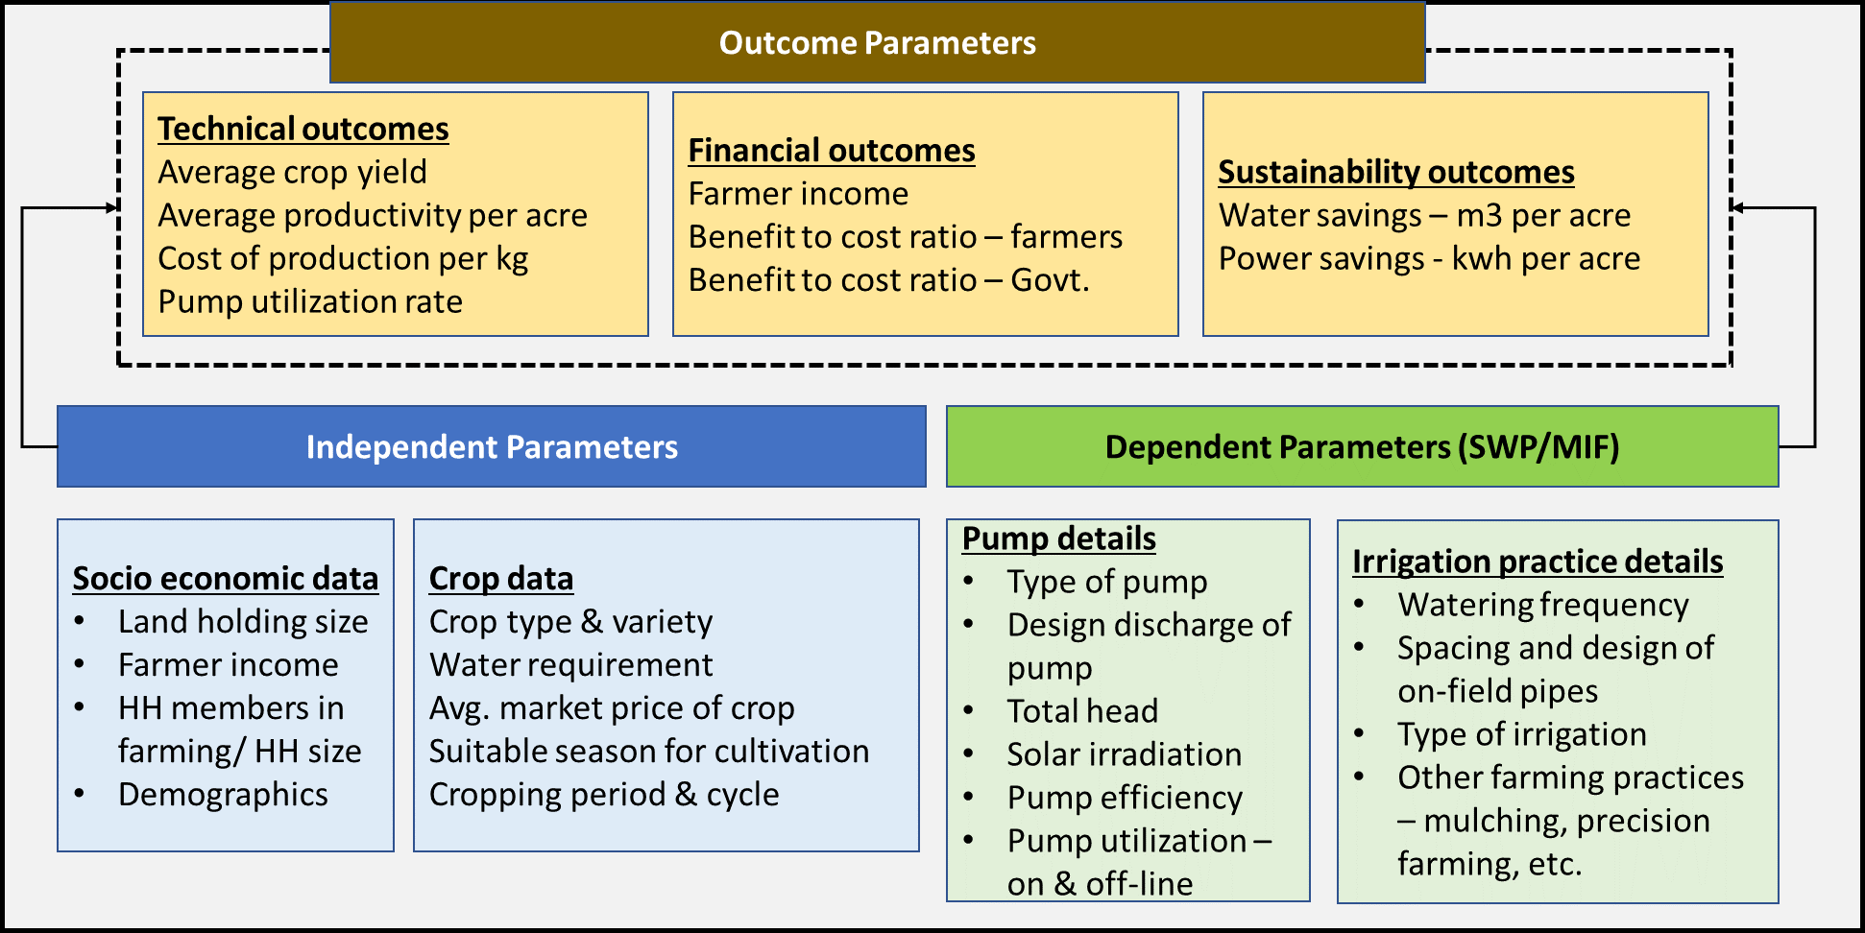
Need for Convergence Scheme for Agri Pump Solarization in West Bengal
Key Concept
Steps
With introduction of KUSUM scheme and with availability of funds from schemes like RIDF and REAPS, a convergent scheme can be envisaged
Power Department ,Irrigation department, WRID inter alia can join forces to implement this convergent scheme
Solarization of agricultural/irrigation pumps and sale of excess energy (if any) can be achieved leading to decrease in subsidy requirement
Identification of all existing central/schemes in the country
Mapping of central schemes, its key features, implementation status and progress
Mapping, and shortlisting of key parameters for consideration, along with detailed justification for each parameter selected
Finalizing on pooling of available funds for each scheme, setting up of Project Monitoring Unit (PMU) and determination of nodal implementing agency
Carrying out stakeholder consultations (Beneficiaries, Officials under Nodal Agencies under MNRE, Water Resource Dept, Irrigation Dept, Dept. of Power etc.)
Pool of essential parameters

Slide 124
Green Tariff Introduction by WBSEDCL for C&I Consumers
8B

Slide 125
Green Tariff Scheme - Background
Customers from residential customers to large industrial ones are increasingly procuring renewable energy in an effort to reduce their electricity bills and avoid fuel price unpredictability
Factors influencing rising demand for RE
Government Targets; Policy push
Sustainability targets among various stakeholders
Falling RE prices
As a result of a multitude of factors, such as national and international commitments to RE, falling RE prices, government regulation promoting RE, and the advent of sustainability targets, C&I consumers all over the world have begun to actively explore the possibility of increasing the share of RE in their power mix.
Opportunities thus presented
Opportunity for C&I consumers to drive the demand for RE products
Unique opportunity for utilities to market new RE products to C&I consumers

Slide 126
Drivers for procuring RE by C&I consumers (2/2)
C&I consumers are motivated to source power directly from generators due to commercial advantages and regulatory requirements
01
What has changed in last 3 years?
Saving in power purchase cost
Arbitrage of RE/ conventional cost over DISCOM/ESCOM tariff
Favorable Open Access (OA) Regulations and charges drive demand in a state
Consumers opting for this model prefer short/medium term agreements
Consumer tariff is linked/ indexed to their existing power purchase cost
Solar and wind energy have become the cheapest source of ex-bus energy in most of the large states;
Increasing RPO compliance of DISCOMs/ESCOMs, thereby putting pressure on obligated C&I consumers to comply with their RPO targets;
Many corporates adopting net zero strategy;
Falling prices of storage technologies;
Draft Amendments to Electricity Act 2003 and Tariff Policy 2016 promoting development of electricity markets:
Delicensing of distribution business to enable increased competition and thus enable efficient services to consumers;
Penalty for not meeting RPO target specified by Central Government: Rs. 0.25-0.50/kWh in 1st year of default; Rs. 0.5-1/kWh in 2nd successive year of default and Rs. 1-2/kWh continuing after 2nd year of default.
Transparent open access process and time bound approvals;
Open access surcharge (CSS and additional surcharge) shall not be more than 20% of applicable tariff;
Cross Subsidy Surcharge shall be applicable for a maximum period of 1 year from the date of opting for open access.
02
Meeting RPO / green sourcing commitment
Consumer is driven by RPO it has to meet
An emerging group of consumers, especially MNCs and Indian MNCs undertake green power sourcing as part of its corporate goals
Savings in energy cost and energy security are added incentives factored
Consumers opting for this model prefer long term commitments
03
Reliable supply of power
High energy intensive industries where uninterrupted supply of electricity is crucial opts for captive source
This is a motive for consumers in states which face energy deficit
Reliability of supply is the vital criterion and cost of supply is secondary. Therefore, energy banking facilities and storage technologies are crucial for these set of consumers
Sale under this driver usually have medium to long term commitment

Slide 127





RE100 -Initiative to Bring together Businesses all around the globe to transition to 100% Renewable Electricity
RE100 is a global initiative urging and bringing together businesses around the globe to transition to 100% RE
India RE100 Companies Status
No. of RE100 companies headquartered in India | 4
Electricity Consumption (MWh) | 2,057,658
Total Renewable Electricity Consumption (MWh) | 805,255
Percentage share of renewable electricity among RE100 members in the market | 39%
Existing Energy Attribute Certificates | Indian RECs, I-RECs
India in the Paris Climate Agreement committed to an “Intended Nationally Determined Contributions” (INDC) target of achieving 40% of its total electricity generation from non-fossil fuel sources by 2030
Corporate Electricity majorly the industrial and commercial sector demand accounts for about 50% of total electricity consumption in India and globally.
Indian companies voluntarily adopting 100% RE consumption targets
In 2019, RE100 grew over by a third and 50 Indian companies reported GHG emission reduction targets
With the C&I segment being the major consumers of electricity, the onus is on them to drive the decarbonization of the power sector

Slide 128
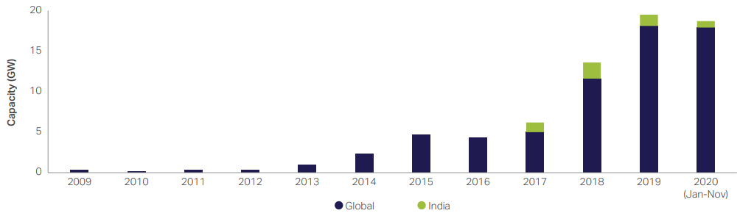
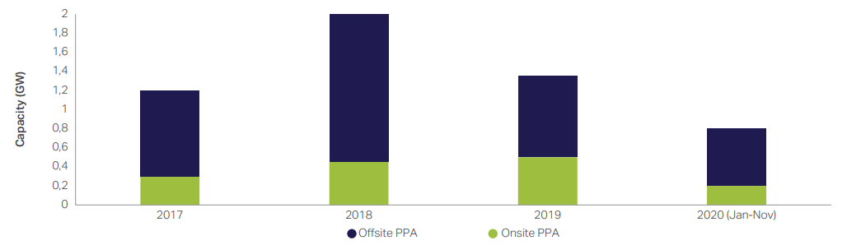
Impact of RE 100 and resultant Rise of Corporate RE Procurement Market in India
There is a growing demand from consumers for a rapid transition to a zero-carbon economy with over 175 of the world’s most influential companies having already made this commitment through the global corporate leadership initiative, RE100.
This is driving up demand for renewable electricity and creating a shift in demand patterns away from fossil fuels across the global power system
In India, the main drivers for many companies to adopt this transition are rising electricity tariffs for commercial and industrial consumers, falling prices for solar photovoltaic (PV) technology and corporate sustainability goals
As companies seek to meet their renewable electricity targets, manage their electricity costs and obtain tariff certainty in the longer term, market for corporate RE PPA(s) are set to substantially grow globally as well as in India
Annual global signed corporate renewable PPA capacity
Annual India corporate renewable PPA capacity additions
Source:https://www.wbcsd.org/contentwbc/download/11241/165820/1

Slide 129
Green Tariff – Operational Principle
Green tariffs are tariff structures offered by utilities that allow large commercial and industrial customers to buy bundled renewable electricity from a specific project through a special utility tariff rate or a premium.
This provides these larger energy customers an option to meet their sustainability and renewable energy goals, reduce long-term energy risks, and demonstrate commitment to the development of new renewable energy projects.
Advantages of Green ToD with respect to stakeholders
Thermal Generators
RE Generators
DISCOMs
Customers
Increased daytime demand can improve the PLFs and reduce the variability in the generation pattern, which can increase the revenue from catering to increased demand and cost of generation
Increased demand can provide enough capacity for the grid to absorb more RE and thus reduce the need for curtailment. A decrease in curtailment will increase the revenue of the RE generators
Increased daytime demand can help flatten the load profile, allowing DISCOMs to absorb more power at a lower cost. Adding new demand will increase the business and profitability of the DISCOM
With the rebate for incremental consumption, customers can consume more electricity by adding new appliances and substituting other energy sources for electricity. This can reduce their average cost of energy

Slide 130
Estimation of Potential of Additional Electricity Demand
As per latest 19th Electric Power Survey (EPS) Report , CEA observes that in the business as usual (BAU) case,
Electricity demand will grow at a CAGR of 5.1% from 2021-2022 to 2026-2027,
and at the rate of 4.66 percent from 2026-2027 to 2036-2037, assuming CAGR of gross domestic product GDP) is 7.3 percent and using a partial end-use methodology
Key factors that can contribute to increase in Demand:
Potential of Demand Generation*
Lower cost electricity generated from RE sources
Improvement of T&D losses
Scope for increase in Per capita consumption
Growth of EV sector
Increased penetration of cheaper RE with envisaged decrease in price of Lithium-ion batteries
 | Elasticity | Potential of Demand Generation (GWh) at 1% Lower Tariff | Potential of Demand Generation (GWh) at 15% Lower Tariff
Short term | 0.02% | 22.6 | 3390.7
Long term | 0.06% | 67.8 | 10172.7
Source: https://www.pace-d.com/wp-content/uploads/2021/07/Green-ToD-White-Paper_1.pdf
Electricity consumption for industrial loads is elastic in nature. The elasticity is higher in the long term compared to the short term because industry needs to make investments, either capital investments in equipment or investment in processes, to alter its consumption patterns.
Also, changes in demand curves will kick in only after a tariff change of say 5 percent; below that, the demand will be inelastic

Slide 131
High Industrial Tariff- Trend of Customer shift towards RE- Expected increase in Demand among key factors that can motivate introduction of Green Tariff in West Bengal
Key Factors that can encourage Green Tariff introduction in West Bengal:
High Industrial and Commercial Tariff; need for cheaper RE options to encourage further industrialization and prevent migration
Growing interest among corporate entities to shift to RE to achieve sustainability goals
Significant scope for further RE integration, considering that actual installed capacity of RE in West Bengal is 587 MW as on January 2022, whereas total potential of RE is 7198 MW (~8.16%)
Impending penetration of EV inter alia to drive significant growth in demand
Significant Precedent cases in India to learn from and implement the Green Tariff Scheme successfully

Slide 132
Precedence Cases – Andhra Pradesh
In 2008–09, for the first time, Andhra Pradesh introduced an optional green power tariff for C&I consumers at a premium price of Rs. 6.7/kWh (IDFC 2010)
Citing absence of sales, this category was removed vide 2017-18 tariff order
In response to a petition by the only consumer who subscribed to this tariff category in 2016 and 2017, APERC re-introduced the “HT Category VII-Green Power” tariff category in 2018–19 for HT consumers “who wish to avail power from Non-conventional sources of energy voluntarily and show their support to an environmental cause” (APERC 2018)
At Rs. 11.32/kVAh, subscription to this tariff category is optional and concomitantly entitles the subscribing HT consumers to RECs as well
There is no restriction on the end-use purpose of this green energy (except for use as start-up power for generating plants), and no monthly minimum charges are levied under this category
Note:
However, In 2019, AP Govt had launched High Level Negotiation Committee (HLNC) to renegotiate tariffs set under Power Purchase Agreements (PPAs) for solar and wind projects
Industry associations consequently moved the Andhra Pradesh High Court (APHC), which had put a halt to the stand-off by dismissing the HLNC and directing AP to clear the dues of power generators
Source: Respective tariff order and Working paper by WRI India

Slide 133
Precedence cases – Karnataka (1/2)
Karnataka Electricity Regulatory Commission ["KERC"] had already approved Green Power Tariff for the distribution licensee (BESCOM) since FY 2011-12 in respective tariff orders
Relevant extract of BESCOM tariff order for FY 2011-12 for approval of green power tariff is as follows:
“1) Tariff for Green Power:
….
Commission’s Analysis & Decision:
The Commission welcomes the new initiative of BESCOM to promote Green Energy and hence, decides to introduce Green Tariff for HT industries & HT Commercial Consumers with Contract Demand of 1 MVA & above in all the ESCOMs. The above Tariff is optional. The Commission is of the view that, the Consumers who opt for Green Energy should bear the additional power purchase cost of Renewable Energy sources over and above the normal tariff.
Based on the power purchase cost approved for FY-11, the additional average cost for RE source in the State as a whole is worked out as under:
…
As per the existing Tariff schedule, there is no separate category for EHT & HT supply. As such the HT distribution loss has been considered in addition to transmission loss. Accordingly, the Commission determines Green Tariff at Re.1.00 per unit as the additional tariff over and above the normal tariff to be paid by HT-consumers, who opt for Green Tariff.”
Source: Respective tariff order

Slide 134
Precedence Cases – Karnataka (2/2)
All figures in Rs/unit
Note:
As per latest KERC tariff Order for BESCOM (FY 21), Commission has decided to continue the existing Green Tariff of 50 paise per unit as the additional tariff over and above the normal tariff to be paid by HT consumers, who opt for supply of green power from out of the renewable energy procured by distribution utilities over and above their Renewable Purchase Obligation (RPO)
*assuming power factor of 0.85
Source: https://bescom.karnataka.gov.in/storage/pdf-files/RA%20section/Electricity%20rates.xlsx

Slide 135
Precedence Cases – Maharashtra (1/2)
Citing KERC’s Order on Green Tariff as reference, Tata Power Company Limited (Distribution) had filed a petition before Maharashtra Electricity Regulatory Commission (MERC) seeking approval for levying “Green Energy Tariff" to supply Renewable Energy to consumers opting for 100% green energy for meeting their entire demand
In the petition, MERC had issued an order in Case No. 134 of 2020 dated 22nd March 2021 and has determined Green Energy Tariff of Rs 0.66/kWh which is over and above the normal tariff of the respective category as per Tariff Orders, be levied to the consumers opting for meeting their demand by 100% green energy
Following order was passed by MERC:
Green Energy Tariff of Rs 0.66/kWh, which is over and above the normal tariff of the respective category as per Tariff Orders, be levied to the consumers opting for meeting their demand by 100% green energy.
Revenue earned through Green Energy Tariff shall be treated as non-tariff income of Supply Business and thereby be fully accounted for reduction in ARR of supply business.
All consumers (Extra High Voltage, High Voltage and Low Voltage) shall be eligible for opting 100% RE power on payment of Green Power Tariff.
The Commission may take overview of the scheme at the time of MTR Proceedings.
Note:
As submitted by Tata Power Co. Ltd., the Green Power Tariff recovered from these consumers for supply of 100% RE will increase the other business income of the distribution business
As per Section 51 of the EA, 2003, a proportion of the revenues derived from such business shall, as may be specified by the concerned State Commission, be utilized for reducing its charges for wheeling
Therefore, these services will further subsidize the Annual Revenue Requirement (ARR) of the distribution business and normal tariff of the consumers may also get proportionately subsidized
Source: Respective tariff order

Slide 136
Precedence Cases – Maharashtra (2/2)
As per Order, Commission had ruled that Green Power Tariff which would be uniform for all Distribution Licensees in the State is to be computed as difference between pooled power purchase cost of non-conventional and conventional sources of energy (only variable cost) for all Distribution Licensees in the State.
While doing so, instead of computing year wise different tariff, uniform number for MYT control period is computed for providing certainty in rate as shown below:
Total | RE power Procurement for MYT Period |  |  | Non-RE power procurement (only variable) for MYT Period |  |  | Diff between RE & Non-RE power
 | MU | Rs. Cr. | Rs./kWh | MU | Rs. Cr. | Rs./kWh | Rs./kWh
MSEDCL | 141772 | 57440 | 4.05 | 586029 | 146412 | 2.50 | 1.55
AEML-D | 13295 | 4691 | 3.53 | 38206 | 15367 | 4.02 | -0.49
BEST Undertaking | 2949 | 940 | 3.19 | 22534 | 7938 | 3.58 | -0.34
TPC-D | 3927 | 1491 | 3.80 | 22377 | 8069 | 3.61 | 0.19
MBPPL | 58 | 17 | 2.88 | 348 | 161 | 4.19 | -1.31
GEPL | 41 | 12 | 2.88 | 248 | 101 | 4.08 | -1.20
KRC | 35 | 10 | 2.89 | 190 | 76 | 4.02 | -1.14
Total | 162077 | 64600 | 3.99 | 669968 | 178125 | 2.66 | 1.33
Thus, as per methodology explained, Rs. 1.33/kWh could have been Green Power Tariff.
However, as this concept was being introduced for the first time and also considering the fact that Distribution Licensee would be able to use such power consumed by consumers towards fulfilment of its RPO target, certain benefit of the same needs to be passed on to concerned consumers.
Hence, the Commission had decided to levy only 50% of charge determined above i.e. 0.66/kWh as Green Power Tariff to the consumer opting for meeting its 100% of power requirement through RE sources.
Such Green Power Tariff would be in addition to regular tariff approved in MYT Order
Source: Respective tariff order

Slide 137
Precedence Cases – Madhya Pradesh (1/2)
Citing KERC’s Order on Green Tariff as precedence, as well as the MERC order on the same, MPPMCL or collectively with DISCOMs have submitted in their petition to MPERC to include the option of Green Tariff
Following order was passed by MPERC:
Commission had fixed Green Energy Tariff for FY 2022-23 as 50% of the difference in weighted average charge of RE and weighted average rate of Energy charge of Non RE sources
RE supplied by the Petitioners to its consumer shall only be considered towards the RPO compliance of the Petitioners. Further, if the consumer is also an obligated entity, then he may make its own arrangement towards fulfilment of its RPO, separately
the revenue earned by the Petitioners from such sale of power shall be considered as Tariff Income at the time of truing up. Such treatment of revenue shall also ensure that the benefit of same is passed on to other consumers of the State in terms of reduced cost
This arrangement is optional / voluntary and shall only be provided on the request of the Consumer. The Green Energy Tariff shall only be applicable if Consumer wishes to avail power under this arrangement
In order to operationalize the scheme uniformly across the State, necessary modalities including guidelines, if any shall be worked out / prepared by the Licensees & information in this regard shall be made available to the Commission within period of one month from the date of this Order
Note:
The above is as per the latest MPERC Tariff Order for FY 23
Source: Respective tariff order

Slide 138
Precedence Cases – Madhya Pradesh (2/2)
Similar to Maharashtra case, following is the computation of green tariff as was proposed to Commission along with the tariff actually approved:
RE Power Procurement for the Period FY 2022-23 |  |  | Non-RE Power Procurement (Only Variable) for the Period FY 2022-23 |  |  | Difference between RE & Non-RE Power | Approved Green Energy Tariff
MU | Rs. Cr. | Rs./kWh | MU | Rs. Cr. | Rs./kWh | Rs./unit | Rs./unit
A | B | C | D | E | F | G = (C-F) | H = G*50%
14,625.42 | 6,051.10 | 4.14 | 71,070.76 | 13,328.04 | 1.88 | 2.26 | 1.13
Reasons for adoption of Green Tariff by Commission:
The Commission has observed that during the meeting of State Advisory Committee as well during the Public Hearings some of the stakeholders have requested green energy tariff for consumers who are willing to purchase 100% Renewable Energy from the Distribution Licensee.
These consumers are either not eligible for taking 100% RE through Open Access or they do not have the resources, expertise and the bandwidth required for carrying out this activity.
Given the proposed arrangement is completely voluntary in nature, the Commission have been inclined to consider it
Further, such arrangement would promote RE in MP, which is also one of the mandates under the Electricity Act, 2003

Slide 139
Best Practices for Designing Green Tariff (1/4)
A. Tariff Design, Planning, and Forecasting
Since green tariffs are based on long-term contracts, it is imperative that DISCOMs invest in improving their planning and forecasting mechanisms to efficiently assess demand and supply, and strive toward creating optimal infrastructure
While enabling large consumers to choose their energy suppliers for the long term, DISCOMs must be cautious to avoid adding additional base load capacity without first undertaking a rigorous demand-supply analysis
DISCOMs must assess the quantum and nature of demand from various consumer segments (for example, the specific demand for RE by C&I consumers based on their sustainability targets)
On the other hand, DISCOMs must assess potential supply-side options (for example, the availability of third-party RE producers that are amenable to entering into long-term contracts with DISCOMs)
Instead of charging a fixed premium as part of the green tariffs, DISCOM(s) could link the pricing of green tariffs to the price of RE in the long-term PPAs executed

Slide 140
Best Practices for Designing Green Tariff (2/4)
B. Tailor-Made Solutions for Different Categories
within the C&I Sector
In order to increase corporate sourcing of RE, particularly among the small and medium enterprises (SMEs), there is a need to further develop procurement mechanisms
The identification and study of the specific needs of different sectors may help utilities offer attractive customized green tariffs to different corporate consumers.
However, excessive customization options may be deterrernt to achieving economies of scale and hence, a balance must be ensured (Scope for further research study)
C. Fairness Toward Non-subsidizing Consumer
Categories
The successful formulation of green tariffs by utilities entails working closely with regulators and consumers to ensure that the tariff adds value to certain consumers without unfairly shifting the cost of the tariff to other consumer groups
Comprehensive discussions about the various cost components of green tariffs at forecasting stage can further the goal of transparency and prevent the inequitable passing on of these costs to other groups at an ex post stage (i.e. based on actual results rather than forecast data)

Slide 141
Best Practices for Designing Green Tariff (3/4)
D. Ensuring an Inclusive, Transparent
Consultative Process
Collaborative exchanges between corporate consumers and utilities can help utilities with integrative resource planning, and help corporates achieve their decarbonization goals more quickly
So far, in the Indian context, exchanges like Green Power Market Development Group (GPMDG), Distribution Utilities Forum (DUF), and so on, have focused on enabling OA. A similar structure can be adopted for consultative processes to design green tariffs.
E. Transparency and Verifiability
Transparent and predictable energy prices through the duration of the green tariffs contract are one of the most valued features of successful green tariff contracts
As part of this process, utilities must start publishing integrated resource plans (IRPs), which would describe their long-term RE sourcing plans, energy efficiency plans‚ and conventional plant retirements

Slide 142
Best Practices for Designing Green Tariff (4/4)
E. Transparency and Verifiability (Contd..)
Therefore, with increasing RE purchases, an important best practice is the development of infrastructure that facilitates the verification and tracking of RE purchases, and provides strong contractual arrangements that enable corporates to have confidence in their procurement
One of the preferred modes for tracking and verifying RE purchases is Renewable Energy Certificates (RECs), which can be sold separately or together with the underlying electricity to the corporates.
These certificates help corporates ensure that the RE is not double-counted by different end users, and allow them to corroborate their claims about their RE purchases

Slide 143
Implementation of Cloud based Advanced Metering Infrastructure (AMI)
8C

Slide 144
Introduction
WBSEDCL caters to the electricity needs of more than 2.07 crore consumers across 21 Districts.
To match the infrastructure needed to meet increasing load growth, WBSEDCL has been heavily investing in power distribution infrastructure through own fund as well as funding received from various central government schemes as well as from multilateral funding agencies
One of the key investment areas for WBSEDCL is implementation of Cloud based Advanced Metering Infrastructure (AMI).
Currently, WBSEDCL has recently floated NIT to implement AMI Solution for all RLI (River Lift Irrigation) Consumers, that is Consumers having Connected Load 5 KVA to 50 KVA with all Distribution Transformer meters throughout the jurisdiction of WBSEDCL. Total numbers of such category consumers are 5,22,300 approximately*
*Source: WBSEDCL Tender Notice No: WBSEDCL/ IT&C/ 33.10(iv)/ 1402 dated 20.02.2019

Slide 145
Background and Objective
Background
Out of total 77 divisions in West Bengal, billing efficiency is found to be less than 80% in 42 divisions.
Collection efficiency is found to be less than 95% in 32 divisions. Further AT&C loss is more than 30% in 32 divisions. Same is summarized below as follows
High AT&C Loss
5.66% (46,16,925 nos.) of total bills generated in a year is based on average billing of consumers
Cumulative government department dues are in the range of 4 to 6% of total revenue of WBSEDCL
In addition to the same, debtors amounting to Rs 772.81 Cr has an average aging of more than 4 years
Key Objective of Smart Metering
# | Zone | No of divisions with billing efficiency |  |  |  | Grand Total
 |  | <60% | 60% to 80% | 80% to 90% | >90%
1 | Bardhaman | 1 | 7 | 5 | 3 | 16
2 | Siliguri |  | 6 | 7 | 2 | 15
3 | Berhampur | 1 | 8 | 3 | 0 | 12
4 | Kolkata | 6 | 3 | 6 | 5 | 20
5 | Medinipur | 1 | 9 | 3 | 1 | 14
Total |  | 9 | 33 | 24 | 11 | 77
Key objective of AMI is to implement smart metering system and data analytics with an aim of implementing Revenue protection measures, bring improvement in Billing / Collection efficiencies and betterment /automation of customer services in a targeted manner

Slide 146
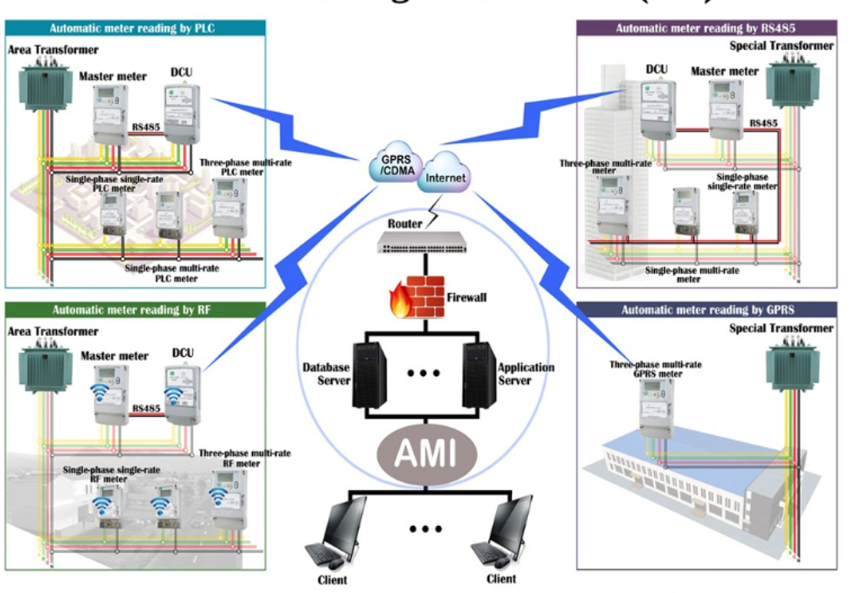
AMI - Rationale for implementation
Why AMI?
Advanced Metering Infrastructure (AMI)
AMI is not a single technology implementation, but an integrated system of smart meters, communications networks, and data management systems that enables two-way communication between utilities and customers
Billing is no longer the only function of smart meters. High-resolution data from smart meters provide rich information on the electricity consumption behaviors and lifestyles of the consumers.
The system can provide important functions that were earlier not possible or had to be done manually, like, the ability to remotely/automatically measure electricity use, connect and disconnect service, detect tampering, identify and isolate outages, monitor voltage.
Source - https://zhuhaiyujian.en.made-in-china.com/product/HsIxrohZElkV/China-Advanced-Metering-Infrastructure-AMI-and-System.html

Slide 147
Utilization of Smart Meter Data
Areas where Smart meter data can be used for analytics, include energy forecasting, smart meter analytics, asset management/analytics, grid operation, customer segmentation, energy trading, credit and collection, call center analytics, energy efficiency and demand management
Smart Meter Data Analytics
Smart Meter Data Analytics
A. Load Analytics
B. Load Forecasting
C. Load Management
Use case
Customer Characterization - Identify applicable tariff category of consumer based on consumption pattern
Electricity consumption profiles follow a daily, weekly, and seasonal trends.
Consumption Data from meters may be compared with benchmarked consumption data of consumers to identify tariff category the consumer belongs to
D. Outage Management
D. Outage Management
Bad Data Detection
Non-technical loss detection
Load Profiling
Forecasting with Individual Meters
Forecasting w/o Individual Meters
Probabilistic Forecasting
Customer Characterization
Customer Demand Assessment
Remote Disconnect/Reconnect based on Demand Profile
E. Asset Manager Management
E. Asset Manager Management
Key Techniques – Time Series Analysis, Outlier Detection, Classification, Clustering

Slide 148
Benefits to WBSEDCL (1/2)
Benefits for Customers and Utilities
Improvement in Meter Reading, Billing and Collection (MBC) from remote billing and metering services is a major benefit of implementation of AMI in Utilities.
AMI helps in enhancing revenue collection and bring about improvement in customer service and satisfaction
AMI projects demonstrate that AMI and customer systems can achieve substantial grid impacts and benefits for customers and utilities as follows:
1. Reduced costs for metering and billing.
Remote meter reading using AMI generates more timely, accurate bills; also, WBSEDCL will be able to execute remote service connection and disconnection orders in hours instead of days
WBSEDCL would be able to improve billing accuracy, reduced customer complaint and use AMI data to resolve billing disputes faster
Provisional billing estimation accuracy and precision shall be enhanced significantly.

Slide 149
Benefits to WBSEDCL (2/2)
2. Enhanced customer control
More customer control over electricity consumption, costs, and bills
It facilitates greater use of new customer tools (e.g., web portals and smart electrical devices) and techniques (e.g., shifting demand to off-peak periods).
3. Lower utility capital expenditures
Lower utility capital expenditures leading to customer bill savings
Smart meter data will help WBSEDCL in taking informed decision on Demand Management, improve its asset utilization and plan maintenance activity
4. Faster outage restoration
Lower outage costs and fewer inconveniences for customers from faster outage restoration
Crew mobilization; Precise dispatching of repair crews to the locations where they are needed

Slide 150
Important contributor to Operation and Maintenance (O&M) activities
AMI can be an important contributor to outage management, service restoration, and voltage monitoring and should be implemented as part of investments in distribution automation technologies,
AMI will enable WBSEDCL to identify and isolate outages faster and dispatch repair crews more precisely, reducing outage duration, limiting inconvenience
Utilities facing regular, severe weather events and storm-induced outages have greater incentives for using AMI for outage management than those that do not
AMI would also enable WBSEDCL to proactively identify and notify customers of unusual usage patterns in advance of bills.
AMI data integration with other information and management systems, including outage management systems (OMS) and geographic information systems (GIS), enabled utilities to create detailed outage maps, and in some cases posted these maps on utility websites to keep the public informed on service restoration progress
Utilities can use AMI voltage monitoring capabilities to enhance the effectiveness of automated controls for voltage and reactive power management
Use case
Monitor power quality of Distribution Transformer – Identify useful life of transformer, enhance capacity, or replace transformer
Utility can judge the use of distribution transformers through smart meter data, determined whether the transformer's actual voltage exceeded the rating plate rating to determine its remaining life
Use the load data from meter to assess if capacity of the transformer needs to be enhanced to meet existing / future load growth.

Slide 151
Significant Cost Reduction can be achieved by Commercial Losses Reduction (1/2)
Leveraging of RDSS Investments in a targeted manner complemented with IT OT initiatives are critical
Targeted Program on Metering Efficacy for Billing complemented with other initiatives for specific pockets
Reduction of Cost of Supply after considering Average variable cost of DVC ** Plant (as per tariff petition for FY 2020-21)
Improvement in Billing Efficiency vis a vis AT&C Losses
Requirement of input energy would go down
Reduction of Cost of Supply after retirement of contract of highest merit order plants
RDSS
Grid Modernization
IT/OT System
** Based on approved average power purchase rate of DVC Plant – Mejia and RTPS

Slide 152
Significant Cost Reduction can be achieved by Commercial Losses Reduction (2/2)
Reduction of Cost of Supply after considering Average variable cost of DVC ** Plant ( as per tariff petition for FY 2020-21)
Particulars |  | Billing Efficiency | Energy Sold (MU) | Net Input Energy (MU) | Net Energy Reduction (MU) | Energy Charge | Net Saving | Saving in Per Unit
 |  | (%) |  |  |  | ( Rs /KWh) | ( Crore) | (Rs/KWh)
Actual Parameter |  | 79% | 29556 | 37361 | 0 | 2.89 | 0
Phase Wise Reduction
Phase Wise Loss Reduction Planning | Phase 1 | 82% | 29556 | 36044 | 1317 |  | 380 | 0.11
 | Phase 2 | 85% | 29556 | 34772 | 1272 |  | 367 | 0.11
 |  | 88% | 29556 | 33510 | 1262 |  | 364 | 0.11
 |  | 91% | 29556 | 32319 | 1191 |  | 344 | 0.11
 |  | 95% | 29556 | 31112 | 1208 |  | 349 | 0.11
Reduction of Cost of Supply after retirement of contract of highest merit order plants
Particulars |  | Billing Efficiency | Energy Sold (MU) | Net Input Energy (MU) | Net Energy Reduction (MU) | Energy Charge | Net Saving | Saving in Per Unit
 |  | (%) |  |  |  | ( Rs /KWh) | ( Crore) | (Rs/KWh)
Actual Parameter |  | 79% | 29556 | 37361 | 0 | 4.49 | 0
Phase Wise Reduction
Phase Wise Loss Reduction Planning | Phase 1 | 82% | 29556 | 36044 | 1317 |  | 592 | 0.16
 | Phase 2 | 85% | 29556 | 34772 | 1272 |  | 572 | 0.16
 |  | 88% | 29556 | 33586 | 1185 |  | 533 | 0.16
 |  | 91% | 29556 | 32443 | 1143 |  | 514 | 0.16
 |  | 94% | 29556 | 31309 | 1134 |  | 510 | 0.16
** Based on approved average power purchase rate of DVC Plant – Mejia and RTPS
Source : Tariff Order for 7th Control Period of WBSEDCL.

Slide 153
Demand/Fixed Charge Rationalization – Domestic Consumers
8D

Slide 154
Domestic LV Fixed charges for West Bengal is much lesser as compared to other states
Source: Applicable Tariff Orders of States

Slide 155
Domestic HV Fixed Charge Comparison
Source: Applicable Tariff Orders of States
As can be seen from above, Domestic Fixed charges for HV connections for West Bengal are considerably lower compared to other states

Slide 156
Opportunity for WBSEDCL for higher FC recovery from idle consumers with negligible consumption
For LV consumers in West Bengal, Fixed Charge is Rs. 15/kVA /month - considerably low in comparison to other states
For consumers with Nil monthly energy consumption-
No Energy charge recovery for WBSEDCL, low FC recovery
Fixed Charge per month need to be increased to a level at par with certain other states- Revenue recovery from Idle valid consumers of WBSEDCL would substantially increase
Care must however be taken to reduce the Energy Charge Rate simultaneously to the point that the overall tariff for LV consumers with Average monthly consumption does not increase significantly
Illustration 1 : Calculation of Modified Energy Charge Rate with increase in Fixed Charge
Illustration 2 : Cost benefit Analysis
Assumptions/ Computation:
Load: 1 kVA
Assumed monthly unit consumption: 200 kWh
Average Energy Charge rate assumed: Rs. 4.5/kWh
Original Fixed Charge: Rs. 15/kVA/month
Modified Fixed Charge proposed (for illustrative purpose): Rs. 50/kVA/month
Therefore, modified Energy Charge : Rs.((200*4.5+15)-50)/200)/kWh = Rs. 4.3/unit
Assumptions/ Computation:
Sample size no. of consumers with load of 1 kVA: 10
No. of consumers with negligible consumption: 5
No. of consumers with average consumption of 200 units/month: 5
Revenue Recovery by WBSEDCL at original Fixed charge and Energy Charge rate : Rs. (5*15)+(5*15)+(5*200*4.5) = Rs. 4650
Revenue Recovery by WBSEDCL at Modified Fixed charge and Energy Charge rate : Rs. (5*50)+(5*50)+(5*200*4.3) = Rs. 4800
Net Benefit of WBSEDCL = Rs. 150

Slide 157
Industrial Tariff Rationalization
8E

Slide 158
Comparison of Industrial Tariff Rate vs Average Tariff rate of different States
Industry Intensive state like Gujarat, Andhra Pradesh have lower Industrial Tariff.
Average tariff rate for 11 KV Industrial Consumer and Average Billing Rate ( At Load Factor 40%)
Average tariff rate for 33 KV Industrial Consumer and Average Billing Rate (Load Factor of 40%)
** Average Tariff rate includes fixed charge, variable charges and electricity duty
Source : https://cea.nic.in/wp-content/uploads/2021/03/tariff_2019.pdf , ERC Order of different states and Annual report of WBSEDCL , pg 191 of 225 (250kW large industry 40% LF)

Slide 159
Industrial Consumer Growth Analysis for WBSEDCL : Case Scenario 1 (1/2)
Present Scenario of WBSEDCL
Scenario Analysis
Outcome of Scenario Analysis
Actual Scenario ( For Utility C)
Higher Tariff Rate (Rs. 8.35 / KWh) has led to reduction in share of Consumer i.e 10%.
Actual Scenario ( For Utility C)
Higher Tariff Rate (Rs. 8.35 / KWh) has led to reduction in share of Consumer i.e 10%.
Industrial Tariff Rate is higher than other Utilities in multiple licensee area.
WBSEDCL currently notified lower tariff for Industrial Consumer in multiple licensee area but not in other area where it has larger industrial consumer base.
Share of Lower Industrial Consumer adversely impacts revenue for WBSEDCL.
Potential of possible increase in Sales volume also remain untapped.
For illustration purpose a model has been prepared considering three Utilities (A,B & C) within State.
We have mapped hypothetical share of number of HT Consumer based on Tariff Rate for the above Utilities.
We have analyzed the impact in Revenue by altering the Tariff Rate as well as the share of HT Consumer in our Model.
Scenario 1 ( For Utility C)
Tariff Rate has been revised to Rs. 5.55 / KWh which resulted in increase in share of Consumer to 20% which impacts revenue growth by 33%.
Scenario 1 ( For Utility C)
Tariff Rate has been revised to Rs. 5.55 / KWh which resulted in increase in share of Consumer to 20% which impacts revenue growth by 33%.
Scenario 2 ( For Utility C)
Tariff Rate has been revised to Rs. 5.30 / KWh which resulted in increase in share of Consumer to 50% which impacts revenue growth by 217%.

Slide 160
Industrial Consumer Growth Illustrative Analysis for WBSEDCL–Case Scenario 1 (2/2)
3 Scenario- Parallel License Operation Area
Assumption considered for Scenario Analysis
Utility | Consumer Share | Fixed Charge (Rs/KVA/Month) | Variable Charge ( Rs/KWh) | Average Tariff Rate (Rs/KWh)
A | 10% | 384 | 7.32 | 8.35
B | 55% | 384 | 4.52 | 5.55
C | 35% | 384 | 4.27 | 5.30
Three Utilities considered with state i.e A, B & C with different Tariff Rate and Share of HT Consumer.
Total Number of HT Consumer : 100
Load Factor of each Consumer : 60%
Average Load of Each Consumer : 1 MW
Average Power Factor : 85%
Annual Average Consumer of Each Consumer : 5.26 MUs
 | Future HT Growth Planning for Utility “A”
Scenario | Average Proposed Tariff Rate for HT Consumer |  |  | % of Consumer Share |  |  | No of Consumer Share |  |  | Revenue Growth ( In Crore) |  |  | Growth Analysis for C
 | A | B | C | A | B | C | A | B | C | A | B | C | No of HT Consumer | Increase in Revenue for HT Consumer
Original | 8.35 | 5.55 | 5.30 | 10% | 55% | 35% | 10 | 55 | 35 | 44 | 160 | 98 | 0% | 0%
1 | 5.55 | 5.55 | 5.30 | 20% | 45% | 35% | 20 | 45 | 35 | 58 | 131 | 98 | 100% | 33%
2 | 5.30 | 5.55 | 5.30 | 50% | 30% | 20% | 50 | 30 | 20 | 139 | 88 | 56 | 400% | 217%
Scenario 1 : With revision of Tariff Rate from Rs. 8.35/KWh to Rs. 5.55/KWh , the consumer share will increase 10% to 20% ( Subject to Variation). It is because of shifting of Consumer from Utility B i.e 55% to 45%.
Scenario 2 : With revision of Tariff Rate from Rs. 8.35/KWh to Rs. 5.30/KWh, the consumer share will increase 10% to 50% (Subject to Variation) . It is because of shifting of Consumer from Utility B and Utility C ( For Utility B : 55% to 30% & Utility C : 35% to 20%)
Detailed Analysis need to be conducted through statistical assessment of Tariff structure, Network availability, any future capex requirement to cater new load. Additionally proper business development strategies needs to be prepared.

Slide 161
Industrial Consumer Growth Analysis for WBSEDCL : Case Scenario 2
Promotional TOD Tariff Design (Across State for all Industrial Consumers- New and Existing)
Reduction in Peak Hours Rate by 10-50 Paisa per unit to motivate consumers to increase their consumption
Offer Differential lower than approved Ceiling Normal Tariff for a particular industry based on their power consumption pattern during normal hours of operation – which may further lead to increase the load factor utilization of that industry as well as additional revenue for WBSEDCL
Promote Off-Peak tariff incentive scheme considering seasonal consumption pattern of industry class and WBSEDCL may offer lower than ceiling tariff during particular season as per the choice of consumer
Offer Promotional tariff during festival seasons to avoid sudden jump in consumption level- this will help the utility to ascertain the demand of Utility beforehand and power procurement can be planned in advance .
Particulars | Unit | Actual | Situation 1 | Situation 2 | Situation 3
Increase in Energy during Peak Period | MU | 100 | 125 | 150 | 175
Peak Hours Rate | Rs /KWh | 8.64 | 7.78 | 7.00 | 6.30
Decrease rate of Peak | % | 0% | -10% | -19% | -27%
Revenue | Rs. Crore | 86.4 | 97.2 | 105.0 | 110.2
Revenue Growth | % | 0% | 13% | 22% | 28%
Scenario : Reduction in Peak Hours tariff rate from 10% to 27% will impacts revenue growth from 13% to 28%.
Similar exercise shall be carried out for Normal Hours Rate and Off- Peak Hours Rate.
Detailed Analysis need to be conducted using statistical modelling through assessment of Production growth, Consumption Pattern, preferential industrial segments, willingness and affordability of consumers. Additionally, State Industrial Policy and Government initiative for any additional measures for incentivization of industrial consumers in West Bengal to be considered.

Slide 162
Way Forward
9

Slide 163
Requirement of Project Monitoring Unit for Department of Power, West Bengal
Establishment of Project Monitoring Unit (PMU) for better implementation of schemes
Monitoring corporate governance
Proper phasing of project costs and implementation schedule through past experience
PMU monitoring would help in aligning progress of work with amount of funds disbursed and would further help in proper utilization of funds and further would result in reduction of IDC cost
Adopting convergence schemes for implementation of separate individual schemes which would result in optimal outcome for the implementation of all the sub-schemes
Central and State schemes can be merged to prepare a convergence scheme which fulfills the purpose for all state departments concerned
This can ensure optimal utilization of pooled funds with PMU in place for proper project monitoring
With respect to agri-solarization, PM-KUSUM (Part C), REAPS, RIDF can be clubbed to a composite and convergent scheme
Department of Power may become the nodal agency for this convergent scheme, upon consensus
Solarization of agricultural/irrigation pumps and sale of excess energy (if any) can be achieved leading to decrease in subsidy requirement

Slide 164
Overview of Smart Project Monitoring Office
SMART Project Monitoring Office (PMO) will help, maintain, control smooth operation of State Govt. financed/ subsidized projects through a holistic framework enabled by technology, process & people alignment
SMART PMO Framework
Challenge: Inadequate visibility & execution surprises
Solution: Use of visualization based solutions to track project progress/potential constraints
Technology
Challenge: Firefighting across multiple issues
Solution: Implementation of digital & analytics enabled platform for proactive & selective resolution of issues
Challenge: Coordination/ interface issues between stakeholders
Solution: Application of integrated & collaborative digital platform for enabling project governance and coordination
Challenge: Lack of governance framework & accountability
Solution: Establishing a robust project governance framework, KPIs and execution management processes
Challenge: Stakeholder Management and Project Reporting
Solution: Development & implementation of alignment strategies with key stakeholders. Generation of uniform project priorities
SMART PMO
Challenge: Limited bandwidth for planning & analysis
Solution: Implementation of capacity building plan & initiatives to ramp up internal PM capabilities
People
Process

Slide 165
Integrated Project Management enables synchronized execution and effective coordination across key stakeholders
Indicative
Internal
Enterprise MIS Dashboard
Project Indicator
Project KPI
Project Health
Dependency alarms
Predictive analytics
Delays and issues
S Curve
Escalations Matrix
Cost overrun
Mobile Platform
Web Platform
PROJECT COLLABORATION PORTAL
Tasks /Action
Analytics- BI Analytics/ Intelligent Platform
Engineering
Techno commercial
Projects team (HO)
Finance
Site
BD
Safety & Security
Quality
Visualization- Drones and GIS
Communication
Project Corresponding Management
Management system of:
-EBOM & M BOM
-Data
-Doc/ Dwg
Contracts, POs, Invoice, GRN etc.
BPM layer (Workflow management, Alerts, Prioritization etc.)
Integration Layer (Extract Transform and Load)
Resource loaded Project activities ,
Engineering Information Management
- BOQ with estimates
- Billing / Cost
- Project Profitability
Project Schedules and project plan
Management system of:
-- Man-hours Planning
-- Cost planning
-- Workflow
-- Authorization
Enterprise Systems
Project Schedule Management (WBS)
Cost Estimation
Project Finance
Vendor Mgmt
Procurement Mgmt
Monitoring
Stakeholder-1
Stakeholder-2
Stakeholder-3
Stakeholder-4
Stakeholder
DOP
WBPDCL
WBSETCL
WBSEDCL
DPL

Slide 166
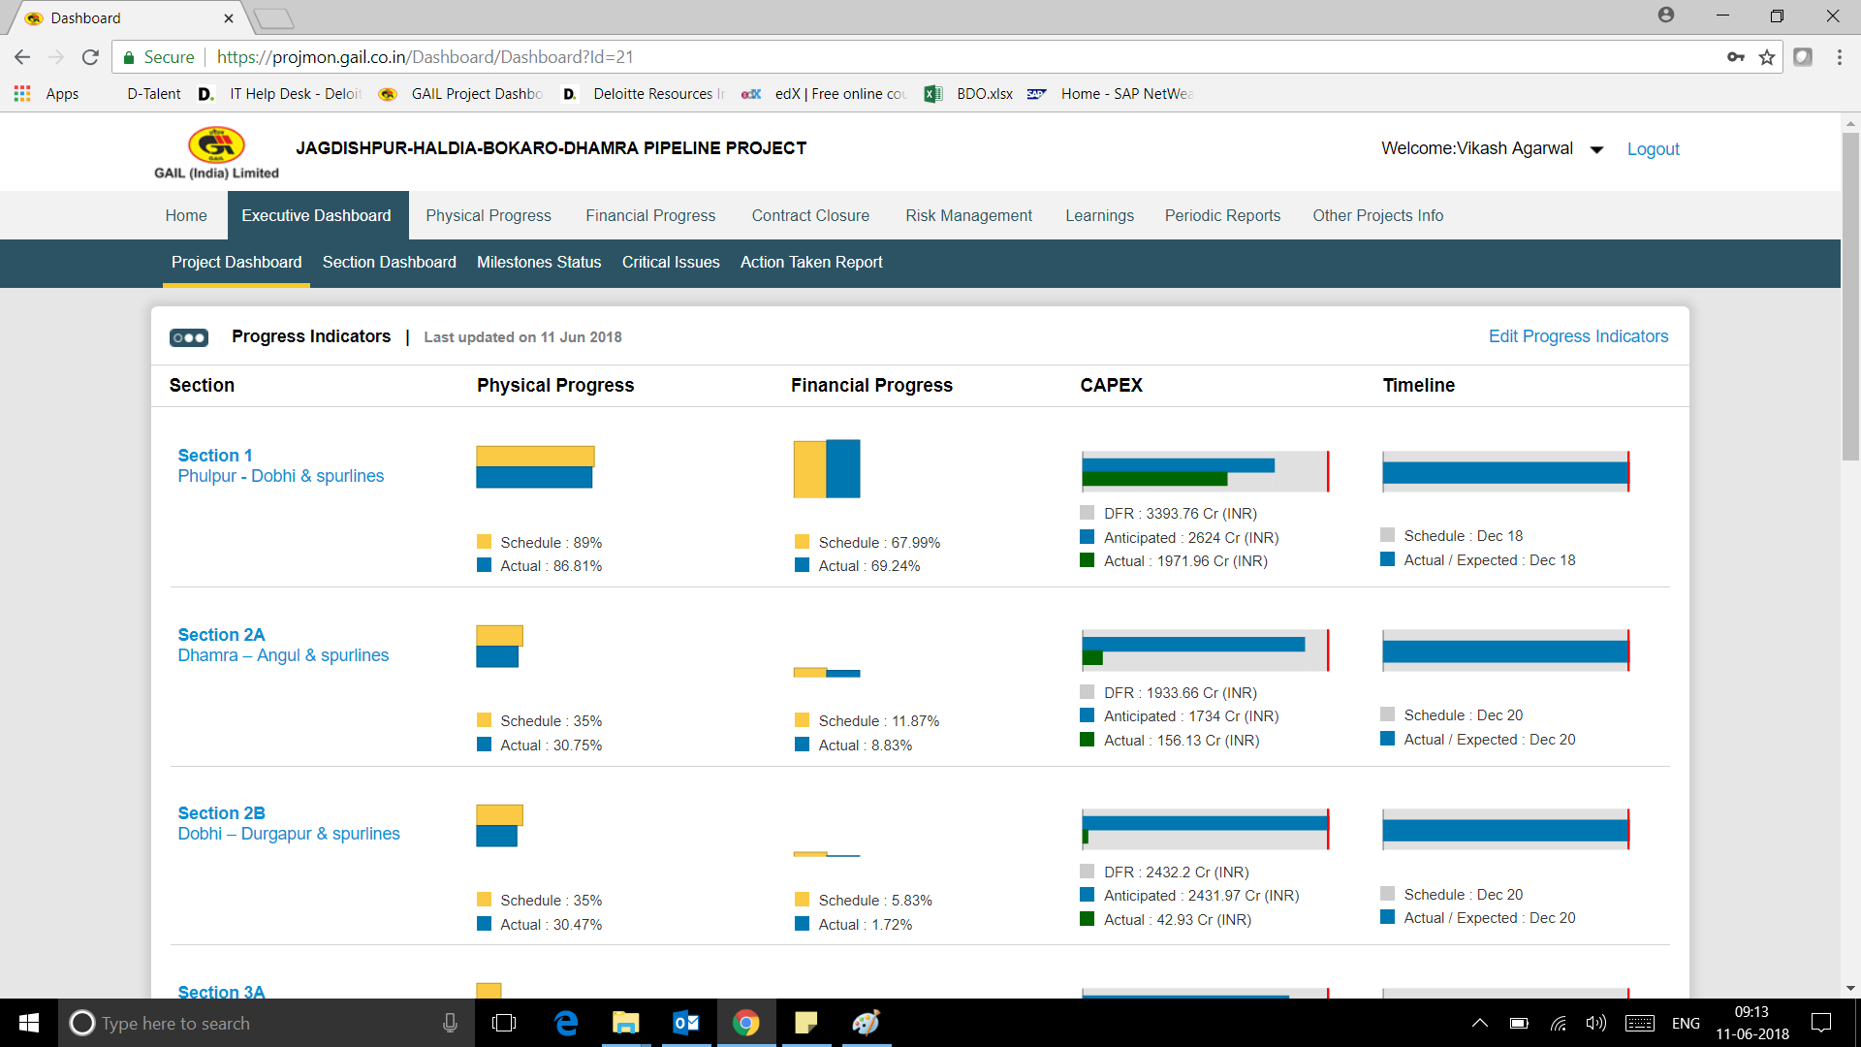
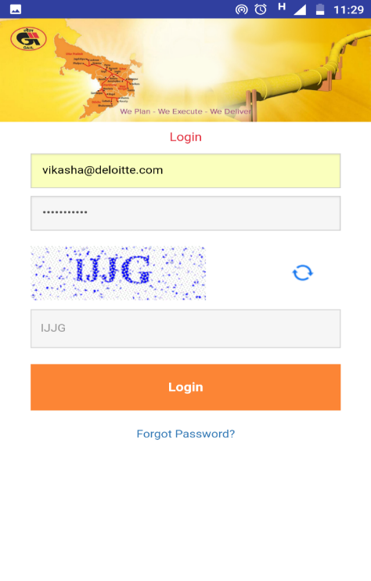
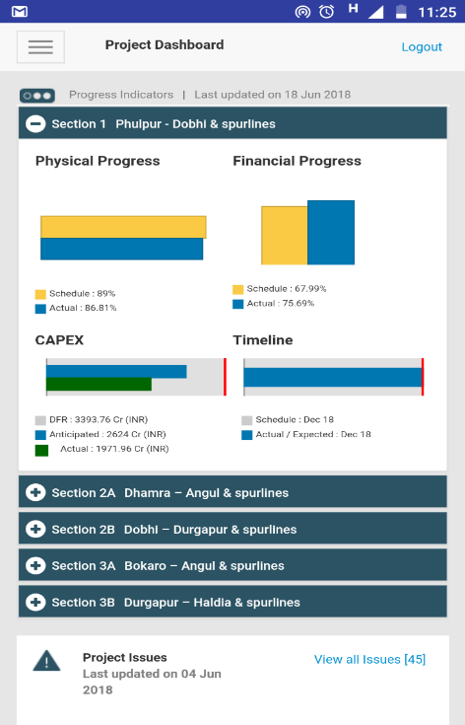
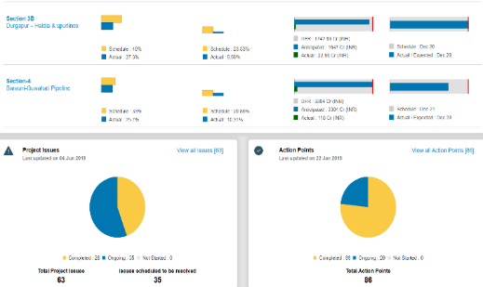
Sample Web/ Mobile Based Dashboard
Web and mobile based are designed to enable early warning signals, visibility & selective intervention from top management
Indicative
Web based monitoring dashboards
Mobile based monitoring dashboards
The above information can be extensively implemented and used for managing project data, highlight critical issues, generate reports and keep track of permissions, tendering/ordering, procurement and related activities etc.

Slide 167
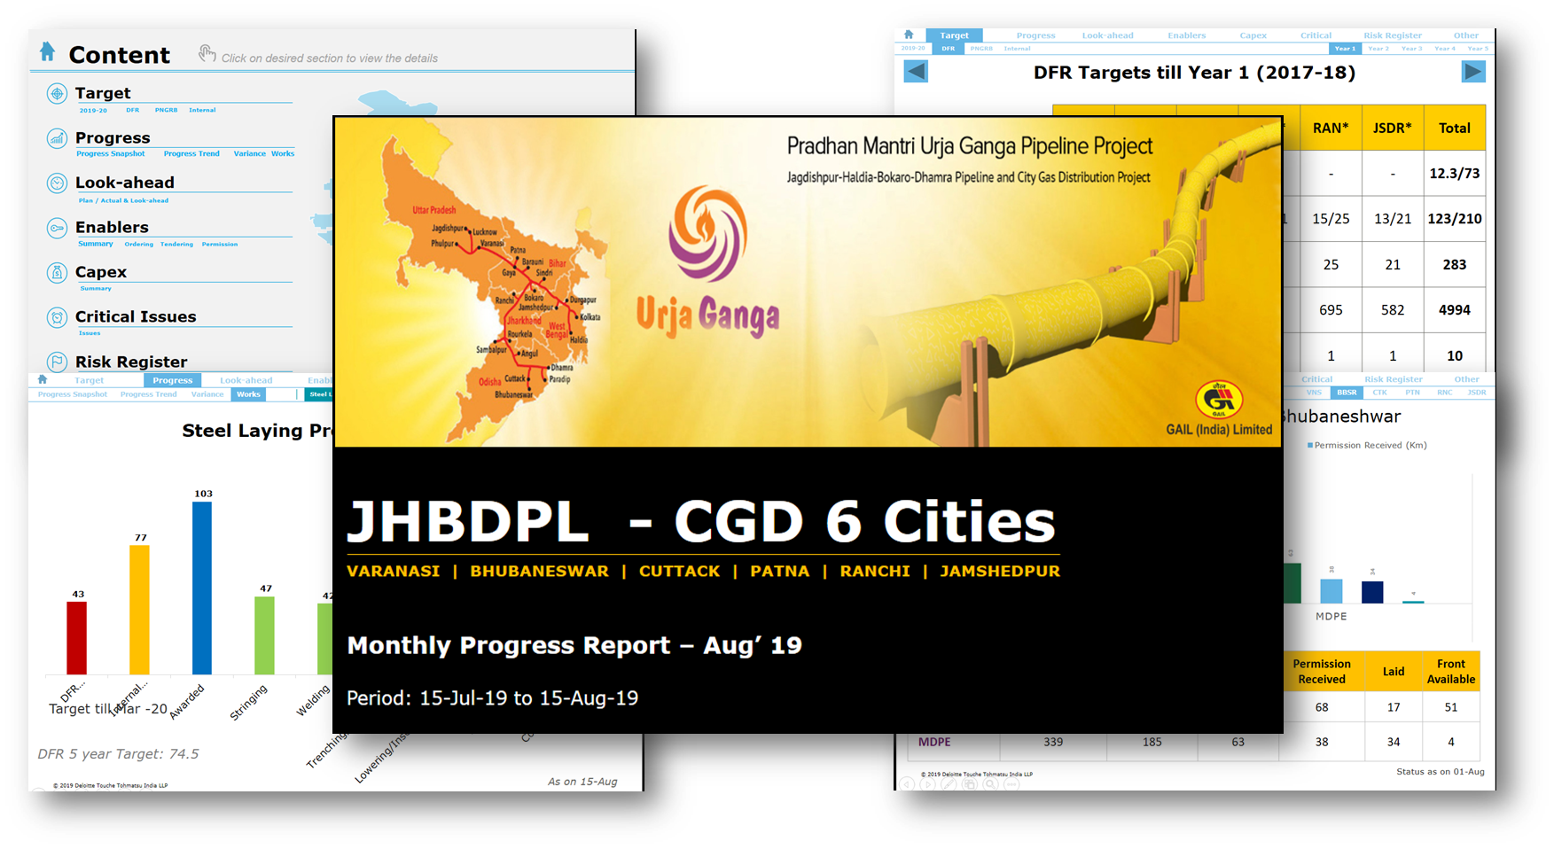
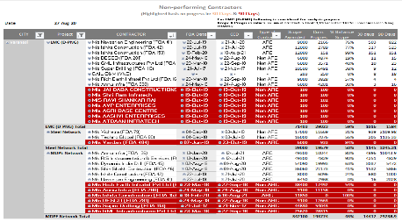
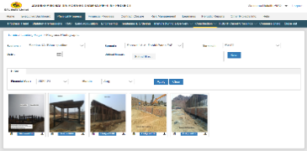
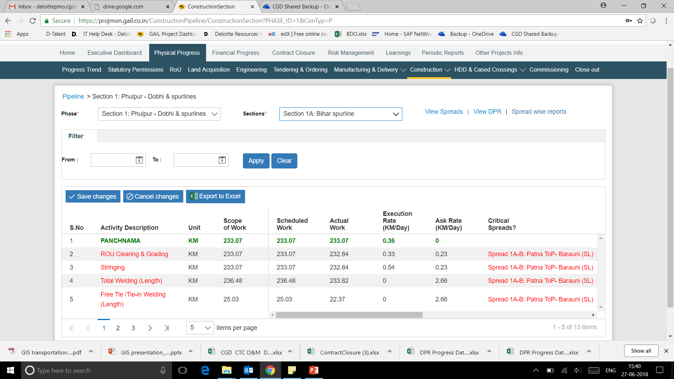
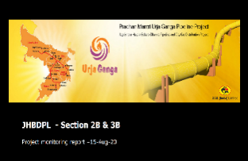
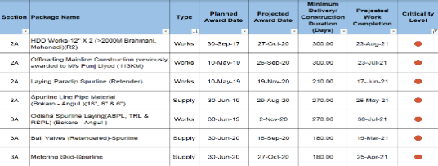
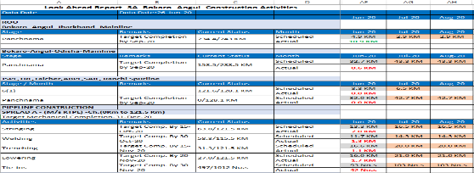
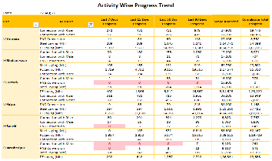
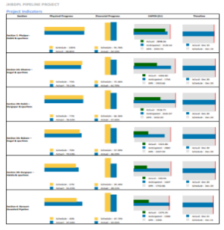
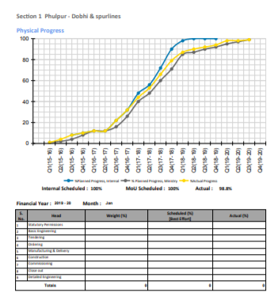
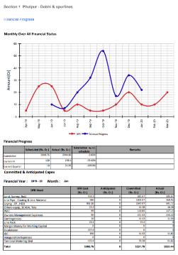
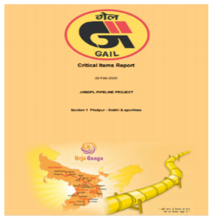
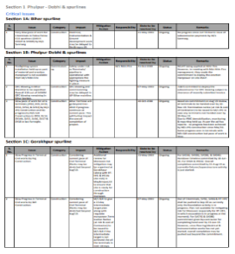
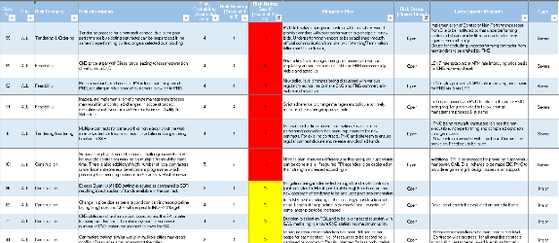
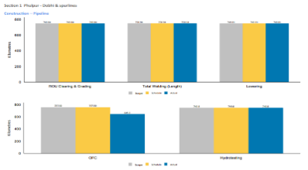
Sample Automated Reports
Various automated reports for project monitoring and control. These reports help in limiting manual effort required for project monitoring and control. The requirement of reports shall be customized as per Department of Power, GoWB requirement.
Indicative
Smart Reporting
Utility Performance
Critical Tender Report
Look-ahead Plan
Summary Report
Detailed Report
Critical Issues Report
Risk Register

Slide 168
Case Study - 1 : A leading public sector oil & gas company in India
PMO Advisory for a large pipeline project for oil & gas company
Background
One of the most prestigious projects executed by Government of India (PM’s Urja Ganga project) with planned CAPEX of US$2B, with objective to provide clean and green fuel to eastern India
Project entails portfolio of pipeline & CGD sub-projects with pipeline network of 2600 Kms, spanning across 5 States, 50 Districts and also includes city gas distribution covering 7 cities
About the Client
Sector: Oil and Gas
Revenues (INR Cr.): USD 10 Bn
Scope and Approach
Phase 1
Design & formulate the project governance framework
6 months
Phase 2
Project Monitoring & Control
(ongoing)
30 months
Develop integrated schedule
Design & implement web and mobile based project monitoring platform
Define project governance processes
Develop risk management framework & conduct risk identification workshops
Develop MIS reporting system & processes
Facilitate stakeholder alignment
Generation of automated reports highlighting project progress & potential constraints
Securing selective intervention of top management on critical issues
Facilitating resolution of potential bottlenecks
Implementation of various management processes focused on preparation & control
Periodic updates of project schedule
Conducting regular interaction with various stakeholders
Carry out robust risk management through workshops & risk registers
Application of analytics to monitor variances & develop catch- up plans
Update of web/mobile platform to enable visualization & early warning signals

Slide 169
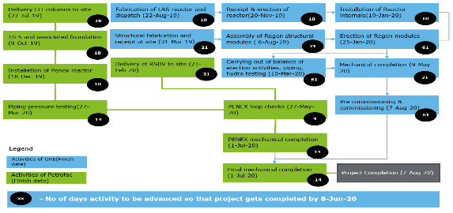
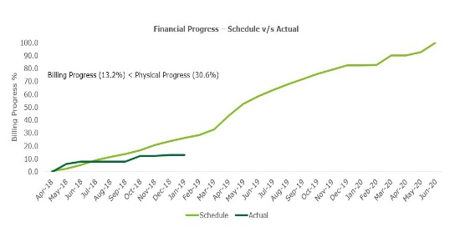
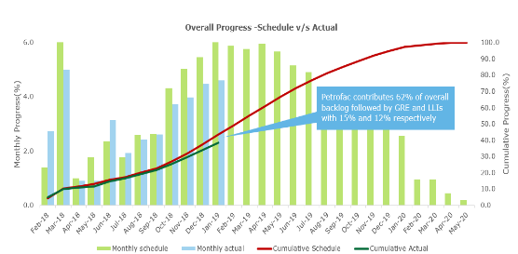
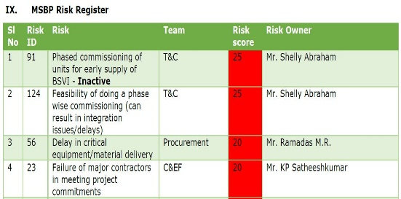
Case Study – 2: A leading public sector OMC in India
PMO for refinery upgradation project
Business Background and Key Challenges
One of the OMC's has undertaken an upgradation project at its refinery' to maximize and upgrade Motor Spirit and diesel processing capabilities to meet BS VI fuel specifications by 1st April 2020. The project will be implemented partly by LSTK route and partly by conventional project execution methodology.
The OMC has engaged Deloitte for designing, setting up and operating a Project Management Office (PMO). PMO will be responsible for planning, scheduling, monitoring, reporting and controlling the project related activities of all stake holders
Scope and Approach
Deloitte was engaged a consultant for designing, setting up and operating a PMO. PMO will be responsible for planning, scheduling, monitoring, reporting and controlling the project related activities of all stake holders.
Key tasks include-
Creation of an integrated project schedule
Application of digital PM tools for constructability & visualization
Carry out risk management and monitoring exercise
Coordination across consultants, vendors & suppliers
Escalation of execution issues and suggesting mitigation strategies
Capabilities Demonstrated, Benefits Realized
Phase 1 – Design and formulate the monitoring strategy and overall framework
Phase 2 – Handholding and capability development to OMC team
Phase 3 – Independent review of project progress using digital project management tools & systems
Result
Efficient project governance framework & application of digital PM tools has enabled BPCL to maintain project control despite various uncertainties
Standardization of project governance frameworks have enabled BPCL team to take up future expansions more efficiently
Illustrative Outputs
Critical Path Analysis
Financial Progress Tracking
Integrated Progress Dashboard
Risk Monitoring

Slide 170

Deloitte refers to one or more of Deloitte Touche Tohmatsu Limited, a UK private company limited by guarantee (“DTTL”), its network of member firms, and their related entities. DTTL and each of its member firms are legally separate and independent entities. DTTL (also referred to as “Deloitte Global”) does not provide services to clients. Please see www.deloitte.com/about for a more detailed description of DTTL and its member firms.
This material has been prepared by Deloitte Touche Tohmatsu India LLP (“DTTILLP”), a member of Deloitte Touche Tohmatsu Limited, on a specific request from you and contains proprietary and confidential information. This material may contain information sourced from publicly available information or other third party sources. DTTILLP does not independently verify any such sources and is not responsible for any loss whatsoever caused due to reliance placed on information sourced from such sources. The information contained in this material is intended solely for you. Any disclosure, copying or further distribution of this material or its contents is strictly prohibited.
Nothing in this material creates any contractual relationship between DTTILLP and you. Any mutually binding legal obligationsorrights may only be created between you and DTTILLP upon execution of a legally binding contract. By using this material and any information contained in it, the user accepts this entire notice and terms of use.
©2022 Deloitte Touche Tohmatsu India LLP. Member of Deloitte Touche Tohmatsu Limited
Deloitte Touche Tohmatsu India Private Limited (U74140MH199 5PTC093339), a private company limited by shares, was converted into Deloitte Touche Tohmatsu India LLP, a limited liability partnership (LLP Identification No. AAE-8458),with effect from October 1, 2015.

